Slide 1
CHAPTER 3
VARIABLE SPEED DRIVE
TECHNICAL SEMINAR SD700
2013

Slide 2
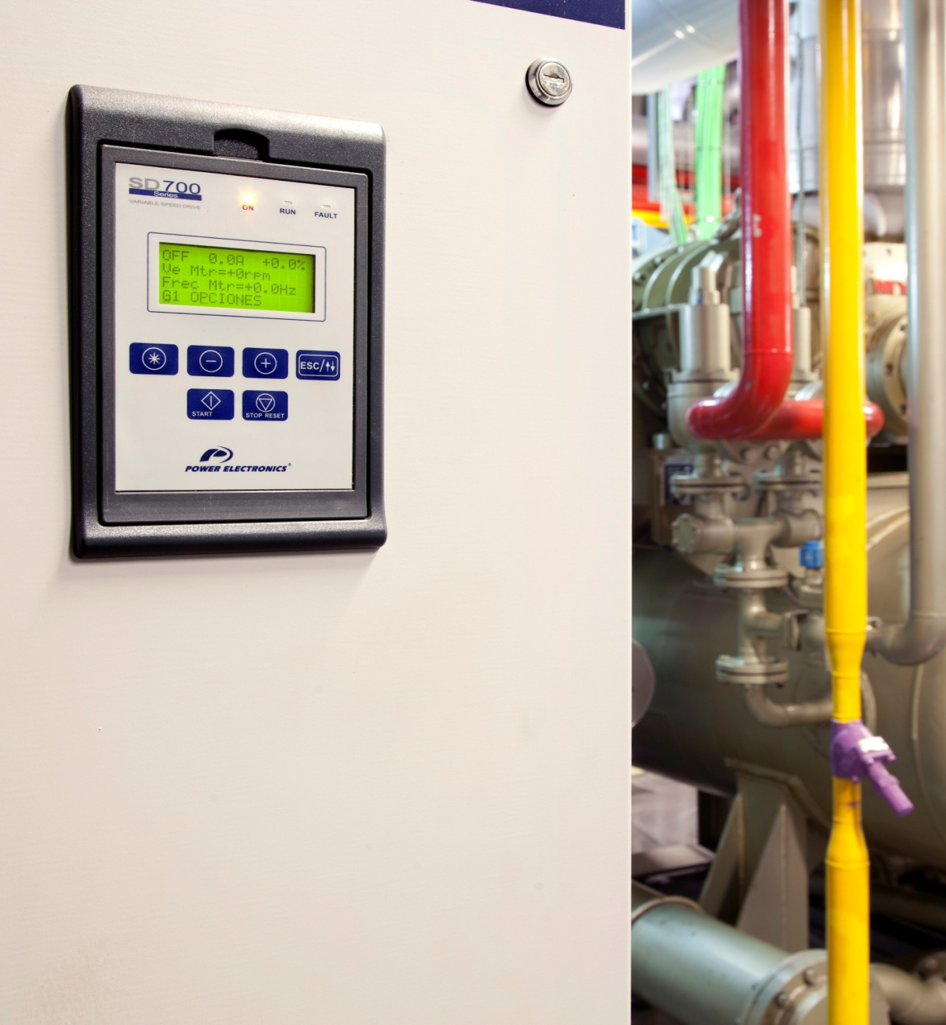
OVERVIEW
“
A Variable Speed Drive is an electric/electronic device that base on the frequency modulation, varies precisely the speed of the electric III phase induction motors.
“

Slide 3

OVERVIEW
ENERGY SAVINGS:
Payback time from 0 to 3 years, depending on the work time and application.
Up to 60% Energy saving in comparison with traditional direct on-line or valve control systems.

Slide 4
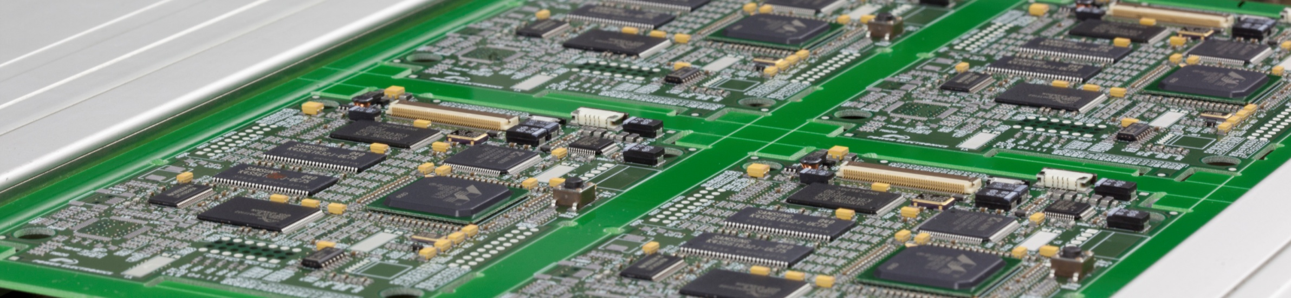
OVERVIEW
QUALITY AND PERFORMANCE IMPROVEMENT:
Introducing torque and speed control the product quality and the process performance increase.
Q

Slide 5
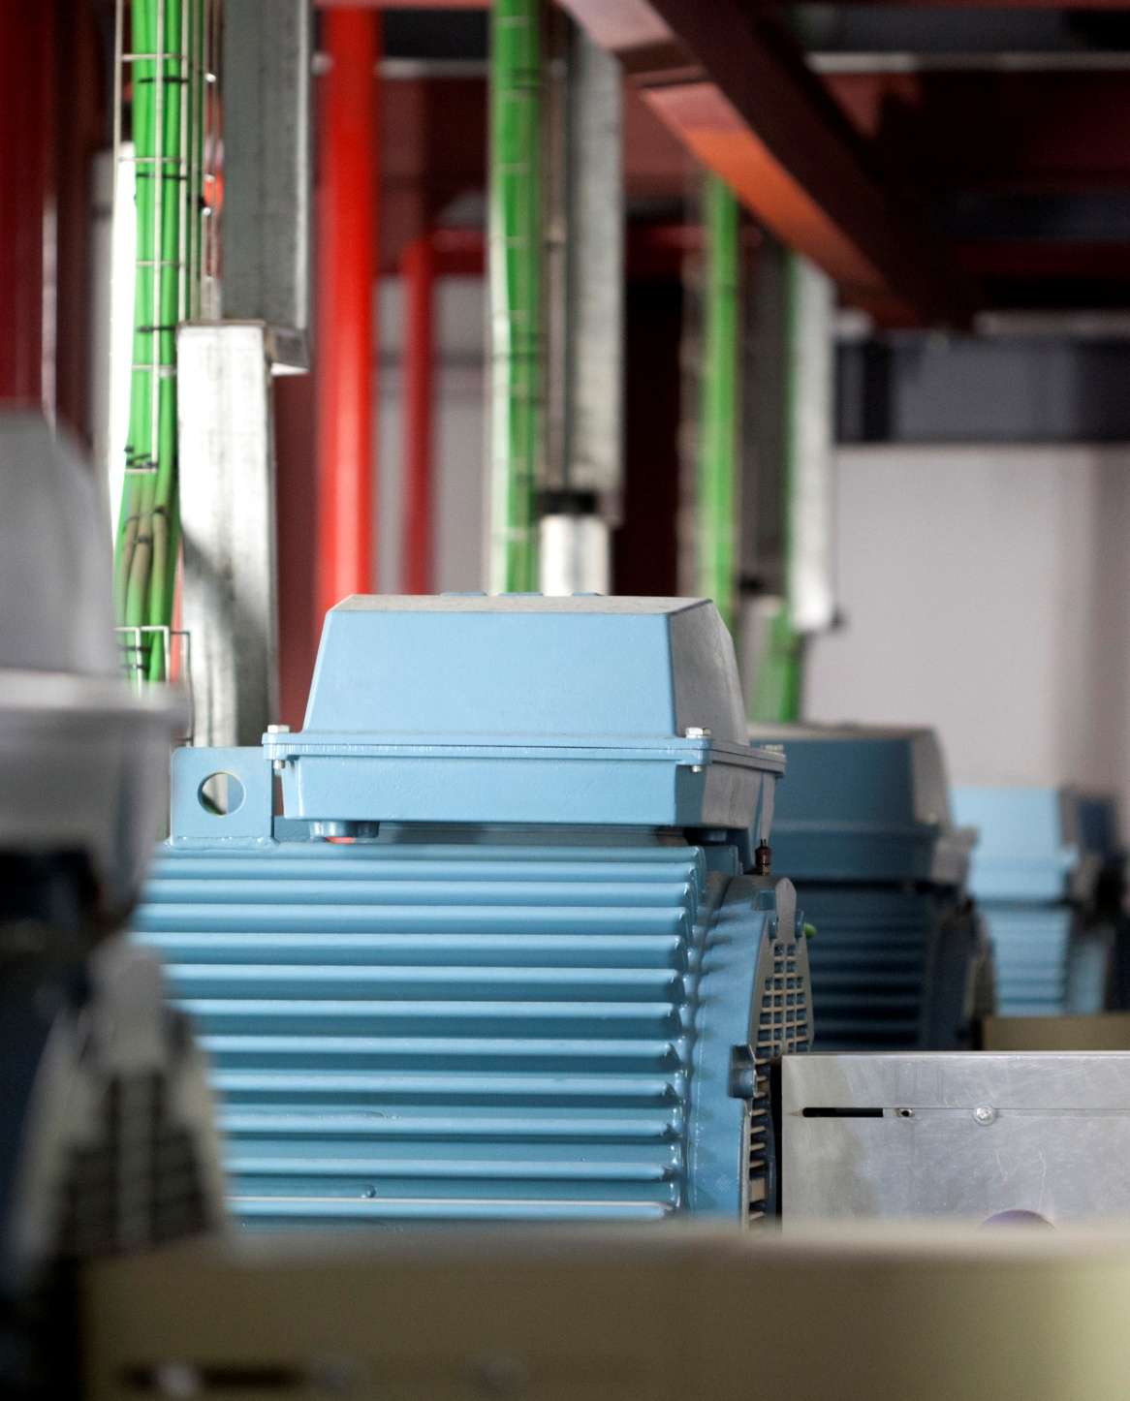
OVERVIEW
MAINTENANCE REDUCTION AND LONG LIFE MOTORS
A high number of direct starts produce mechanical and electric motor stress. The instantaneous overcurrent peaks suffered by induction motors reduce its working lifetime and increases their maintenance costs.

Slide 6

OVERVIEW
CORPORATIVE IMAGE IMPROVEMENT
The reduction of the electricity, natural gas, or diesel consumption decrease the company’s greenhouse gases emission.

Slide 7
EU MEPS DIRECTIVE
The European Commission decides to apply the requirements ECO DESIGN to 3 PHASE MOTORS of 2-, 4- and 6-poles, from 0.75 to 375 kW
PHASE 1: All the MOTORS sold must present an efficiency level IE2
PHASE 2: MOTORS 7.5kW - 375kW sold must present an efficiency level IE3 or IE2 with VARIABLE SPEED DRIVE
PHASE 3:
MOTORS 0.75kW - 375kW sold must present an efficiency level IE3 or IE2 with VARIABLE SPEED DRIVE
2010
2011
2012
2013
2014
2015
2016
2017
2018

Slide 8
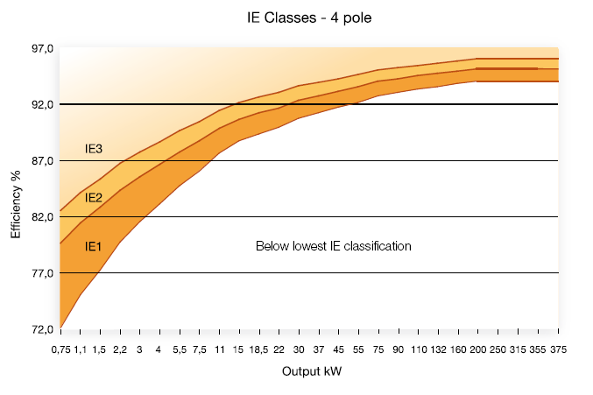
MOTOR EFFICIENCY
▲ 2 % Performance
Fuente: ABB

Slide 9

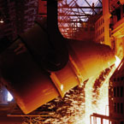
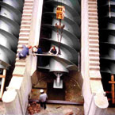
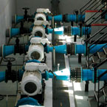
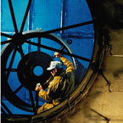
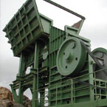

Water • Oil & Gas • Industry · Mining • Food & Beverages • Electronics • etc..

Slide 10
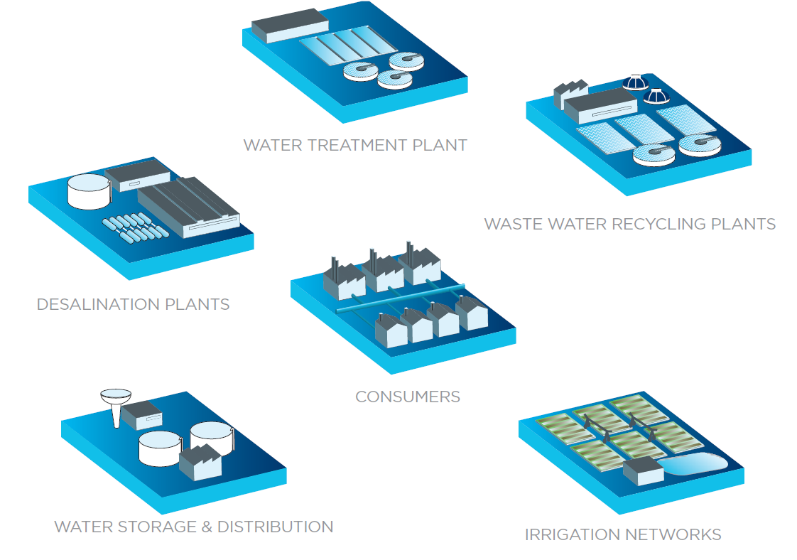
APPLICATIONS | WATER – DRIVE THE WATER CYCLE

Slide 11
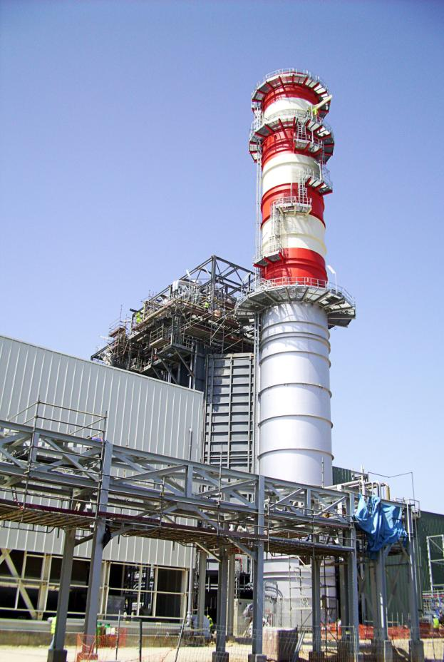
APPLICATIONS | OIL & GAS
Gas Distribution
Gas Processing
Liquefied Natural Gas Processing
Offshore Production
Onshore Production
Refining

Slide 12
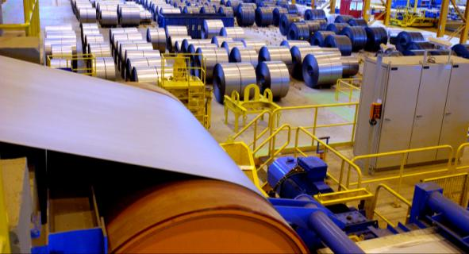
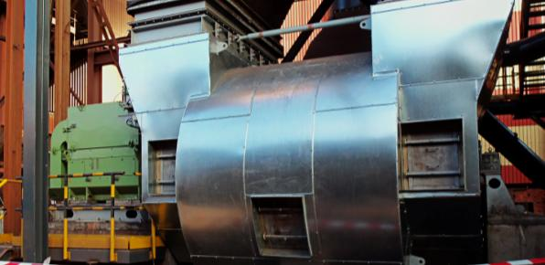
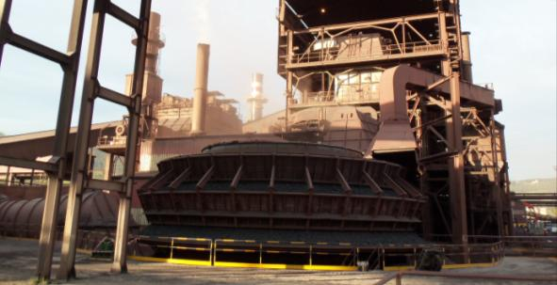
INDUSTRY & MINING
COMPRESSORS
    Gas compressors
    Turbo compressors,
    Centrifugal compressors
    Screw compressors
MILLS
  Pulp Mills
  SAG Mills
  Centrifuges Mills
  Sinter Mills
FANS & BLOWERS
  Sinter fans
  Ventilating fans
  Turbo , Centrifugal, Blast Furnace Blowers
CONVEYORS
  Screw conveyors
  Conveyor belts
HOISTING

Slide 13
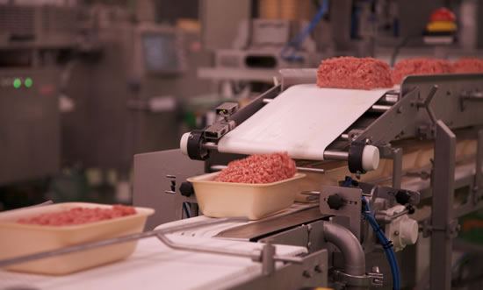
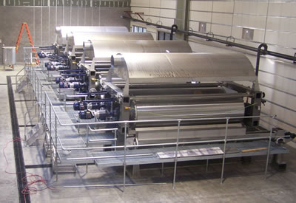
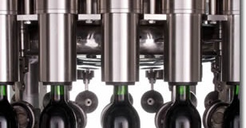
FOOD & BEVERAGES
MILLS
MIXERS
COMPRESSORS
FANS & BLOWERS
PUMPS
SCREW AND CONVEYORS BELTS
ROAST, BAKE AND COOKING OVENS
FREEZER TUNNELS
MOULDING SYSTEMS
BOOTLE FILLING MACHINES

Slide 14
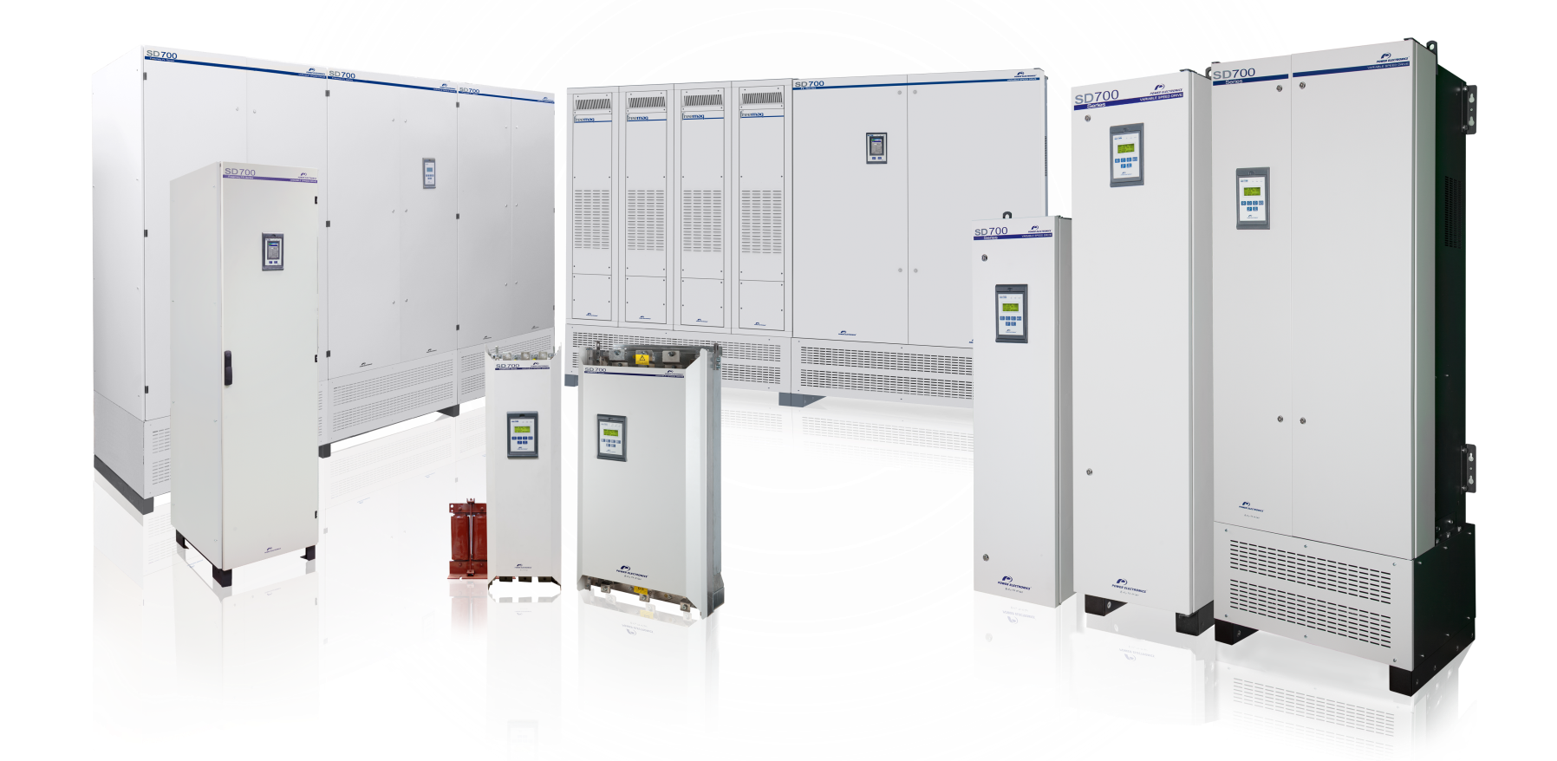













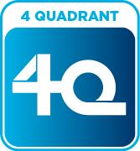
SD700 FREEMAQ FR
SD700 FREEMAQ FL
SD700
SD700 KOMPAKT

Slide 15
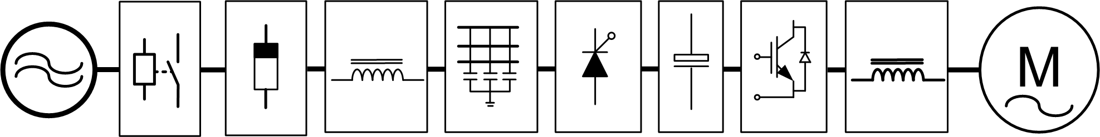
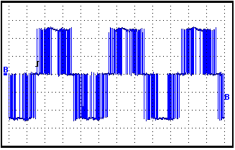
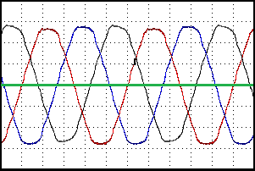
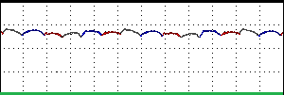
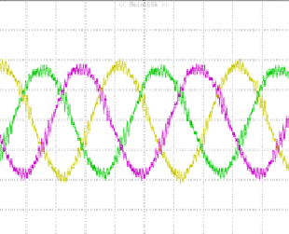
VARIABLE SPEED DRIVE TOPOLOGY
SD700 SERIES
VSD ESTÁNDAR
Harmonic
Filter
Rectifier
Bridge
Inverter
Bridge
dV/dt or sinus filter
Electric Grid
Disconnection
Protection
RFI Filter
DC Bus
Motor
Notes:
15

Slide 16
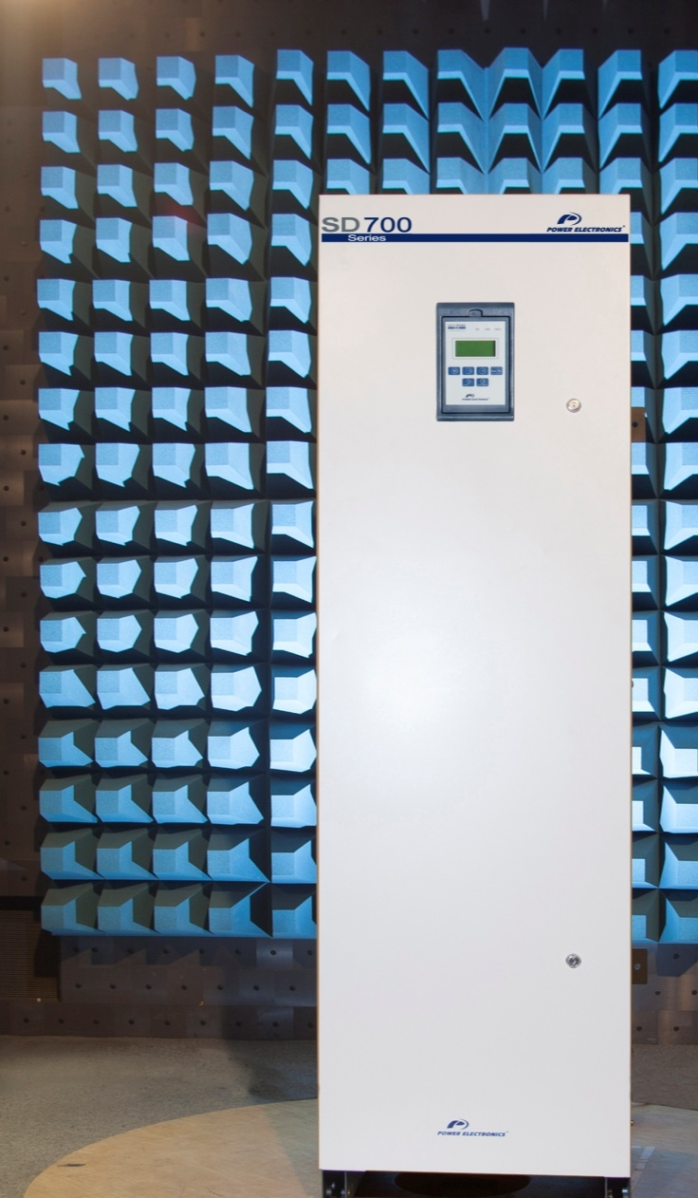
SD700 HIGHLIGHTS
Power range from 2.2kW to 2200kW
Voltage ratings 230Vac, 400Vac, 525Vac and 690Vac
50ºC operation without power derating
Totally sealed electronics IP54 without dust filters
Built-in dV/dt filters (400V/µs - 800V/µs) Up to 300m cable
Built-in harmonics and RFI filters
(FFA) Easy front access to the main components
Conformal coating with military and aerospace technology (IEC61086-1:2004,-3-1)
Low Harmonics Drives - FREEMAQ Series
Compact and competitive - SD700 KOMPAKT series
Regenerative Drive – SD700 FREEMAQ FR

Slide 17

DRIVE PROTECTIONS
IGBT’s overload
Input phase loss
Low input voltage, High input voltage
DC Bus voltage limit, Low DC Bus voltage
High input frequency, Low input frequency
IGBT temperature, Heatsink over-temperature
Drive thermal model
Power supply fault
Ground fault
Software and Hardware fault
Analogue input signal loss (speed reference loss).
STO Safe Torque Off function
Notes:
17

Slide 18
MOTOR PROTECTIONS
Rotor locked
Motor overload (thermal model)
Motor Underload
Current limit
Maximum Starts
Phase current imbalance
Phase voltage imbalance
Motor over-temperature (PTC signal), PT100 Optional
Speed limit
Torque limit.
Notes:
18

Slide 19
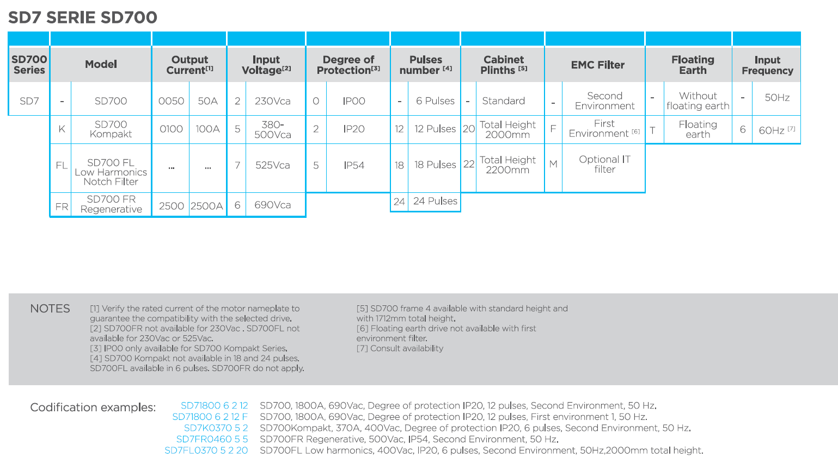
SD700 CONFIGURATION TABLE

Slide 20
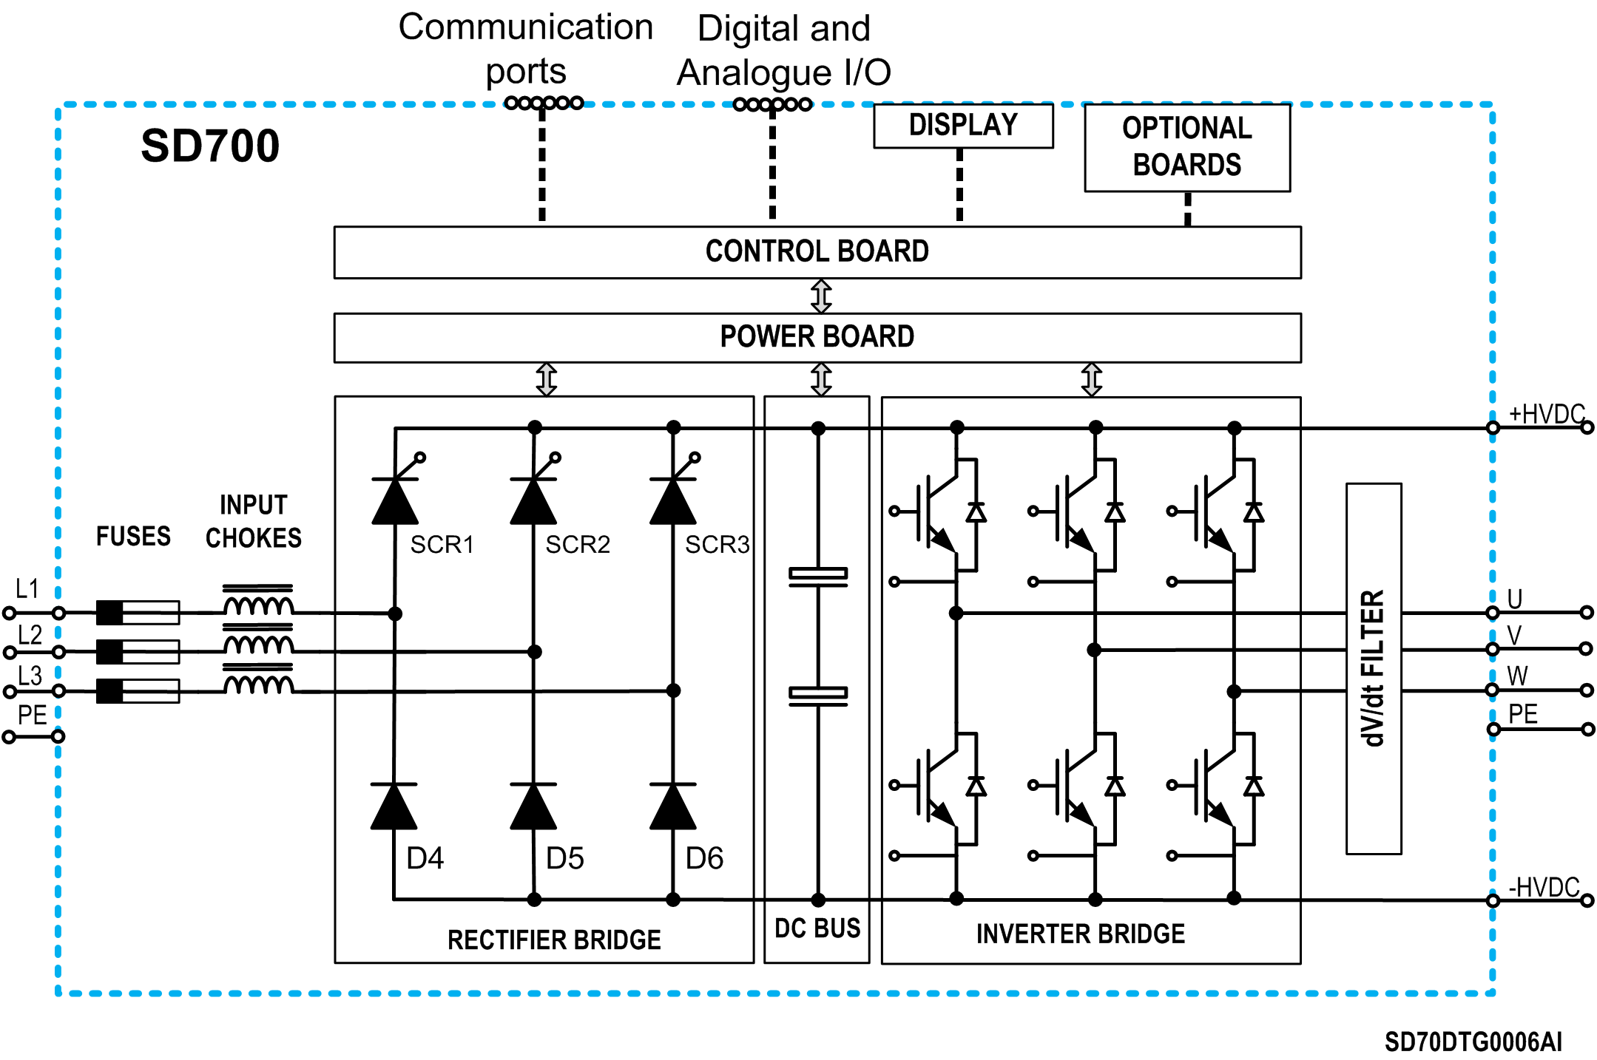
LOW VOLTAGE SD700 & SD700 KOMPAKT - TOPOLOGY

Slide 21
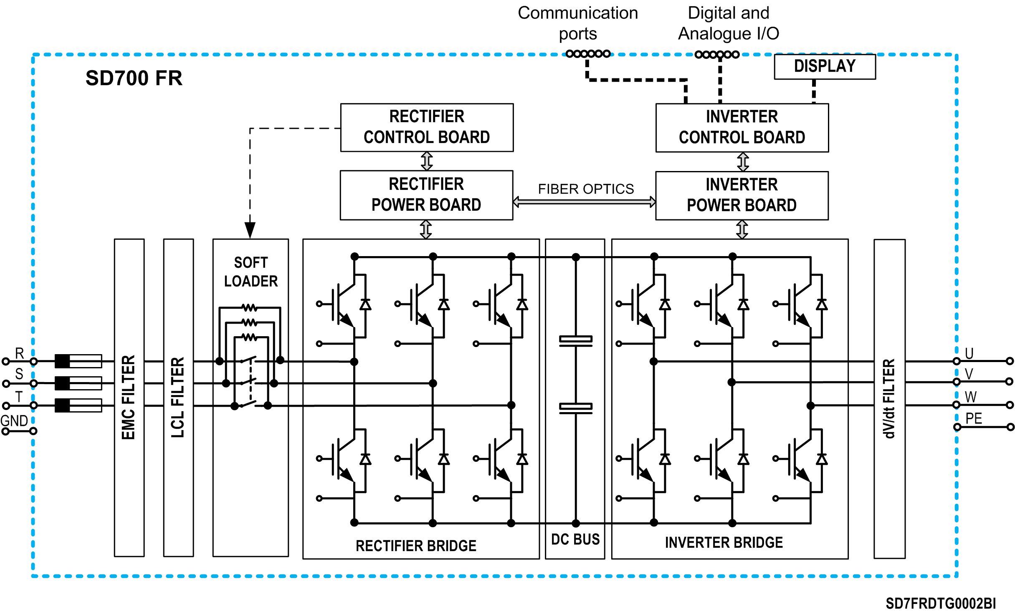
LOW VOLTAGE SD700FR - TOPOLOGY

Slide 22
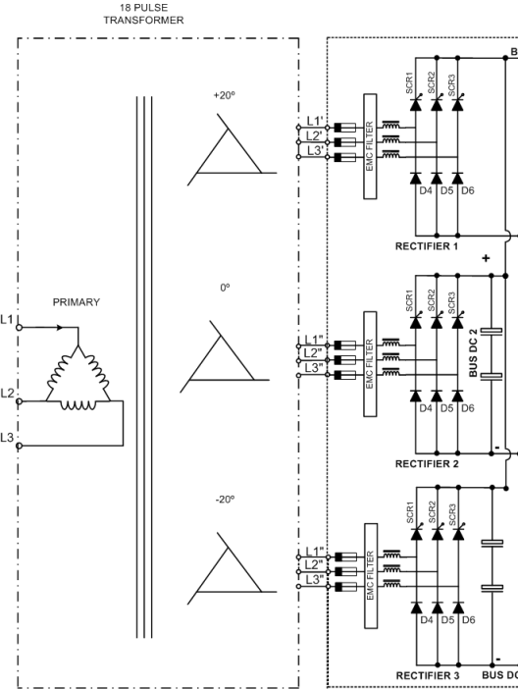
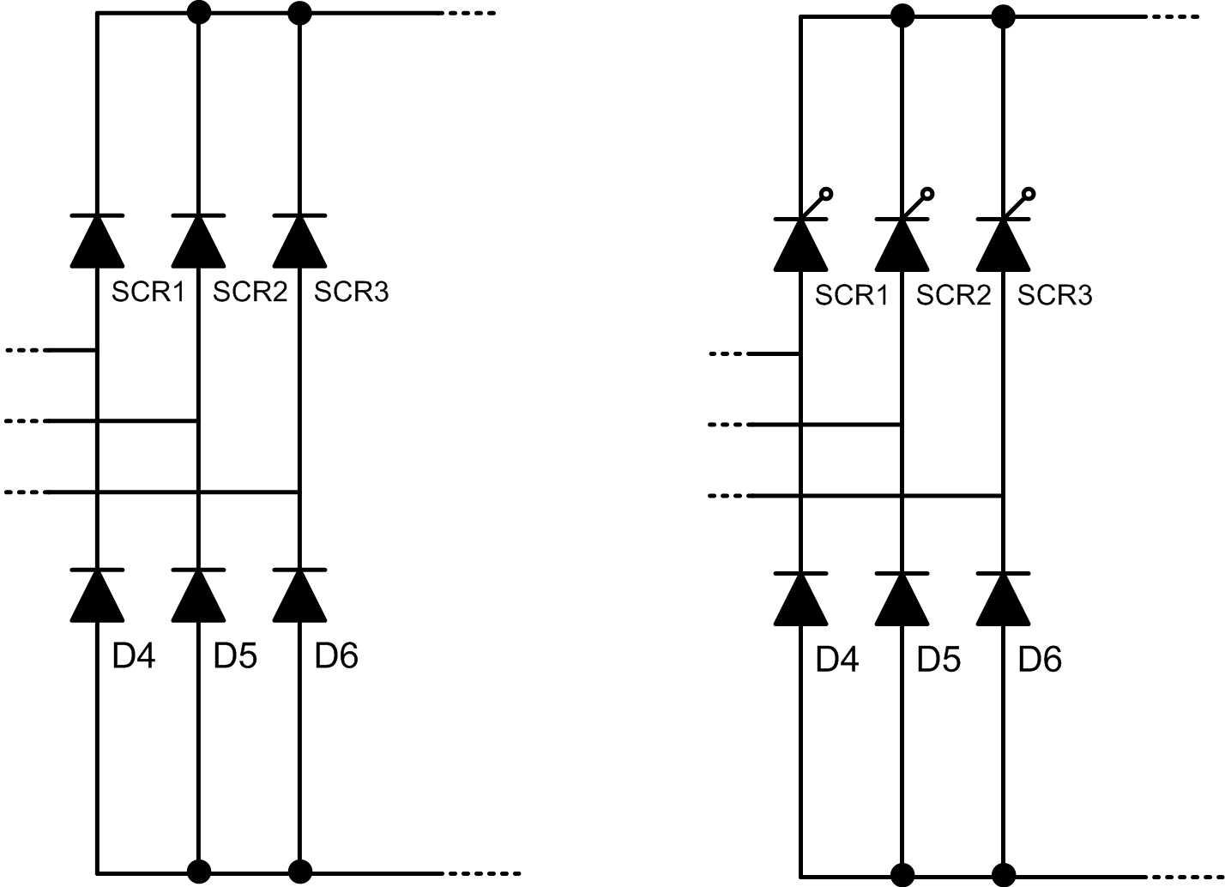
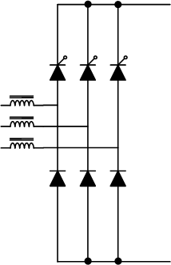
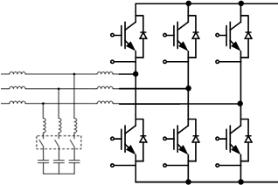
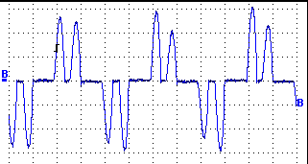
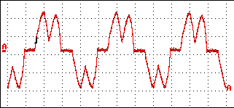
RECTIFIER BRIDGE AND HARMONICS
NO FILTER
----------------
CHOKES 3%
SD700 series
MULTIPULSE
SD700 series 12,18,24p
LCL FILTER
SD700 FREEMAQ FL
ACTIVE FILTER
SD700 FREEMAQ FR
THDi > 45%
THDi <35%
THDi <10% (18p)
THDi <5%
THDi <4%
L1
L2
L3
L1
L2
Notes:
22

Slide 23
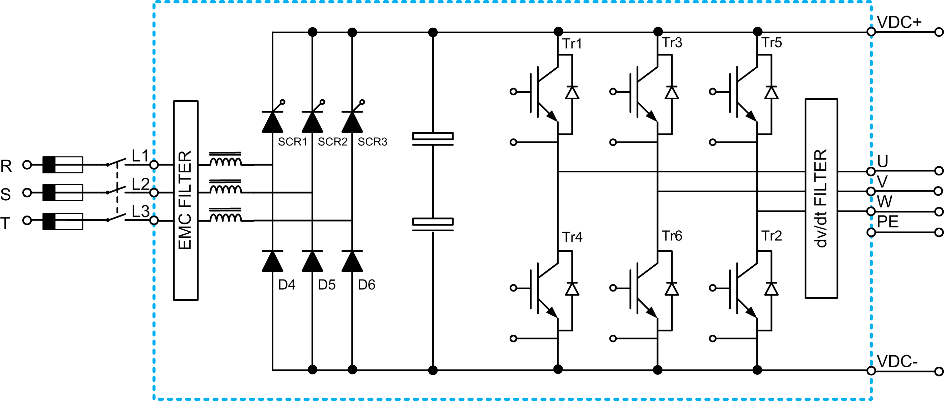
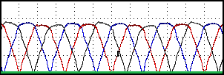
RECTIFIER

Slide 24
DC BUS
DC BUS

Slide 25
INVERTER BRIDGE
Voltage wave form
DC BUS
Current wave form

Slide 26
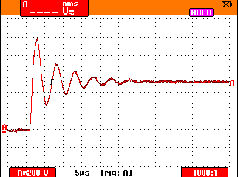
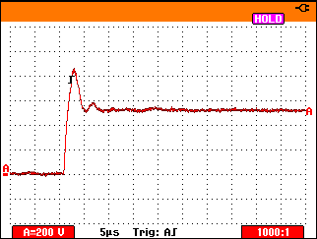
PWM Modulation – Voltage Wave
PWM Modulation – Voltage Flange dV/dt
PWM Modulation – Voltage Flange dV/dt +CLAMP

Slide 27
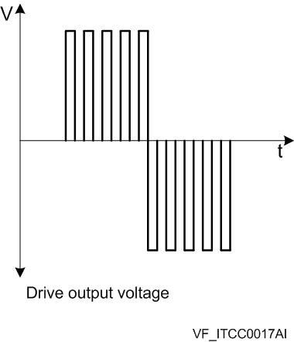
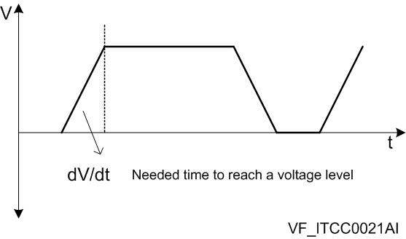
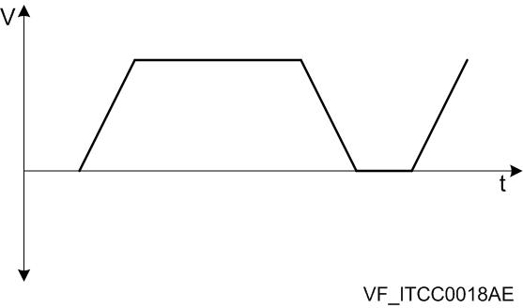
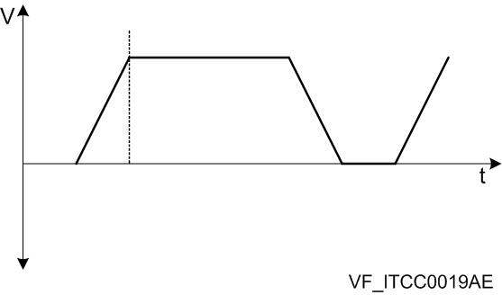
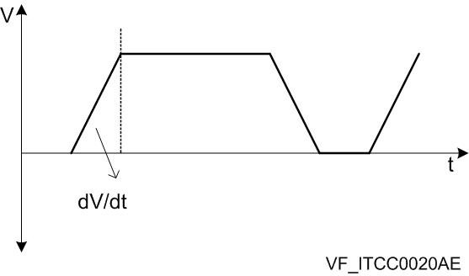
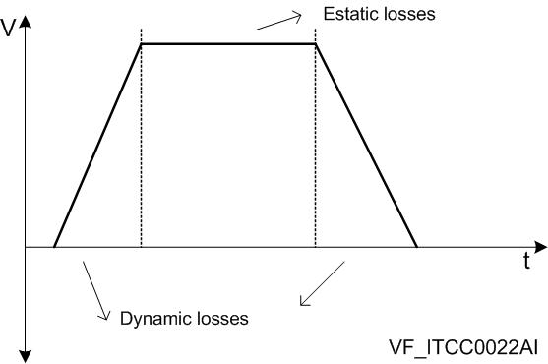
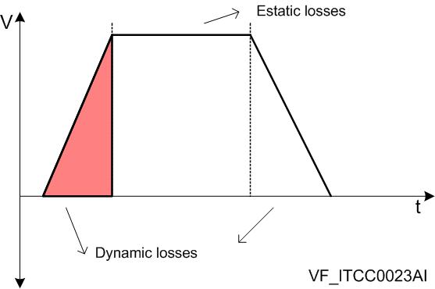

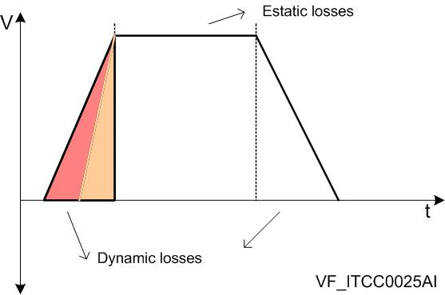
If the waveform is amplified, it is possible to observe that the angle is not 90º exactly:
Drive | dV/dt | Losses
132kW | 800V/µs | 1380W
132kW | 4000V/µs | 1100W

Slide 28
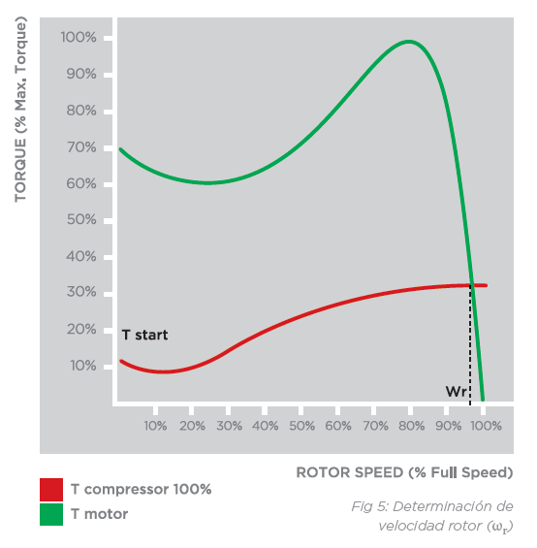
ct.
f(torque)
ct.
n: Speed
f: Motor input frequency (50Hz or 60Hz)
Np: Motor pole pairs
δ : Motor Slip
ɸ: Motor flux
Notes:
28

Slide 29
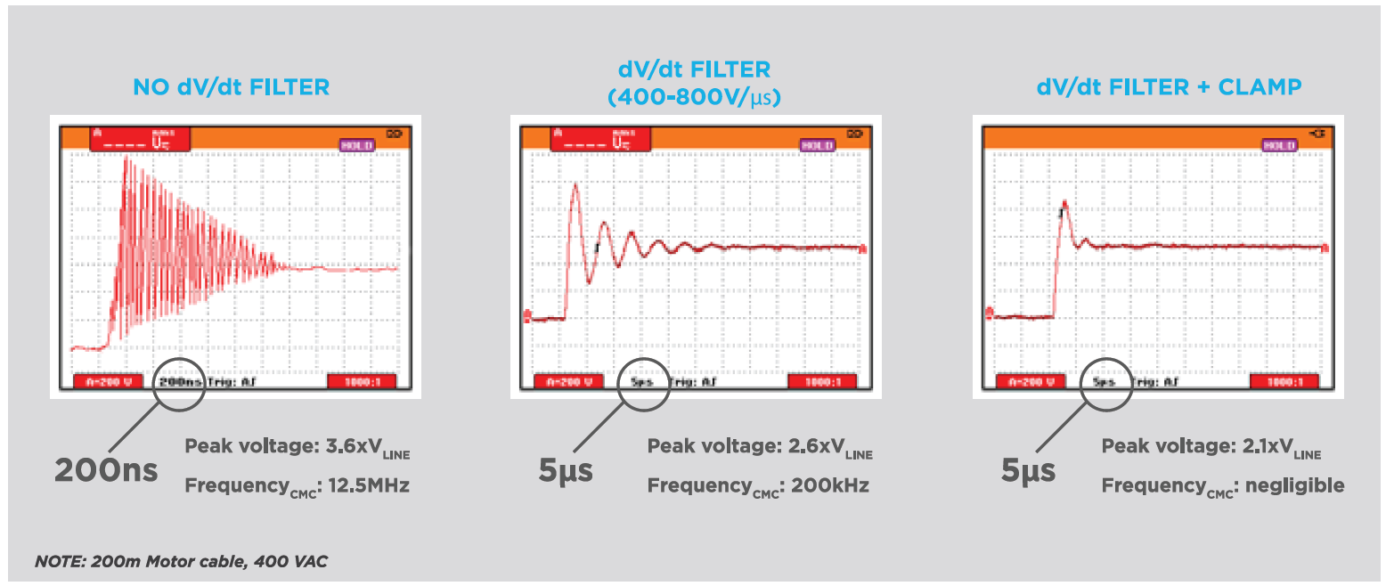
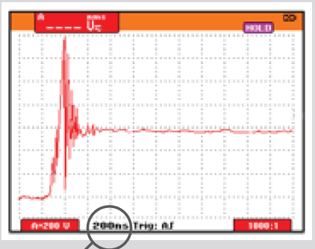
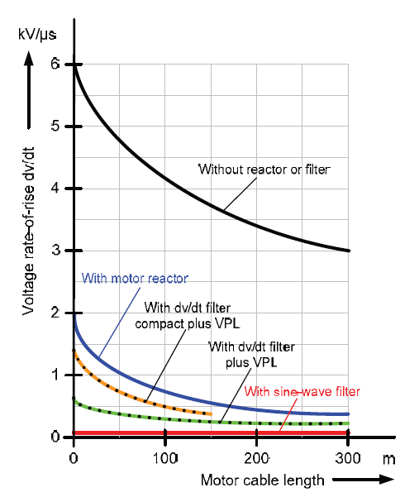

OUTWAVE FORM
ALL DRIVES ARE NOT THE SAME
Competitors dV/dt values
SD700 STANDARD

Slide 30
ADMISSIBLE PEAK VOLTAGE LIMIT CURVES IN AC MOTORS TERMINALS:

Slide 31

SD700 – RECOMMENDED CABLE TYPE
Up to 300m
Up to 150m

Slide 32
SD700 – RECOMMENDED CABLE TYPE

Slide 33

ELECTROMAGNETIC COMPATIBILITY (EMC) | INTRODUCTION
EMC
Electromagnetic Compatibility
EMI
Electromagnetic Interference
EMS
Electromagnetic Susceptibility
Device Immunity level
Minimum Immunity level
Amplitude
ENVIRONMENT CLASS
MARGEN DE COMPATIBILIDAD
Maximum Emission level
Device emission level
Frequency spectrum

Slide 34
ELECTROMAGNETIC COMPATIBILITY (EMC) | INTRODUCTION
EMC
Electromagnetic Compatibility
EMI
Electromagnetic Interference
EMS
Electromagnetic Susceptibility
Radio Frequency
  Conduced
  Radiated
Surges
Electrical fast transients
Electrostatic discharges
THD
Voltage dips and interruptions
Low
frequency
F <150 kHz
THD
Flicker
Medium
Frecuency
150 kHz< f < 30MHz
Conduced
High
Frecuency
f > 30MHz
Radiated
IEEE 519-1992
IEC61800-3
EMC 2004/108/CE

Slide 35
ELECTROMAGNETIC COMPATIBILITY (EMC) | Radiated and Conduced
  RADIATED
  CONDUCED
Noise source: Rectifier and Inverter bridge that interrupts the current due to the IGBT and diode commutation ( ON – OFF status).
Transmission: Depending on the frequency of the noise , it is radiated through the air or conduced through the power cables and earth.

Slide 36



  COMPATIBILIDAD ELECTROMAGNÉTICA (EMC/CEM) | Ruido radiado y conducido
The RADIATED electric noise will be attenuated considering:
  By designing a shielded cabinet – Faraday cage
  By using shielded cables.
The CONDUCED electric noise will be attenuated considering:
  By integrating RFI (Radio Frequency Interferences) / EMC ( Electromagnetic Compatibility).
  By using good practices of Installation and cable selection
C3 COMPLIANCE
Notes:
36

Slide 37

DEGREE OF PROTECTION
IP | FIRST DIGIT (FOREIGN BODIES) |  | SECOND DIGIT (MOISTURE)
 | 0 | Not protected | 0 | Not protected
 | 1 | Protected against solid foreign objects of 50 mm diameter and greater | 1 | Protected against vertically falling water drops
 | 2 | Protected against solid foreign objects of 12,5 mm diameter and greater | 2 | Protected against vertically falling water drops when enclosure is tilted up to 15 °
 | 3 | Protected against solid foreign objects of 2,5 mm diameter and greater | 3 | Protected against water sprayed at an angle up to 60 ° on either side of the vertical
 | 4 | Protected against solid foreign objects of 1,0 mm diameter and greater | 4 | Protected against water splashed against the component from any direction
 | 5 | Protected from the amount of dust that would interfere with normal operation | 5 | Protected against water projected in jets from any direction
 |  |  | 6 | Protected against water projected in powerful jets from any direction
 |  |  | 7 | Protected against temporary immersion in water
 |  |  | 8 | Protected against continuous immersion in water, or as specified by the user

Slide 38


iCOOL – FILTERLESS

Slide 39



iCOOL – FILTERLESS
1ST level: ELECTRONICS
2ND level: COOLING
3rd level: FILTERING

Slide 40

OUTLET GRATING 2ND level
IP54 EXHAUST FANS 3rd level
INPUT COILS
DC BUS CAPACITORS
INLET GRATING 3rd level
HEAT SINKS
IP54 POWER FANS
INLET GRATING 2nd level

Slide 42



Slide 43



1st Level: Electronic
2nd Level: Cooling
3rd Level: Filters

Slide 44
T _{AMB}
2nd Level Cooling
T _{AMB}
{ Max 50ºC}
R_{THS}
AT= 45ºC
T _{HEAT SINK}
{ Max 95ºC}
T _{HEAT SINK =} T_{ELECTRONICS}
T _{CASE}
R_{TC}
AT = 15ºC
T _{J ( SILICE)}
{ Max 115ºC}
T _{CASE}
{ Max 110ºC}
R_{TJ}
AT = 15ºC
1st Level ELECTRONICS
T _{J}
{ Max 125ºC}

Slide 45

SD700 SERIES
TOTAL ENCLOSED ELECTRONIC IP54
COMPETITORS
T _{AMB}
{ Max 50ºC}
T _{AMB}
{ Max 50ºC}
NO ELECTRONIC COOLING SYSTEM NEEDED
R_{THS}
AT= 45ºC
R_{THS}
AT= 15ºC
T _{HEAT SINK}
{ Max 95ºC}
T _{HEAT SINK}
{ Max 65ºC}
R_{TC}
AT = 15ºC
R_{TC}
AT = 15ºC
T _{CASE}
{ Max 110ºC}
T _{CASE}
{ Max 80 ºC}
SEMICONDUCTORS CARE WITH
EXTENDED LIFE
R_{TJ}
AT - 15ºC
R_{TJ}
AT = 15ºC
T _{J}
{ Max 125ºC}
T _{J}
{ Max 95 ºC}

Slide 46
IP54 in case of supplier A
IP54 in case of supplier B: Not Available
IP54 in case of supplier C

Slide 47
HEAT SINK - COOLING CAPACITY
COMPETITORS
SD700
SD700 DESIGN NEEDS 2-3 TIMES HEAT SINK SURFACE
SD700 IS EQUIPPED WITH
OVERSIZED HEAT SINKS

Slide 48

DRIVE SELECTION – POWER DERATING

Slide 49




OVERLOAD DEFINITION – LOAD TYPES
CONSTANT TORQUE
Typical when the system is constantly working with fixed volumes.
Screw compressors, feeders and conveyors.
T = constant , P α N
STARTING TORQUE DEMAND
Same as below but with high torque at low speed. The Overload establish the drive selection extruders and screw pumps.
Extruders, screw pumps, Mills
T = constant , P α N
QUADRATIC TORQUE
Most common load type typical in air and water movement applications
Fans, centrifugal pumps
T α N2, P α N3

Slide 50


OVERLOAD DEFINITION – LOAD TYPES
CONSTANT POWER
When material is being rolled and the diameter changes during rolling.
Paper reel, cable drum.
T α N1/2 , P = cte
CONSTANT TORQUE AND CONSTANT POWER COMBINATION
Special case that depends on the system dimensioning.
Paper reel and rolls, cable drum.
T = cte, P α N & T α N1/2 , P = cte
OTHERS
Torque depending on load typical in cranes
Torque depending on motor angle.
Etc.

Slide 51




SIZE COMPARISON

Slide 53




MODULARITY – REDUCED SPARE PART STOCK & RELIABILITY
FRAME 5
FRAME 6
FRAME 7
FRAME 8
Same Power Board
for the whole series.
Same Control Board
for all frames.
Same Gate Drive
to cover the whole power range.
Just 2 IGBT models
for the whole series.
Just 2 Choke models
for the whole series.

Slide 54
MODULARITY – REDUCED SPARE PART STOCK & RELIABILITY
Frame 5
Frame 6
Frame 7
Frame 8
Same Fan Power Supply Board
for the whole series. For higher drive capacity, additional boards should be connected.
Model 1: 90kW – 170kW.
Model 2: 210kW – 900kW.
Only 2 models of Soft-charge, Protections and Triggering Board to cover the whole series.

Slide 55


CONFORMAL COATING - MILITAR AND AEROSPACE TECHNOLOGY
C3 pollution degree
H²S gas, hydrocarbons, chlorobenzen, and moisture resistance. Militar and Aerospace technology applied to SMT and PCB’s. (IEC61086-1:2004,-3-1)
Applied with automatic spray system, reducing coating defects.
Individual PCB inspection under Ultraviolet lamp

Slide 56


Slide 57





DEDICATED SOFTWARE TOOLS | POWERCOMS
Easy friendly remote configuration
Selectable Graphic representation
Electrical Values register - Datalogger
Analytical Process performance Studies & Data exportation

Slide 58



“
First variable speed drive incorporating a Graphic Display with TFT 3,5” touch screen.
3,5 " Touch Screen (240x320 pixels) with pen
Built-in Help System
4Gb MicroSD card | Faults and events log and notification.
Save and Copy the parameter configuration for fast commissioning
Quad Band GSM modem integrated to remote start, stop and notification by SMS
Ethernet switch with double connection RJ45
Optional 5Vdc external power supply or batteries
”

Slide 59






Slide 60
POWER ELECTRONICS
appreciate your attention
More info:
www.power-electronics.com

