Slide 1
DRIVE THE WATER CYCLE
January 10TH 2013

Slide 2
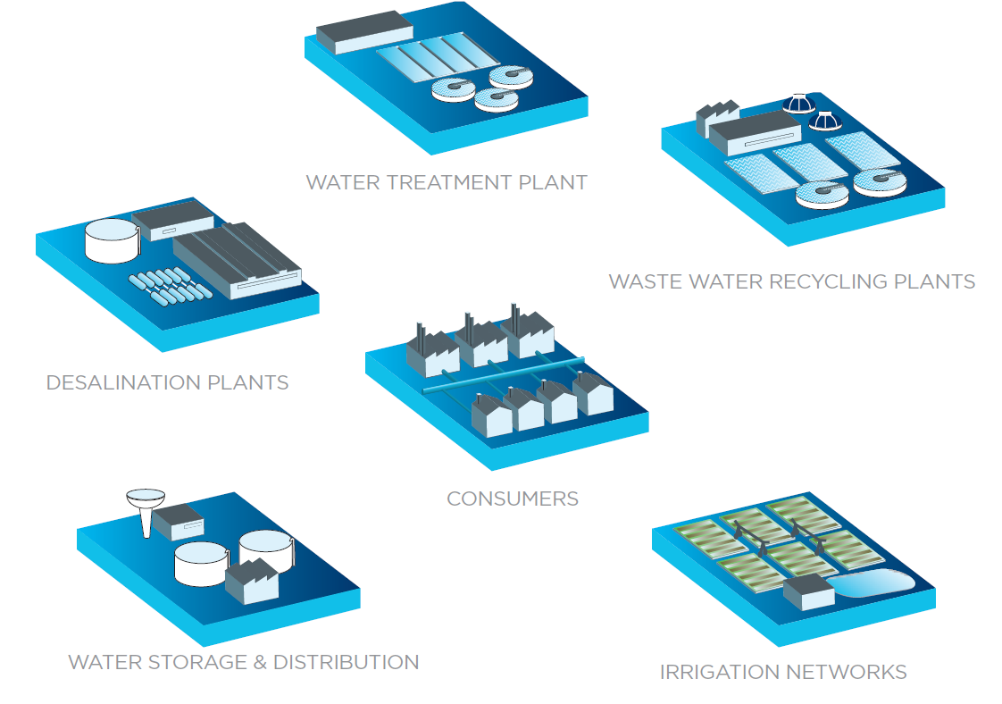
DRIVE THE WATER CYCLE

Slide 3
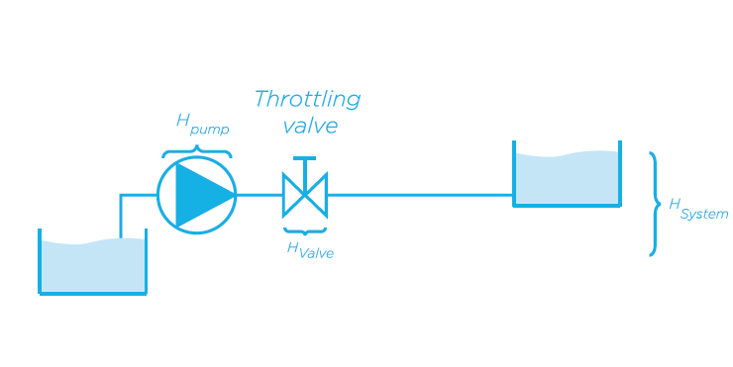
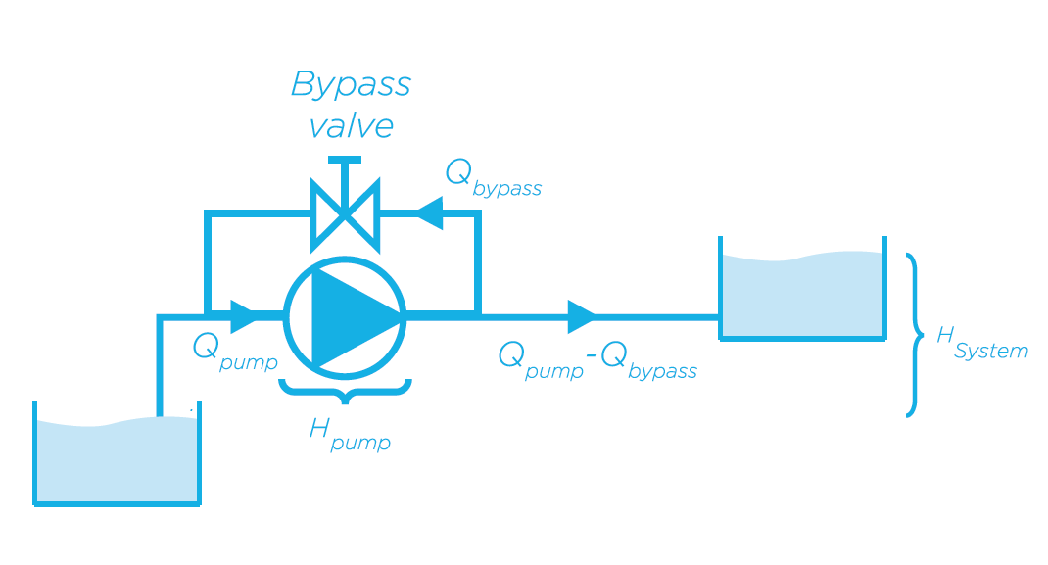
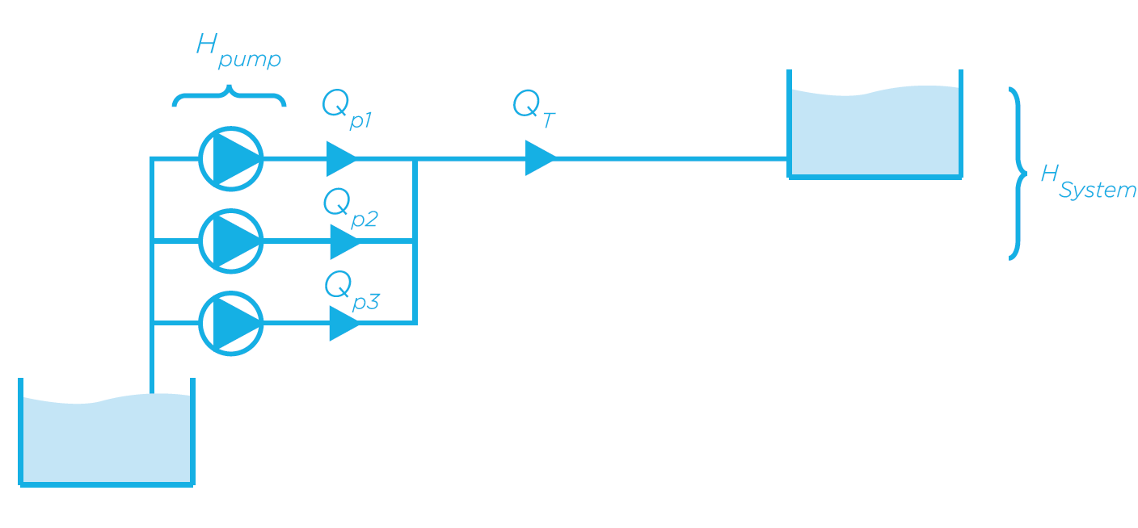
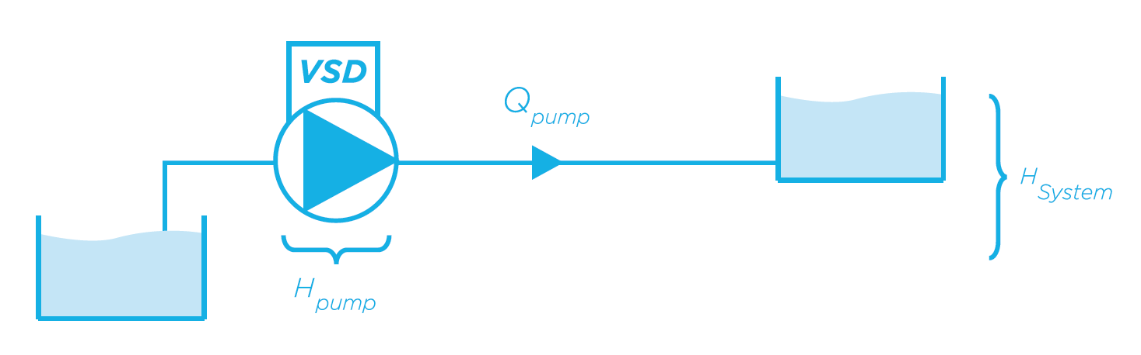
EXTENDED FLOW CONTROLS
Throttling control
Bypass control
Parallel Pump control
VSD control

Slide 4
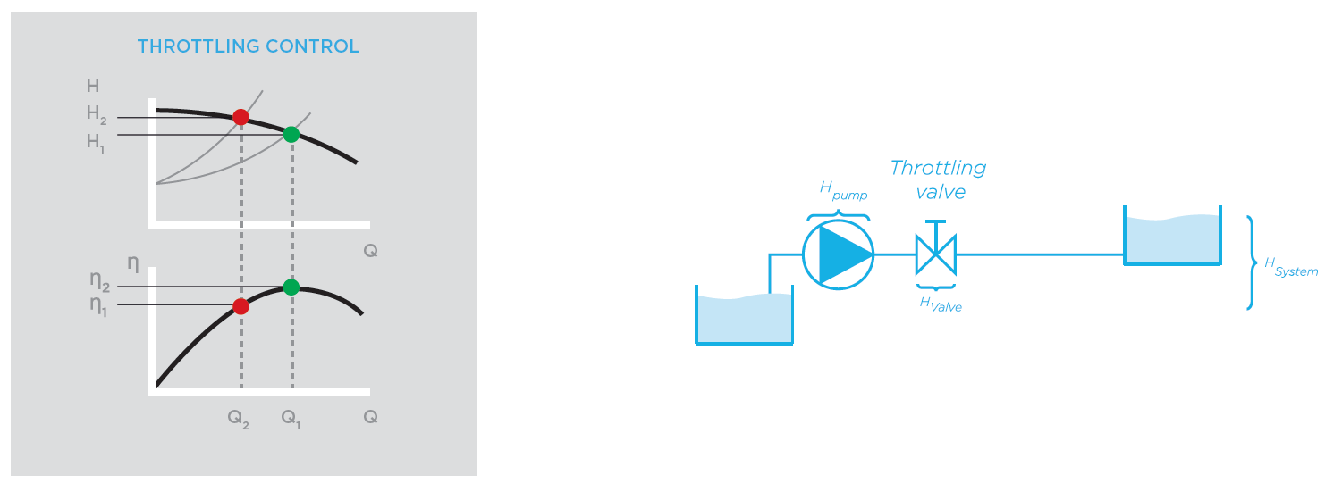
THROTTLING CONTROL
The operation point is modified by closing the line valve. This effect increases the hydraulic losses and reduces pump’s efficiency. Therefore, depending on the pump’s construction, it doesn’t provide any energy savings.

Slide 5
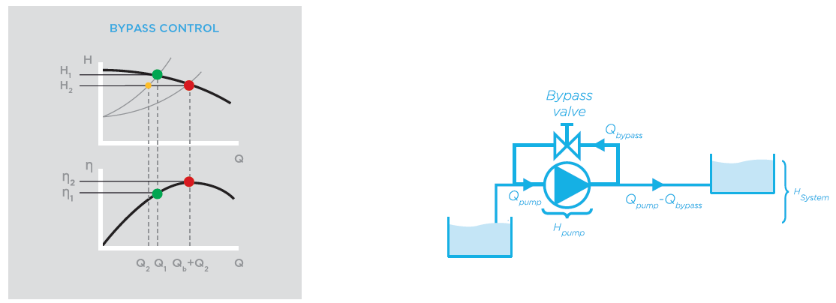
BYPASS CONTROL
A parallel circuit equipped with a line valve guides part of the flow back to the suction line. By opening and closing the bypass valve, the system is able to Control the delivered flow to the system. Consequently, the pump’s flow and efficiency are increased and head is reduced. Occasionally, the pump could deliver a high flow even though the system is completely cut off.

Slide 6
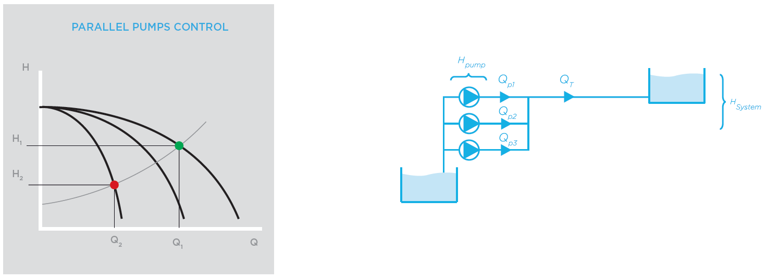
PARALLEL PUMPS CONTROL
In systems with a wide flow range, it can be an advantage to use a number of smaller parallel-connected pumps instead of one larger pump equipped with flow regulation. The centralized control will start and stop the pumps in order to satisfy the flow demand. A combination of variable speed drives and soft starters could be the most efficient solution.

Slide 7
VSD CONTROL - BENEFITS
In general terms, throttling control or bypass system are energy inefficient solutions and should be avoided. The efficient alternative is the variable speed control.
ENERGY SAVINGS: An smart flow control with VSD’s can lead into high energy savings in comparison with traditional flow control systems
QUALITY AND PERFORMANCE IMPROVEMENT: Introducing a pressure, flow or level PID control increase the process performance.
REDUCE MAINTENANCE AND INCREASE MOTOR LIFE TIME: The high number of starts and the overcurrent suffered by induction motors reduce its working lifetime and increases their maintenance costs.
DECREASE THE ENVIRONMENTAL IMPACT AND IMPROVE THE CORPORATIVE IMAGE: The reduction of the electricity, Natural gas or diesel consumption leads into a reduction of the company’s greenhouse gases emission.

Slide 8
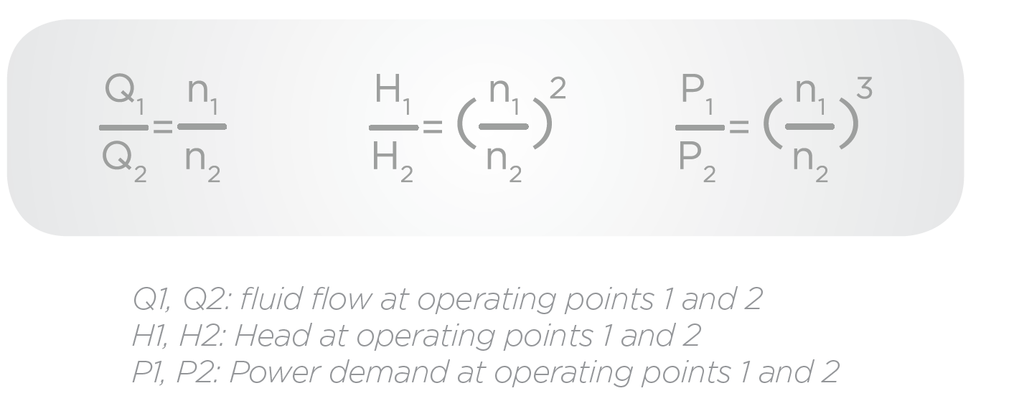
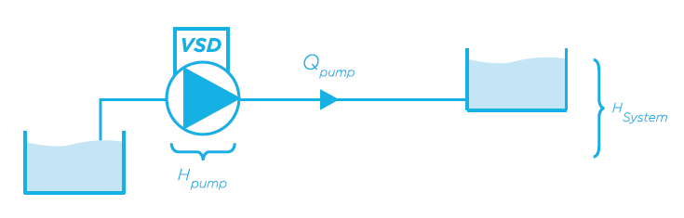
VSD CONTROL
The variable speed pump’s control provides unique regulation and performance features. The variable speed drive modifies the performance curve of the pump in order to meet the system requirements. The centrifugal pump performance is modeled by the affinity laws. In theory, the power reduction is proportional to the cubic of speed, for example a 20% speed reduction cause a power saving greater than 47%.

Slide 9
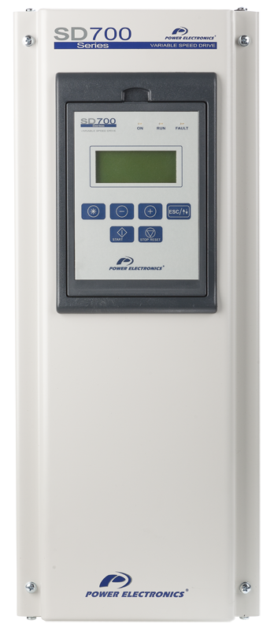
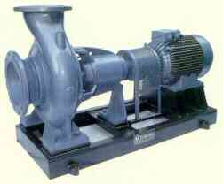
THROTHLING CONTROL VS VARIABLE SPEED DRIVE - OVERVIEW
80
Head in m H₂O
80
Head in m H₂O
1 X n
1 X n
70
FLOW
70
90%
80%
70%
60%
0.9 X n
50%
60
100%
0.9 X n
60
50
0.8 X n
50
0.8 X n
Static height 20 meters
40
0.7 X n
40
0.7 X n
30
0.6 X n
30
0.6 X n
0.5 X n
0.5 X n
20
20
0.4 X n
0.4 X n
10
H-Q
curves
10
0
10
20
30
Q Flow m³/min
50%
100%
0
10
20
30
50%
100%
H-Q Curves
System curves

Slide 10
PUMP’S CURVE DEFINE ENERGY SAVINGS
CURVE A
CURVE B
Head (bar)
50 Hz
Head (bar)
50 Hz
40 Hz
40 Hz
30 Hz
Min. Head
30 Hz
20 Hz
Min. Head
Q (m³)
Q (m³)
High slope curves have good regulation range
Flat pump curves leads into a bad regulation by speed variation
Better regulation means higher energy savings
Energy savings are limited due to a tight regulation range
Notes:
10

Slide 11
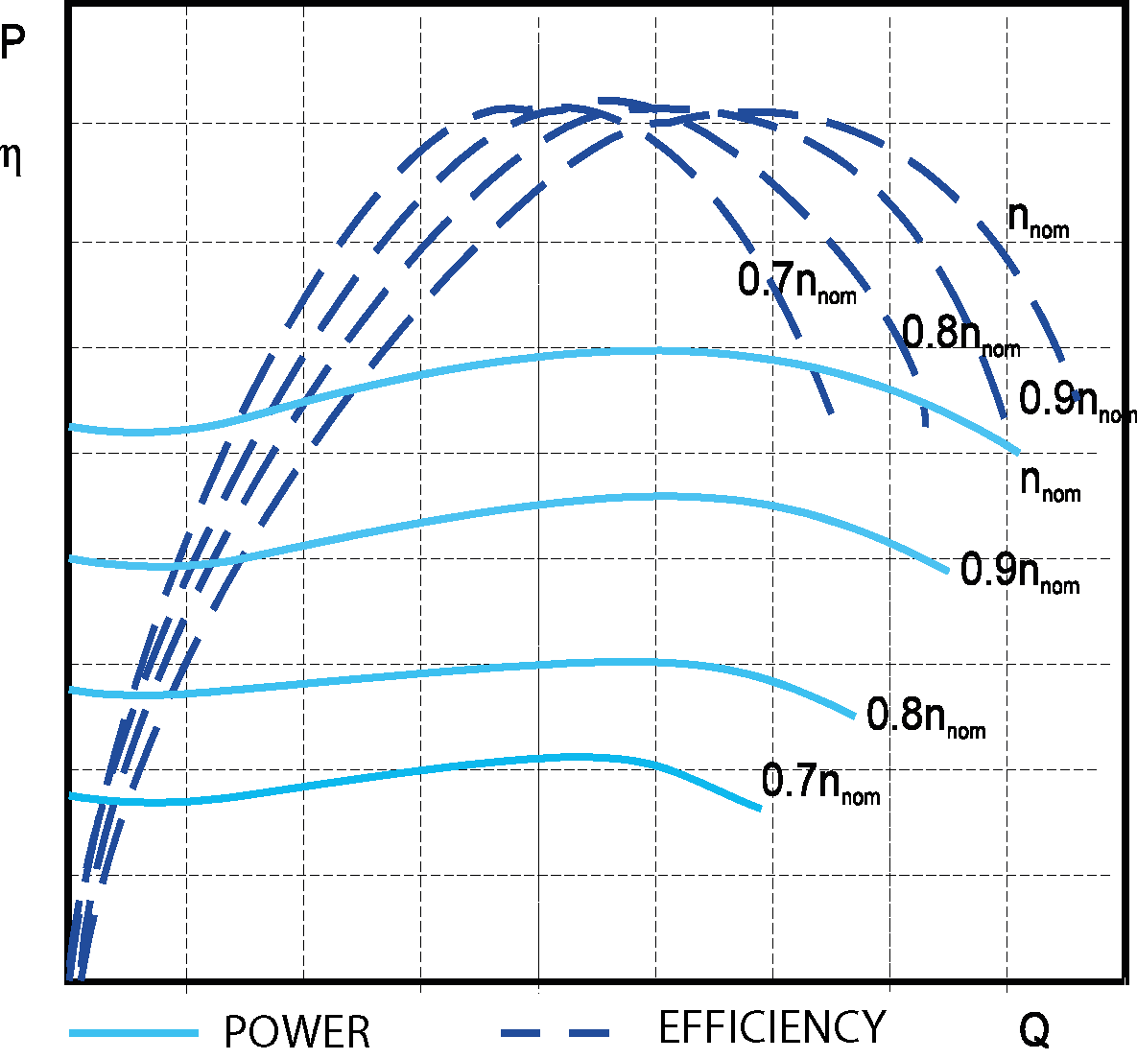
PUMP’S EFFICIENCY VARIATION DEPENDING ON SPEED VARIATION
80
1 X n
30%
50%
N = 1480 RPM
60%
70%
70
80%
85%
0.9 X n
87%
60
88%
0.8 X n
87%
50
85%
80%
40
0.7 X n
30
0.6 X n
20
0.5 X n
0.4 X n
Efficiency curves
10
Curve H – Q
System curve
0
10
20
30
40
Q flow
m³/min
Notes:
11

Slide 12
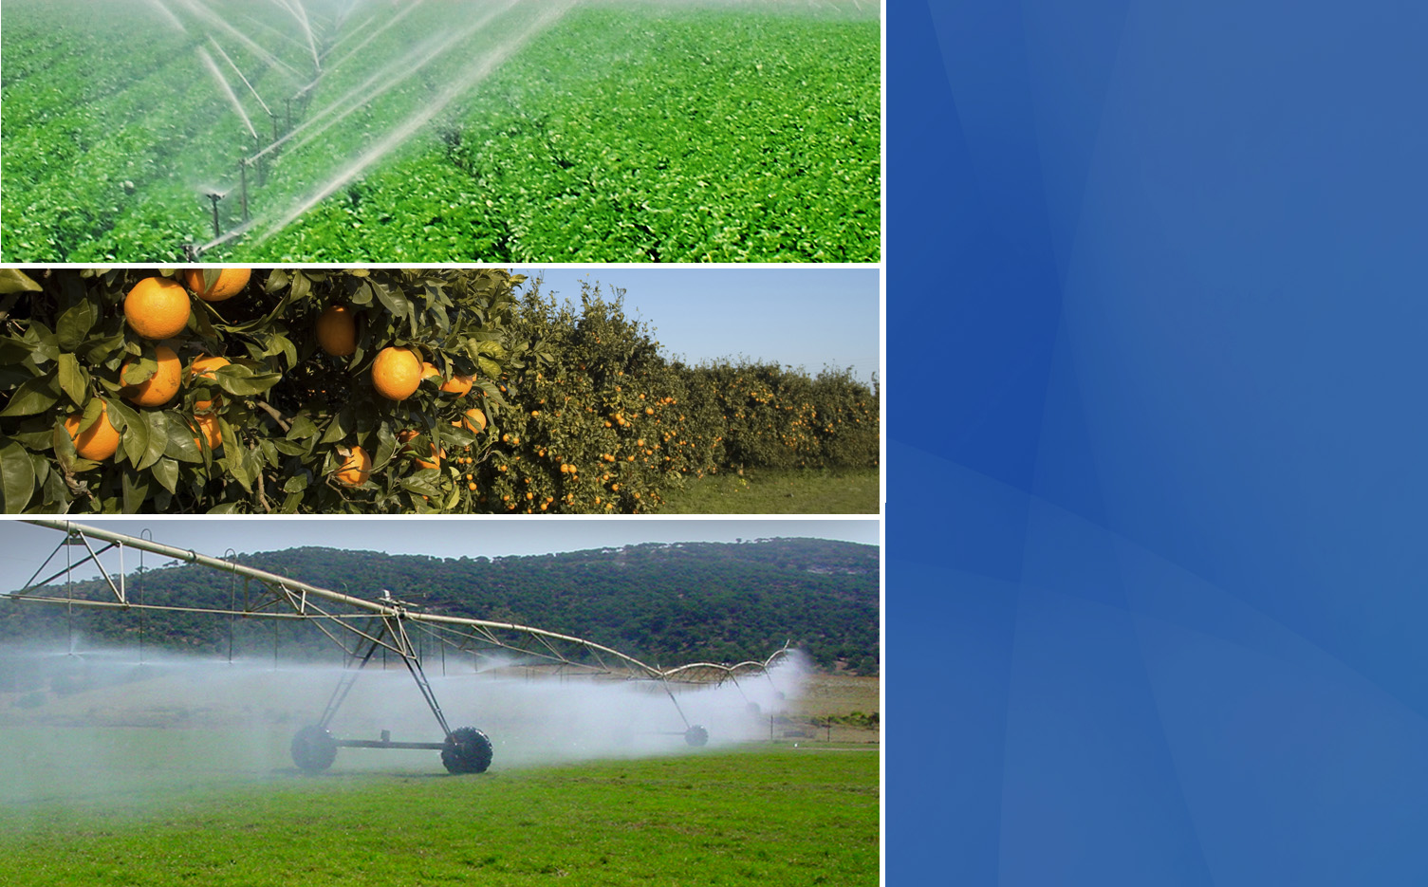
AHORRO ENERGÉTICO - OVERVIEW
POWER
(%)
A: Power reduction by using VSD.
B: Power reduction by using Slide Valve
FLOW (%)

Slide 13
ENERGY SAVINGS - OVERVIEW
Flow (%) | Valve control Power ( kW) | Power Demand with SD700 VFD (kW) | Power Reduction (kW) | Energy saving (%) | Cost saving (€/1000 h)
100% | 100 | 100 | - | - | -
90% | 95 | 72,9 | 22,1 | 23 % | € 3.315
80% | 83 | 51,2 | 31,8 | 38 % | € 4.770
70% | 77 | 34,3 | 42,7 | 55 % | € 6.405
60% | 73 | 21,6 | 51,4 | 70 % | € 7.710
50% | 68 | 12,5 | 55,5 | 81 % | € 8.325
Pump Power : 110 kW
Electric cost: 150 €/MWh

Slide 14
VARIABLE SPEED DRIVES BENEFITS IN PUMPING SYSTEM
Energy Saving by adjustable Head and Flow.
Soft start and inrush current control by implementing a ramp setting.
Water hammer control and soft stop
High power factor >0.98, no capacitor banks need
Automatic re-start after voltage dips or shutdowns
Notes:
14

Slide 15
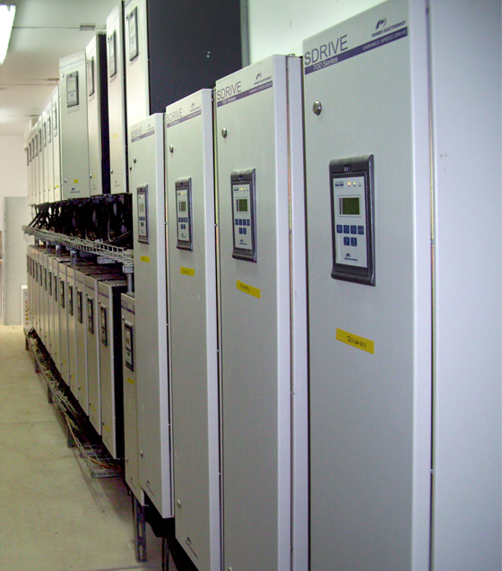
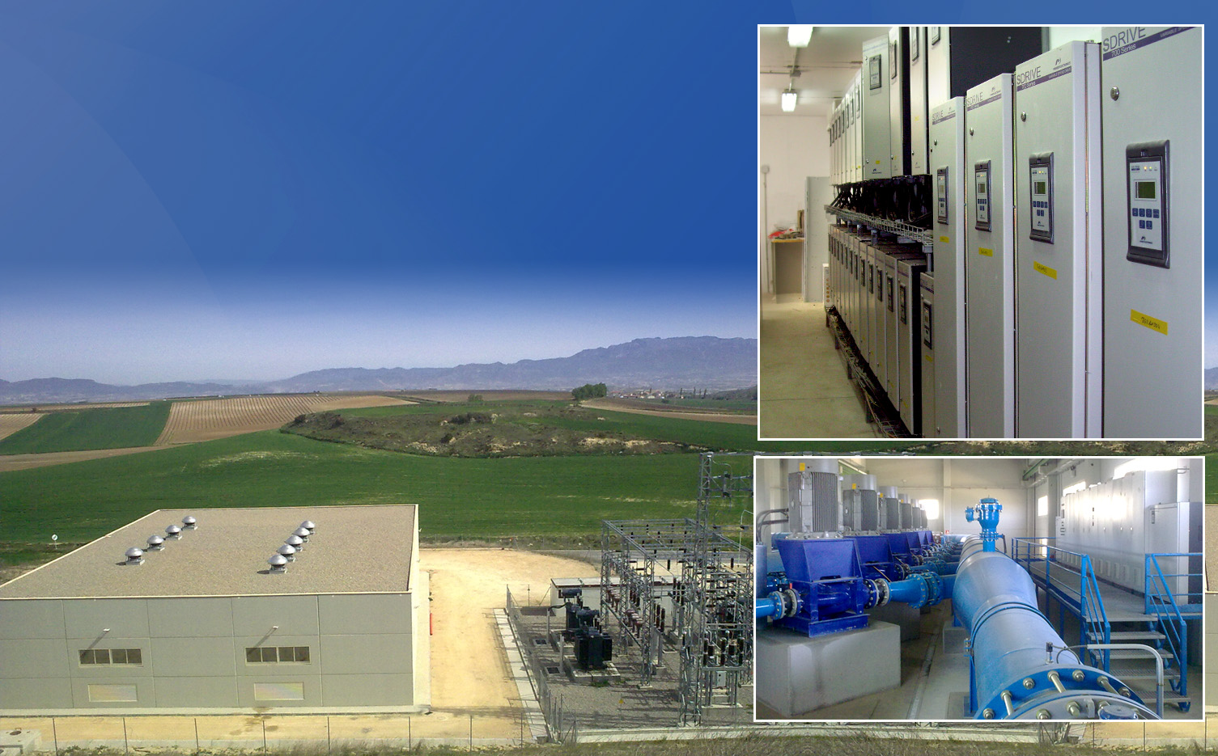
SD700 BENEFITS IN PUMPING SYSTEMS
Low dV/dt - No special motor cable and suitable for long motor cable distances
IP54 without dust filters
Full Frontal Access – maintenance friendly
Totally sealed and varnished electronics
50ºC operation without Power Derating
Low Harmonics – Built-in Input Chokes
Voltage sag tolerance ±10% , -20% VRT.
Motor Temperature monitoring by PTC or PT100
Solar back-up kit availability SD700 SPK
Notes:
15

Slide 16

SD700 PROTECTIONS
IGBT’s overload
Input phase loss
Low input voltage, High input voltage
DC Bus voltage limit, Low DC Bus voltage
High input frequency, Low input frequency
IGBT temperature, Heatsink over-temperature
Drive thermal model
Power supply fault
Ground fault
Software and Hardware fault
Analogue input signal loss (speed reference loss)
Safe Torque Off
Notes:
16

Slide 17
SD700 MOTOR PROTECTIONS
Rotor locked
Motor overload (thermal model)
Motor Underload
Current limit
Maximum Starts
Phase current imbalance
Phase voltage imbalance
Motor over-temperature (PTC signal), PT100 Optional
Speed limit
Torque limit.
Notes:
17

Slide 18
SD700 PUMP PROTECTIONS AND FEATURES
Hammer control
Back spinning soft start and stop
Pipeline filling function
Jockey and Priming pump control
Minimum speed to assure pump’s cooling
Pump cavitation
Pump clogging
Overpressure or underpressure monitoring
PID direct and reverse regulation ( flow, pressure, level, …)
Sleep and wake up functions
PLC shutdown
Timers and irrigation program
Notes:
18

Slide 19
PUMPING SYSTEM CONTROL WITH VSD
PRESSURE CONTROL
FLOW CONTROL - DOSING
LEVEL CONTROL – RESERVOIR PUMPING
MULTI REFERENCE
MULTI MASTER CONTROL
MULTI PUMP – SD700 + V5
MULTI PUMP CONTROL
Notes:
19

Slide 20
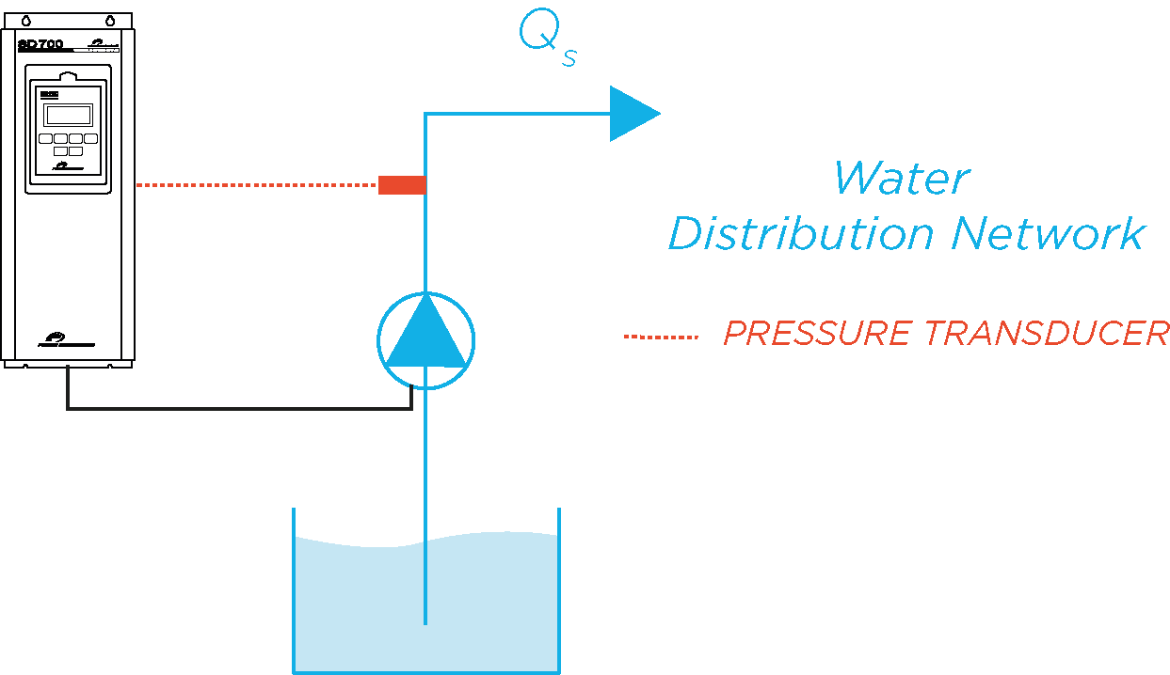
PRESSURE CONTROL
The pressure signal is sent by a pressure transducer to an analogue input of the drive. The PID control adjust the speed reference and flow to keep a constant pressure upstream.
Applications: Fresh water distribution systems. Step Irrigation, Pivot irrigation
Notes:
20

Slide 21
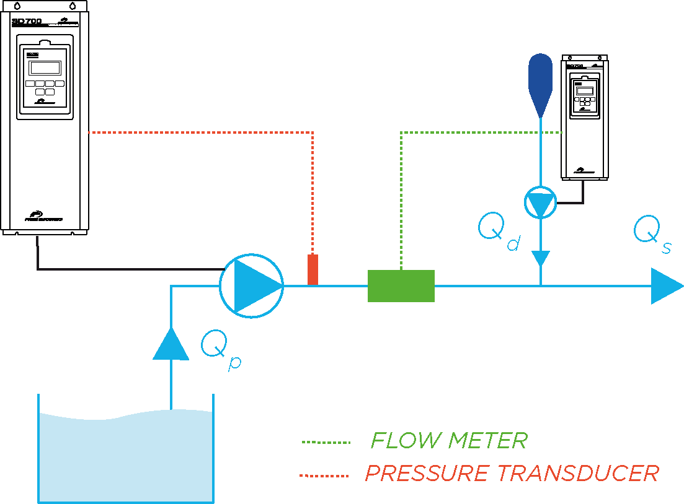
FLOW CONTROL- DOSING
The flow signal that comes from a pulse flow meter is sent to the SD700 analogue input . The PID control adjust the speed reference of the controlled pump according to the configured settings.
Applications: Dosing
Notes:
21

Slide 22
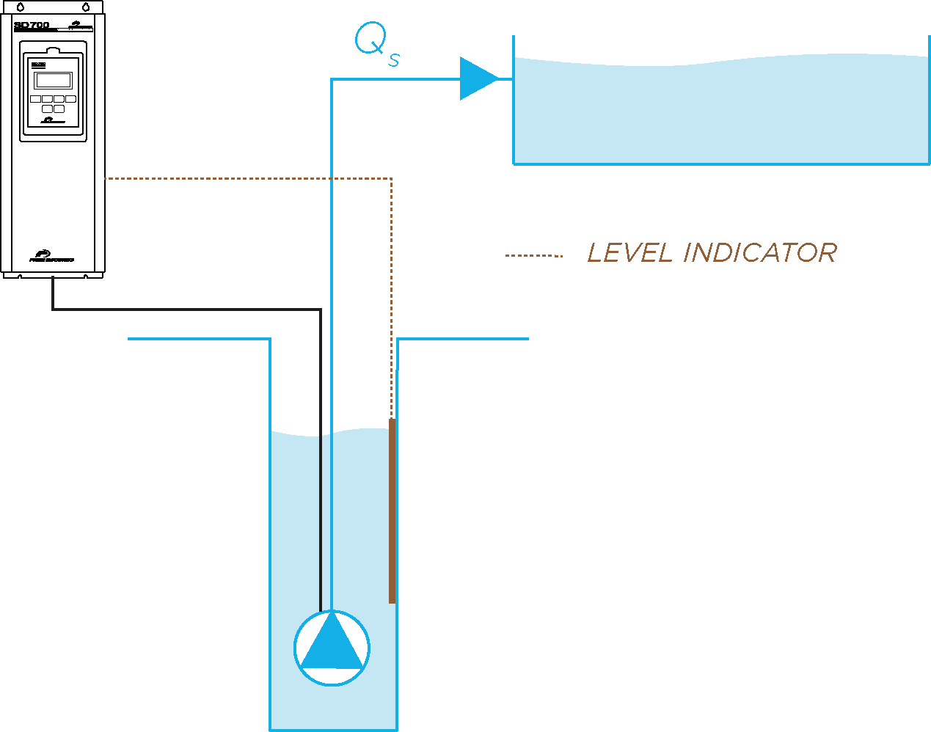
LEVEL CONTROL- DOSING
The water level that comes from a level indicator is sent to the SD700 analogue input . The direct or reverse PID control adjust the speed reference of the controlled pump in order to assure the established level.
Applications: Submergible well pump, pond level control, reservoir control.
Notes:
22

Slide 23
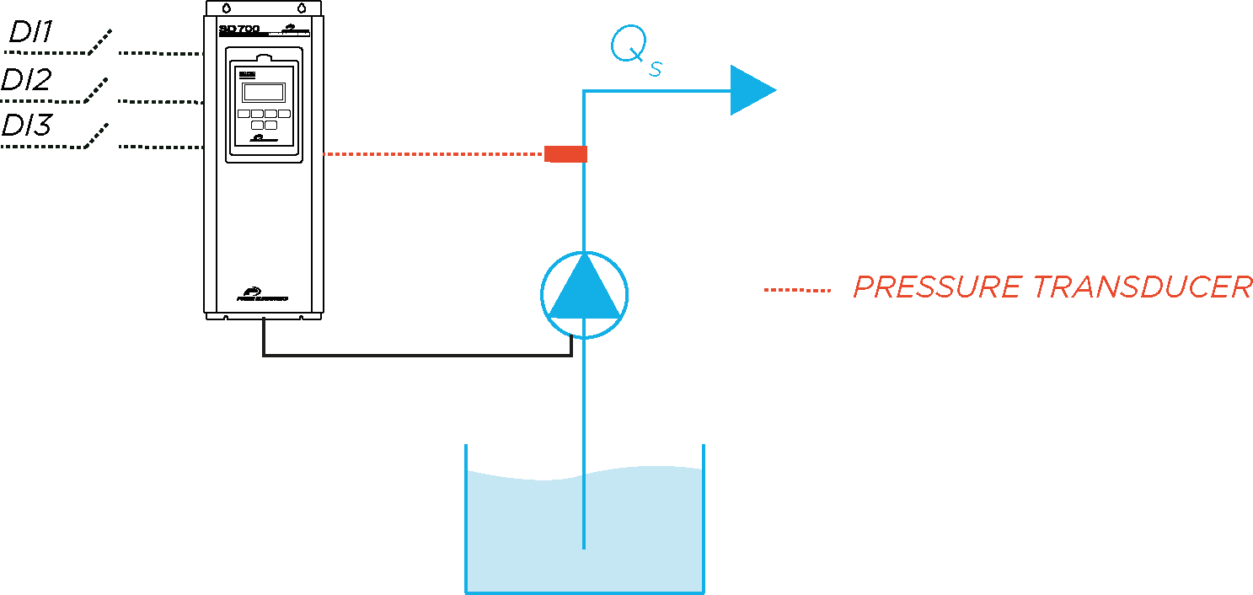
MULTI REFERENCE
The drive can be commanded with up to 9 different pressure reference signals by combining the status of three digital inputs.
Applications: Step irrigation networks, Pivot irrigation
Notes:
23

Slide 24
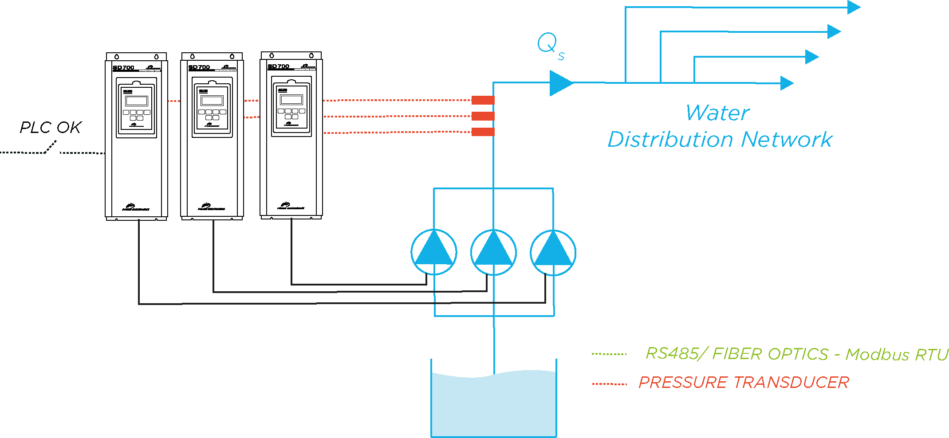
MULTI MASTER CONTROL
When the PLC that manage the system shuts down, the SD700 can control up to 6 pumps in an automatic master-slave system that starts, stops and adapt the slave’s speed to the demand. This system provide full redundancy and reliability to your facilities.
Applications: Multi pump control and stations.
Notes:
24

Slide 25
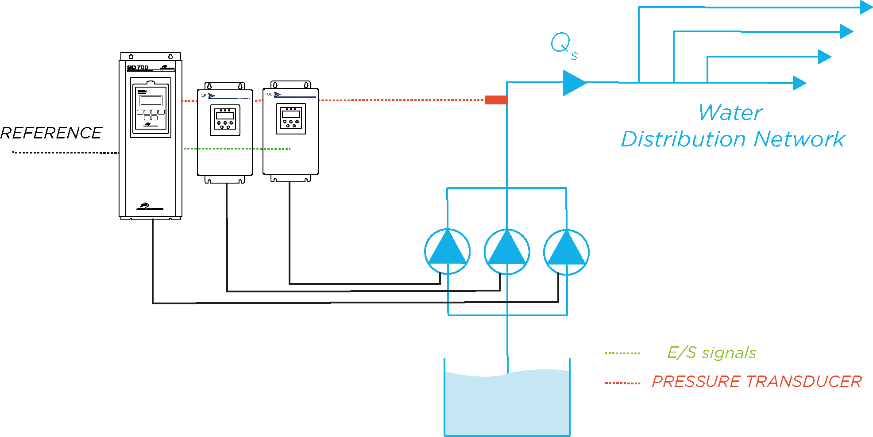
MULTI PUMP CONTROL – SD700 + V5
SD700 acts as a master carrying out a pressure PID control and sending the start and stop commands to the V5 soft starters depending on the downstream water demand. This solution protects every single motor and increase the availability. Being able to run even if the master shuts down.
Applications: Fresh water distribution systems
Notes:
25

Slide 26
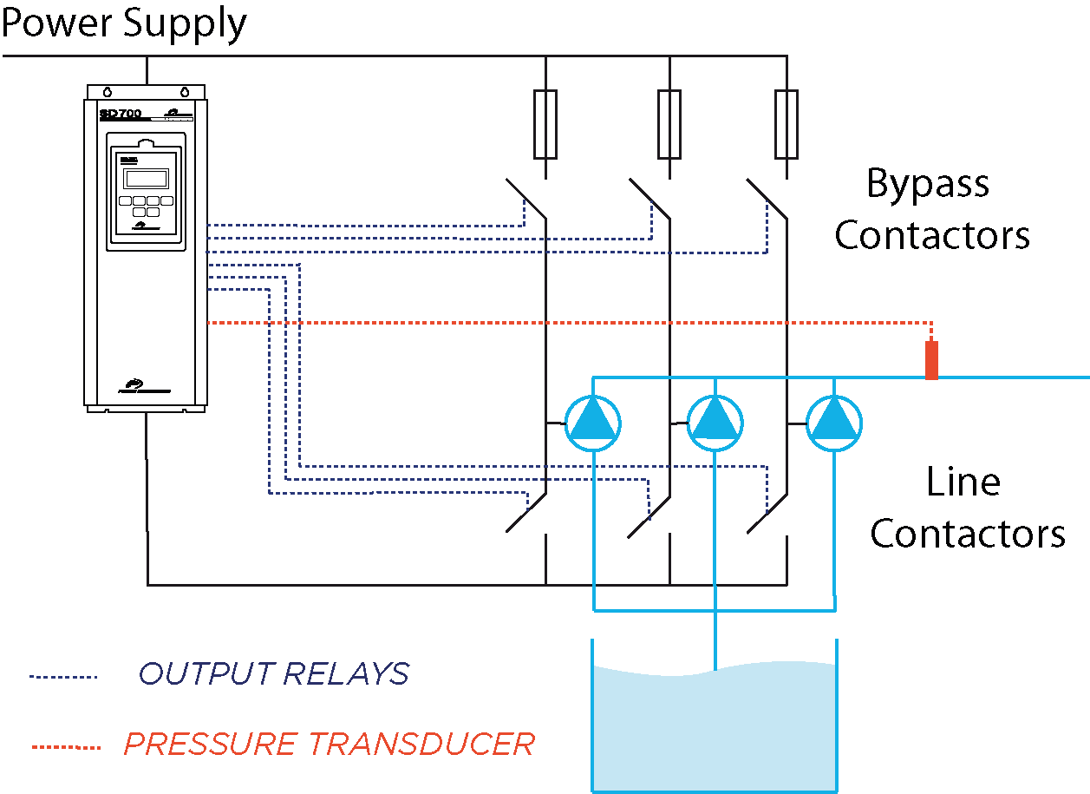
MULTI PUMP CONTROL
A single SD700 can control up to 6 pumps depending on the downstream pressure. It smoothly start and stop the pump and when it reaches the full speed the drive disconnect the line contactor and connects the bypass contactor. When the pump is bypassed the line fuse will protect it.
Applications: Fresh water distribution system with small pumps.
Notes:
26

Slide 27
SUBMERSIBLE PUMPS
ANNEX

Slide 28
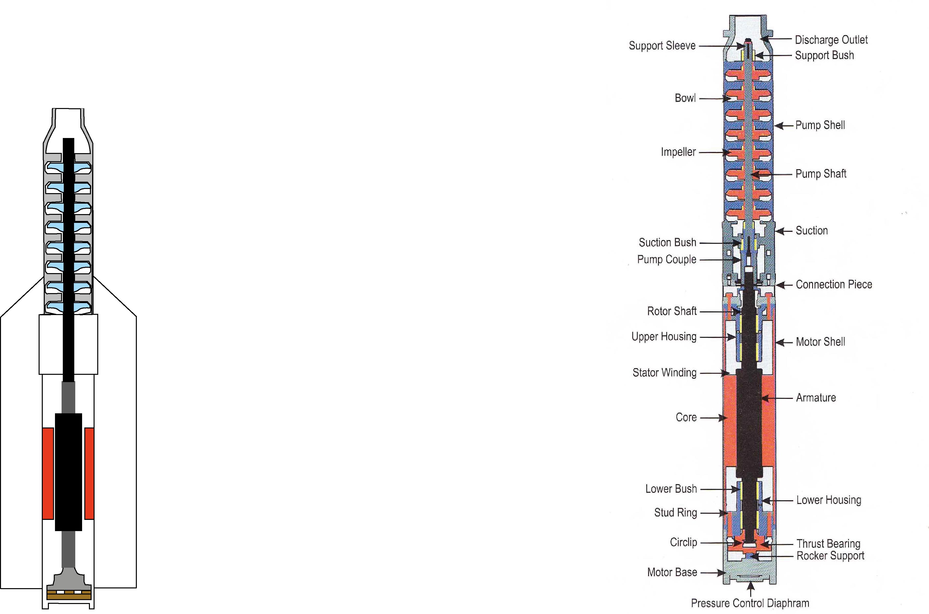

SUBMERSIBLE PUMP TOPOLOGY
Water impulsion
Pump Shaft
Pump Impellers
Cooling jacket
Water intake
Motor Shell
Motor
Thrust bearing
Notes:
28

Slide 29
SUBMERSIBLE PUMPS & VSD CONSIDERATIONS
MOTOR CABLES TYPE AND LENGHT
PUMP COOLING
THRUST BEARING COOLING
VSD OPERATION & SETTINGS
Notes:
29

Slide 30
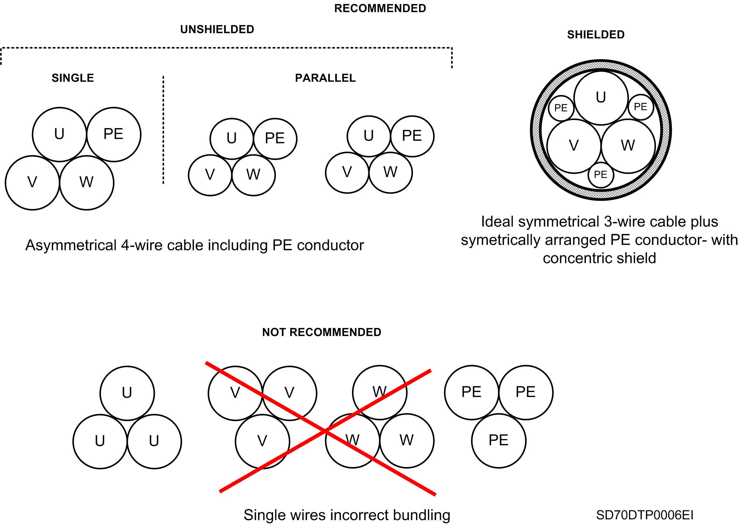
SD700 – RECOMMENDED CABLE TYPE
Desired - Up to 300m
Compatible - Up to 150m

Slide 31
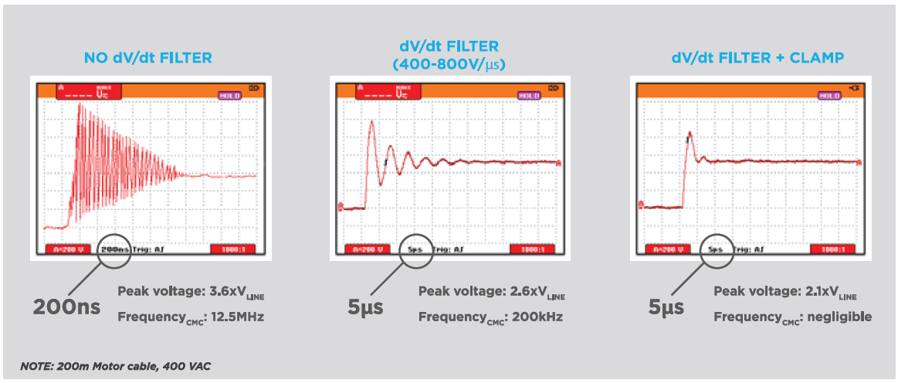
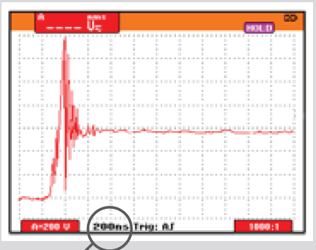
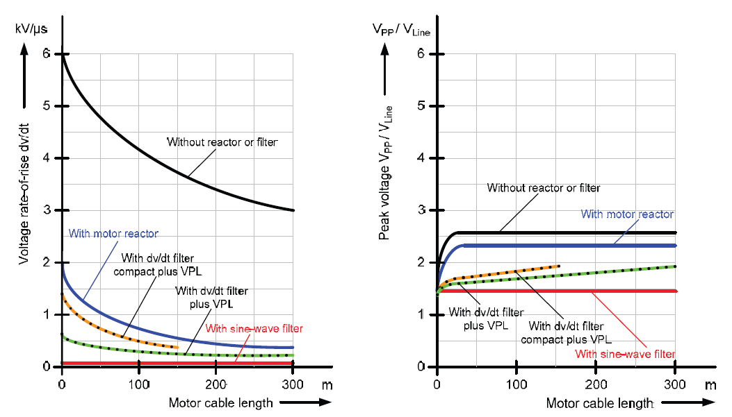

VOLTAGE FLANGE WAVE FORM
ALL DRIVES ARE NOT THE SAME
Competitors dV/dt values
SD700 STANDARD

Slide 32
ADMISSIBLE PEAK VOLTAGE LIMIT CURVES IN AC MOTORS TERMINALS:

Slide 33
PUMP COOLING
Keep a minimum speed of the surrounding water.
  Vc = 0.08…0.5 m/s ( Consult Manufacturer)
Cooling flow depends on:
Water temperature and properties
Pumps geometry and Motor Shell
Motor and pump load
Well geometry
Well intake
T (ºC)
Cooling Speed - V (m/s)
Q (m3/s)
INCREASE COOLING CAPACITY
REDUCE HEAT LOSSES
Lower water temperature (ºC)
Lower motor load (AP)
Higher pump flow (Q)
Pump speed reduction (Hz)
Wider motor Diameter (mm)
Dp
Higher convection factor (W/mm²)
Dw
Water stream distribution
Low factor between motor diameter and well diameter
Notes:
33

Slide 34
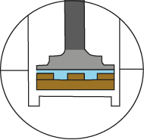
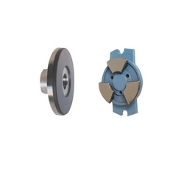
THRUST BEARING COOLING
Thrust bearings needs a minimum water flow (15-30% of Qn) to create a thin lubrication layer.
The layer ensures bearing cooling and reduce friction between fixed parts.
Lubrication layer
Notes:
34

Slide 35
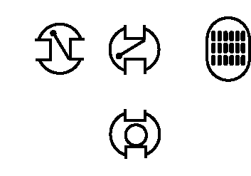
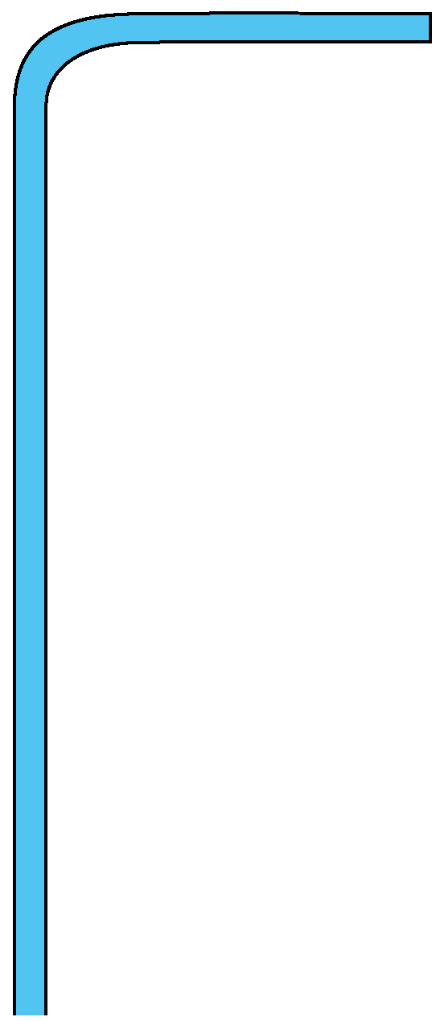
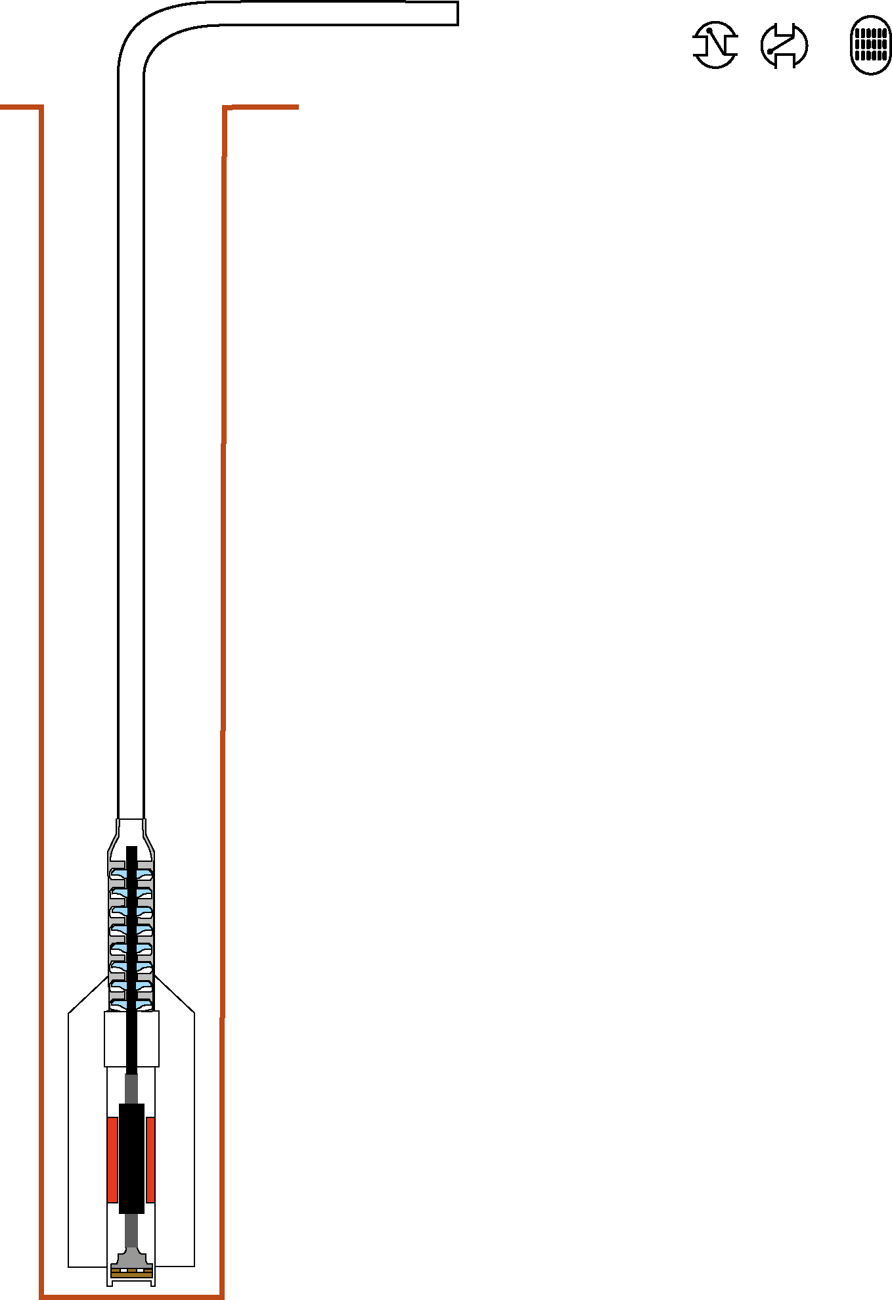
VSD OPERATION AND SETTINGS
YES
How long it takes to empty the pipe?
- Soft start after the empty time
- Soft stop to reduce water hammer
Is there water release holes in the pump?
YES
NO
Start and Stop with water-filled pipe settings
(Maximum head)- CASE 1
1
Is a Check Valve integrated in the pump?
Start with empty pipe but it needs a fast speed transient - CASE 3
3
YES
Is there a check valve on the top of the hole ?
NO
NO
2
Soft start and stop – CASE 2
Notes:
35

Slide 36
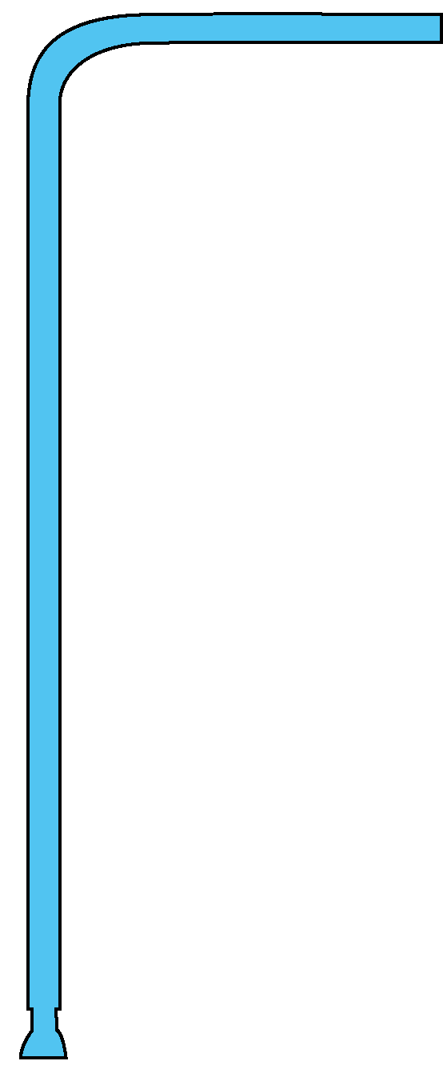

START AND STOP WITH WATER-FILLED PIPE
1
Head (bar)
Min Head
50Hz
40Hz
30Hz
Min Head - AP
20Hz
10Hz
Q min (thrust bearing cooling)
Pump
Installation
Q (m³)
Slow ramp
Flow control range
Reduce sand impulsion
50
Slow ramp
Water Hammer Control
40
Pump Speed (Hz)
30
20
Fast ramp
Pump stop
Fast ramp
– Min Flow
10
Time (s)
0
2s
4s- 7200s
30s
1s
Notes:
36

Slide 37
SOFT START AND STOP
2
Head (bar)
Min Head
50Hz
40Hz
30Hz
Min Head - AP
20Hz
10Hz
Q min (thrust bearing cooling)
Pump
Installation
Q (m³)
Slow ramp
Flow control range
Reduce sand impulsion
50
Slow ramp
Water Hammer Control
40
Pump Speed (Hz)
30
20
10
Fast ramp
– Min Flow
4s- 7200s
4s- 7200s
Time (s)
0
1s
1s
Notes:
37

Slide 38
SOFT START AND STOP WITH FAST TRANSIENT
3
Head (bar)
Inst. Head
Min Head
50Hz
40Hz
30Hz
Min Head - AP
20Hz
10Hz
Q min (thrust bearing cooling)
Pump
Installation
Q (m³)
Slow ramp
Flow control range
Reduce sand impulsion
50
Slow ramp
Water Hammer Control
40
Pump Speed (Hz)
Fast transient ramp
– Checkvalve opening
30
20
10
Fast ramp
– Min. Flow
4s- 7200s
Time (s)
0
1s
4s- 7200s
1s
4s- 7200s
1s
Notes:
38

Slide 39
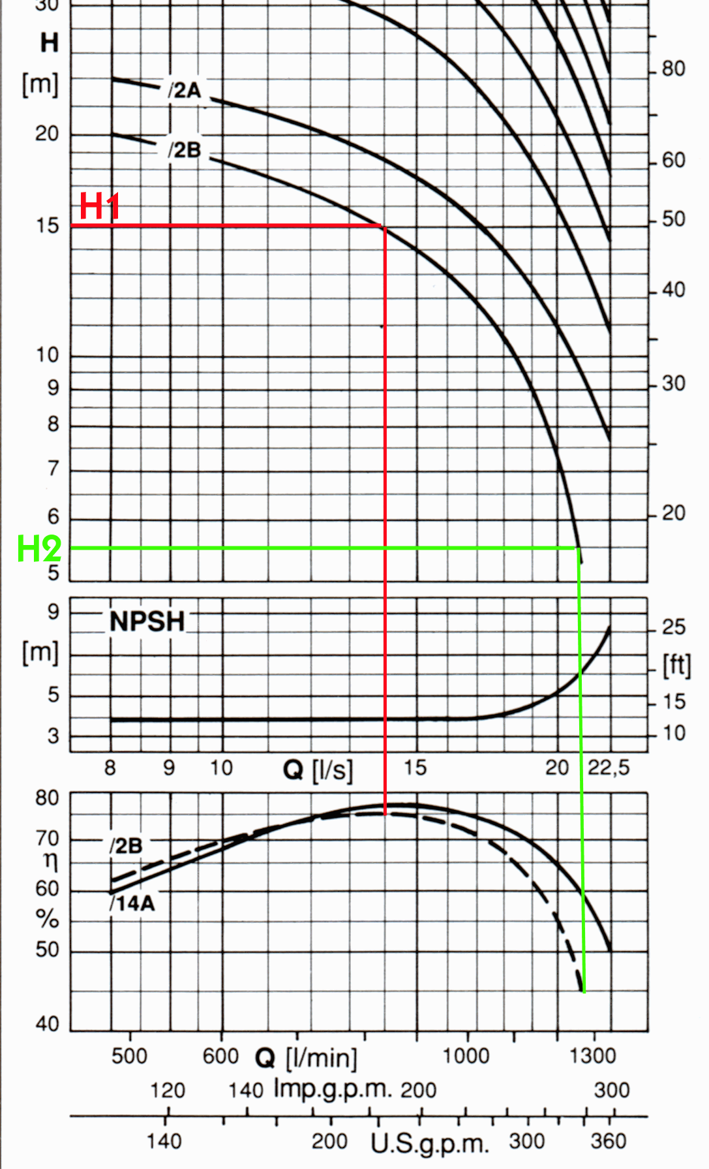
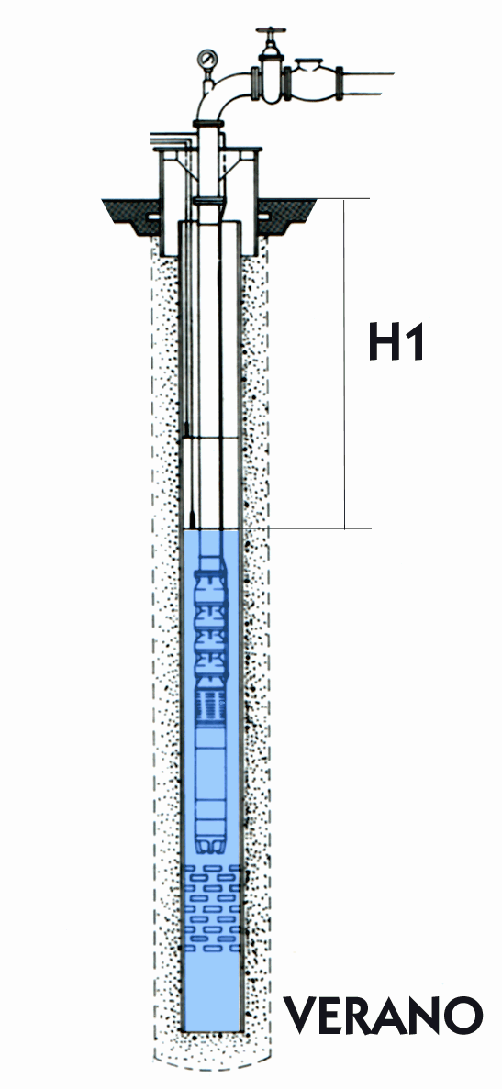
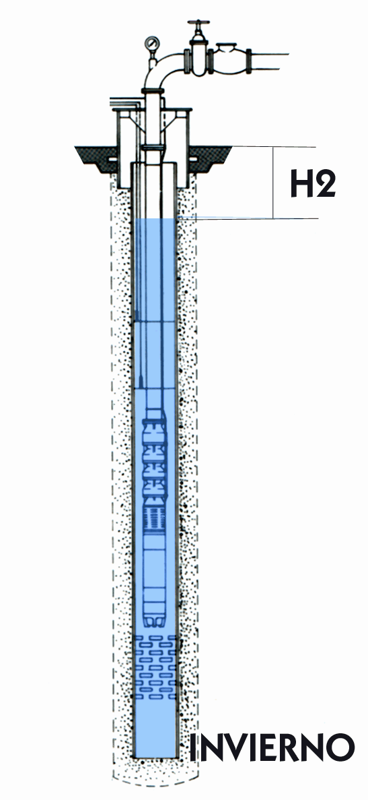
CASE STUDY – WELL LEVEL VARIATION
SUMMER
WINTER

Slide 40
HYDRAULIC POWER EQUATION
POWER (W) = r x g x H x Q x ŋ⁻¹
r = Density (kg/m³)
g = Gravity (9.81m/s²)
H = Head (m)
Q = Flow (m³/s)
ŋ = Efficiency

Slide 41
POWER ELECTRONICS
appreciate your attention
More info:
www.power-electronics.com

