Slide 1
CHAPTER 6
VARIABLE SPEED DRIVE
TECHNICAL SEMINAR XMV660 2013
Notes:
1

Slide 2
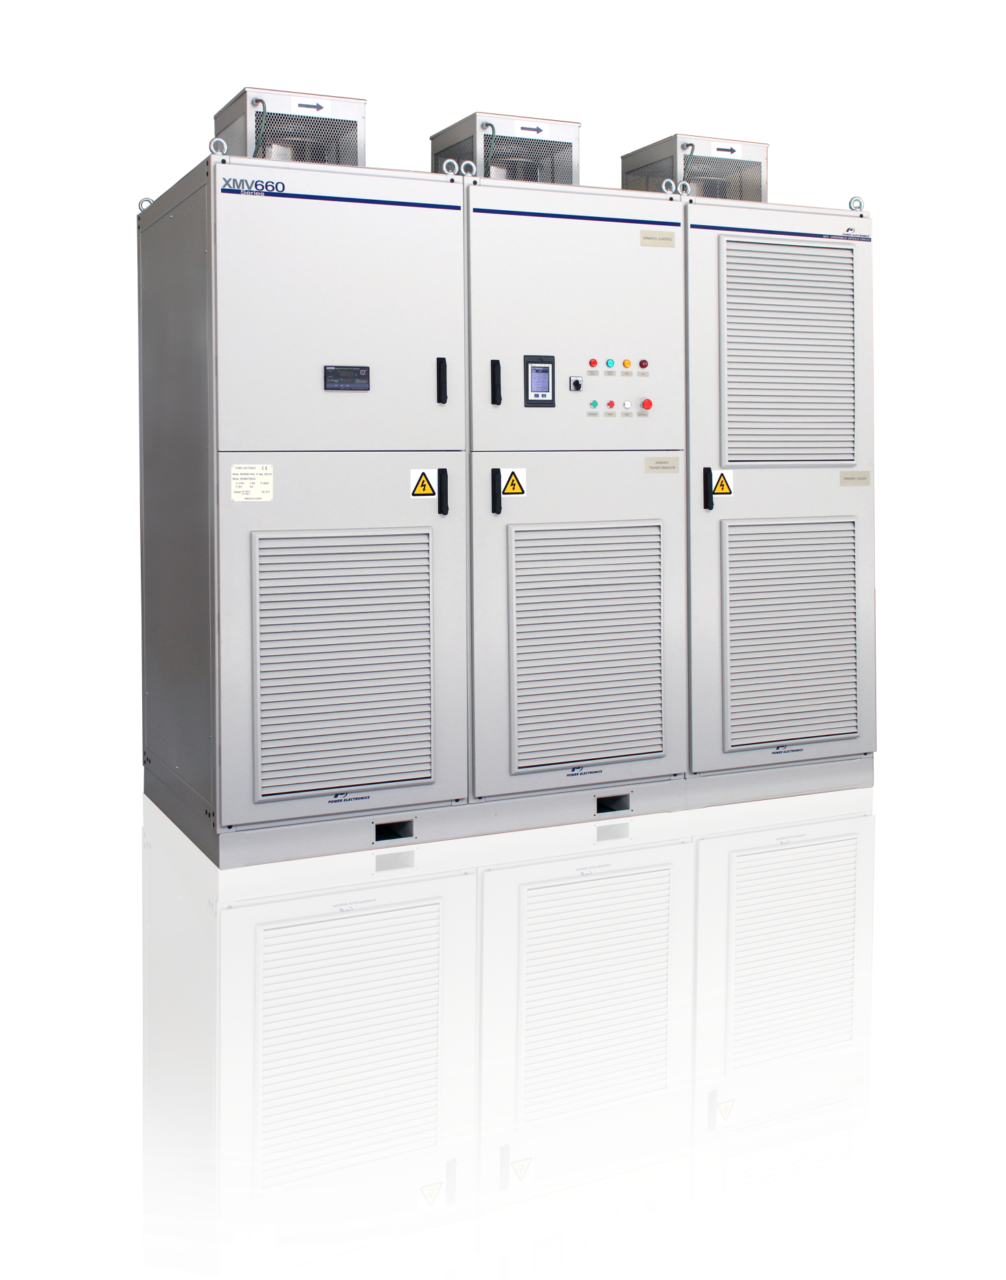
OVERVIEW
“
A Variable Speed Drive is an electric/electronic device that base on the frequency modulation, varies precisely the speed of the electric III phase induction motors.
“
Notes:
2

Slide 3
OVERVIEW
ENERGY SAVINGS:
Payback time from 0 to 3 years, depending on the work time and application.
Up to 60% Energy saving in comparison with traditional direct on-line or valve control systems.
Notes:
3

Slide 4
OVERVIEW
QUALITY AND PERFORMANCE IMPROVEMENT:
Introducing torque and speed control the product quality and the process performance increase.
Notes:
4

Slide 5
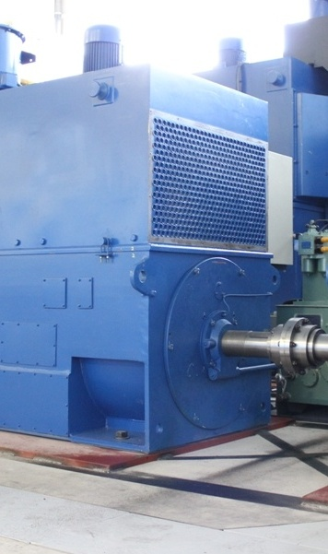
OVERVIEW
MAINTENANCE REDUCTION AND LONG LIFE MOTORS
A high number of direct starts produce mechanical and electric motor stress.
The instantaneous overcurrent peaks suffered by induction motors reduce its working lifetime and increases their maintenance costs.
Notes:
5

Slide 6
OVERVIEW
CORPORATIVE IMAGE IMPROVEMENT
The reduction of the electricity , natural gas and diesel consumption decrease the company’s greenhouse gases emission.
Notes:
6

Slide 7
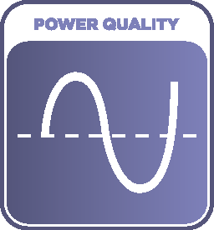
MEDIUM VOLTAGE VSD XMV660
Power range from 200kW to 12.000kW
Voltage ratings 2,3kVac – 11,0kVac
50ºC operation without power derating
Quasi- sinusoidal input and output voltage and current waveform – low THDi, Low dV/dt and HVF
Multi Step PWM with output voltage boosting through 3RD harmonic modulation.
Outstanding rugged and reliable design
Built-in motor and drive protections
Cooling Redundancy and Temperature monitoring
Maintenance friendly with easy frontal access.
Notes:
7

Slide 8
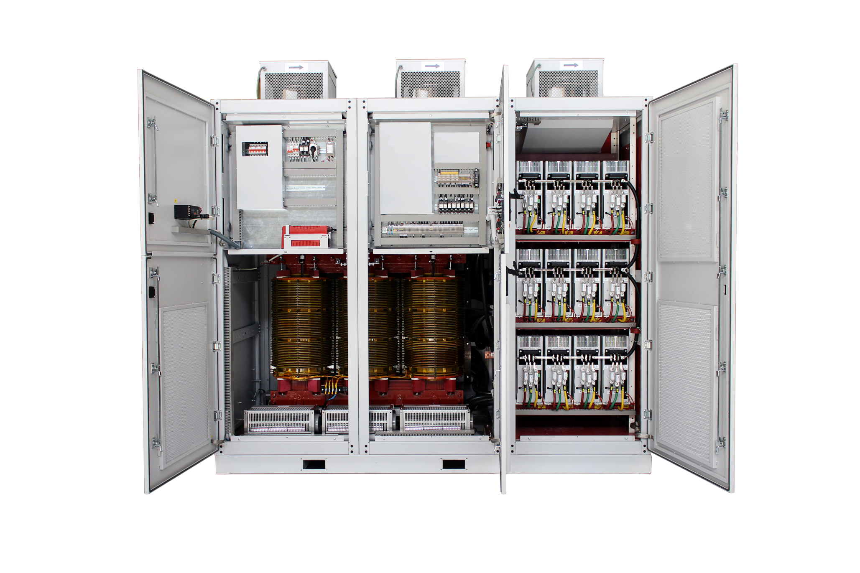
XMV660 TOPOLOGY
CONTROL CABINET
POWER CELLS
CABINET
FPGA BOARD
FIBER OPTICS COMMS
CONTROL & POWER BOARD
DISPLAY & PUSH BUTTONS
USER TERMINAL
STRIP PANEL
INPUT TERMINALS VOLTAGE/ CURRENT MEASSUREMENT & OVERVOLTAGE PROTECTION
POWER TRANSFORMER TEMPERATURE
MONITORING
MV PHASE
SHIFT
TRANSFORMER
LV POWER CELLS FUSE PROTECTED
TRANSFORMER CABINET
Notes:
8

Slide 9
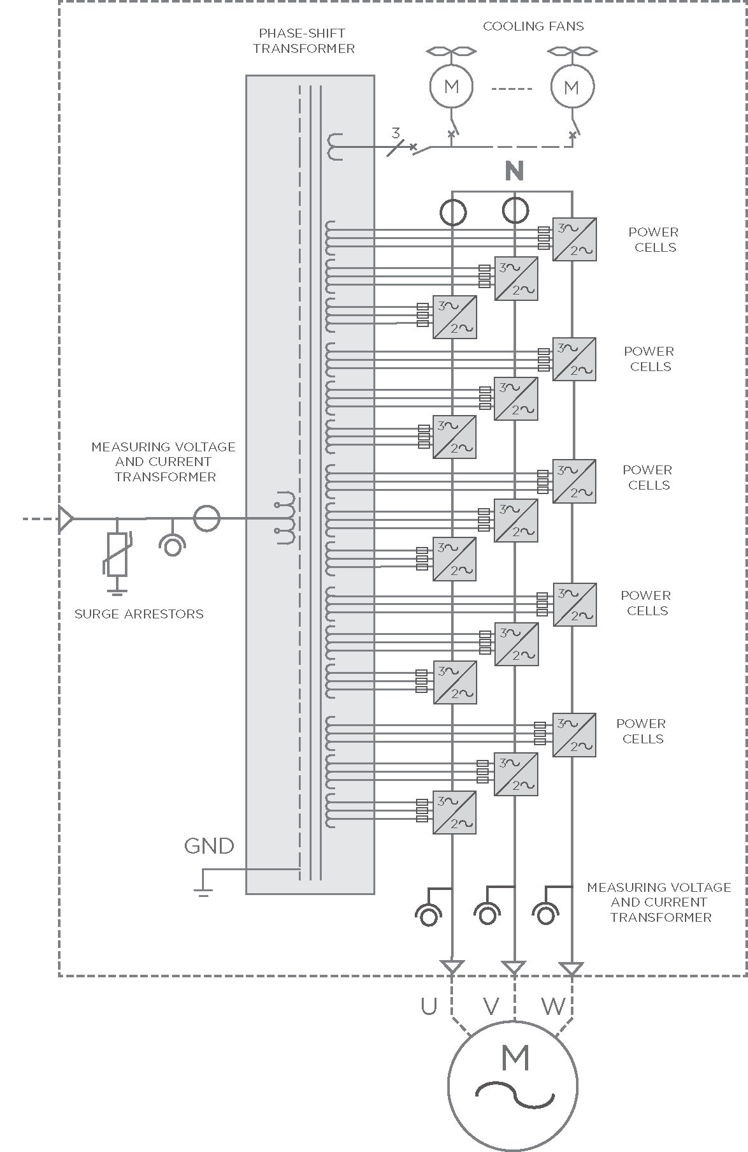
MAXIMUM MOTOR CARE
2885 V
x√3 = 5.000 Vac
577V
577V
5kV
577V
577V
577V
30 pulses
Notes:
9

Slide 10
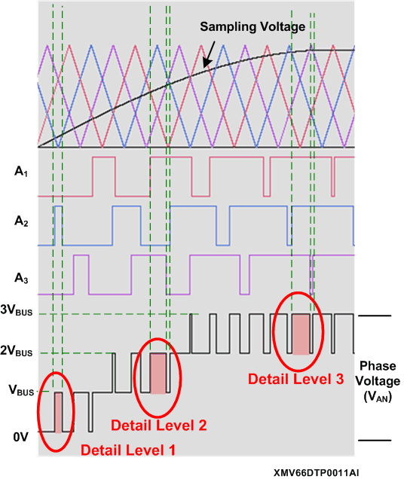
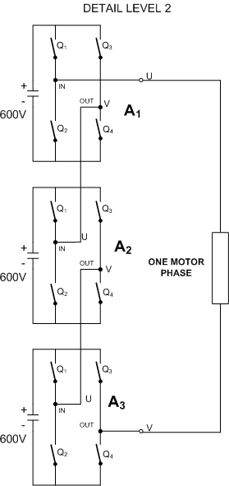
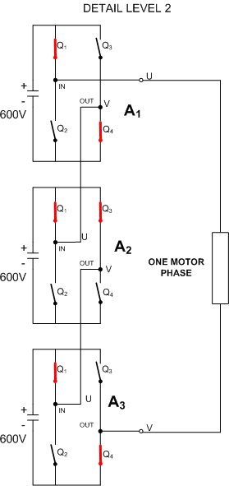
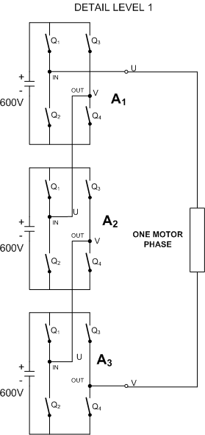
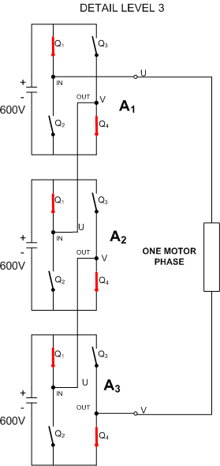
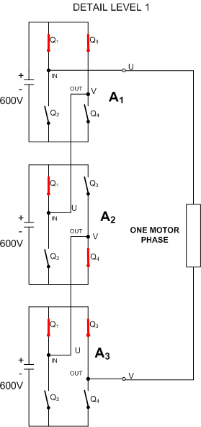
XMV660 TOPOLOGY
700V
700V
700V
700V
700V
700V
700V
700V
700V
Detail Level 1: Power cell A2 offers 700V at the output, power cells A1 and A3 offer 0V. Therefore, the voltage is +700V.
Detail Level 2: Power cells A1 and A3 offer 700V at the output, power cell A2 offers 0V. Therefore, the voltage is +1400V.
Detail Level 3: The three power cells A1, A2 and A3 offer 700V at the output each one. Therefore, the voltage is +2100V.
Illustrative, measured values may vary depending on line-up and motor characteristics.
Notes:
10

Slide 11
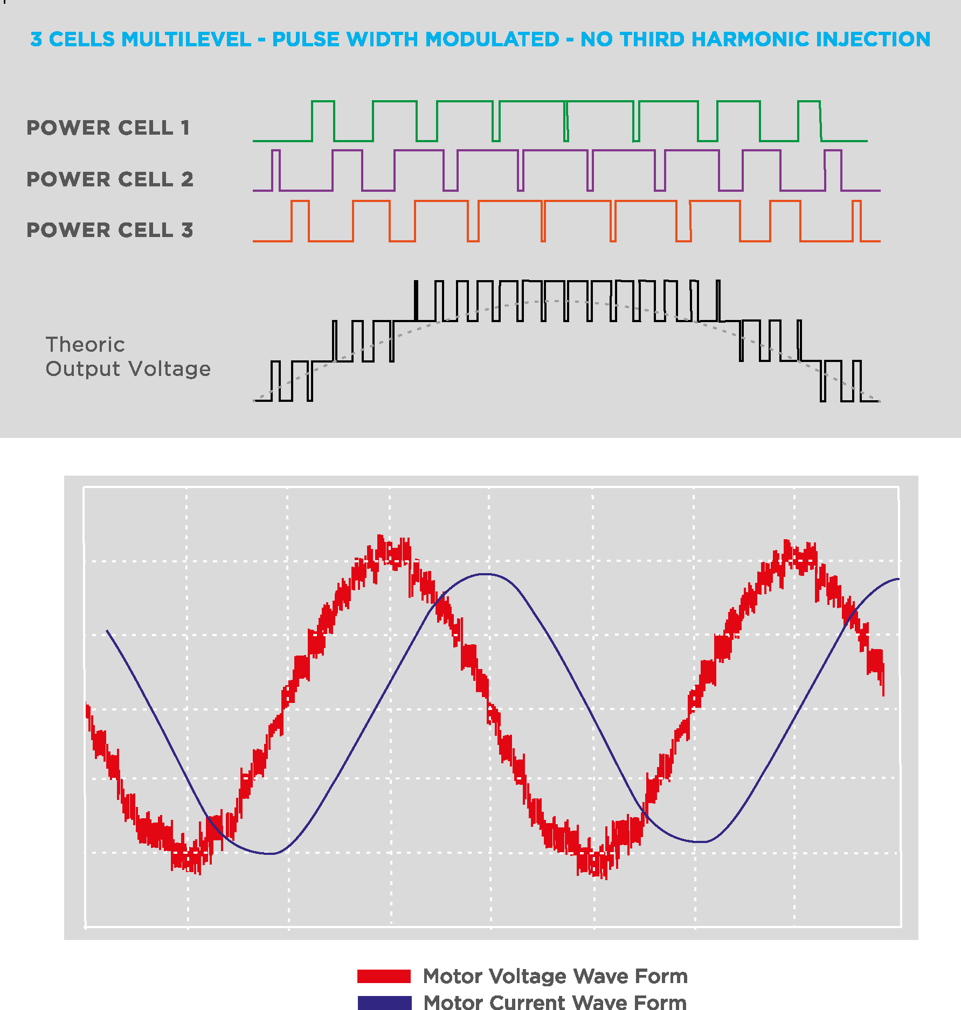
MAXIMUM MOTOR CARE

Slide 12
MAXIMUM MOTOR CARE
Quasi sinusoidal voltage and current output wave form therefore achieving a low dV/dt, low HVF and THDi.
Reduces the voltage peaks at the motor winding and the common mode voltage (CMV) on the motor stator. Therefore, XMV660 can be installed with new and existing motors with standard insulation and motor cables.
Negligible common mode currents (CMC) through motor bearings allow the use of standard bearings and lubrication.
Reduce motor losses and noise caused by non sinusoidal waveforms (high THDi).
There is no need to apply a power derating in medium voltage motors.
Reduce the induced vibrations and torque pulses on the motor shaft by implementing a multi-step pulse width modulation (PWM) with low voltage power cells.
Notes:
12

Slide 13
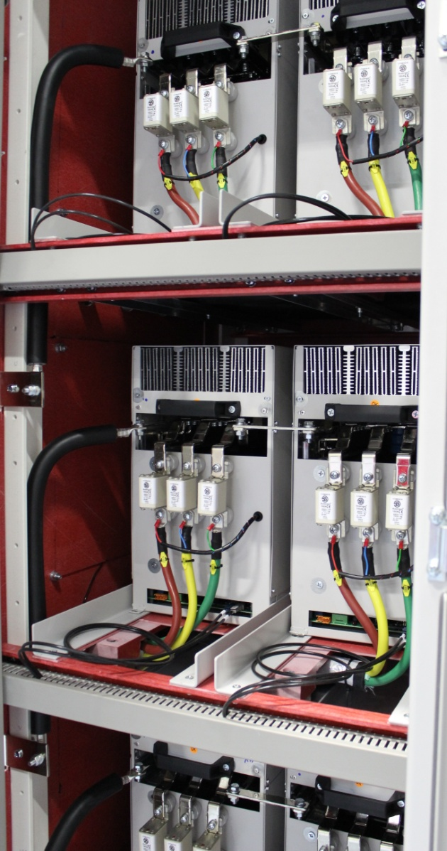
POWER CELL TOPOLOGIES
Low Input Harmonics THDi
High Input Power Factor
2Q operation
Regenerative drive 4Q operation
Low input harmonics THDi
Adjustable Input Power Factor
Regenerative – 4Q
Reduced transformer complexity
Reduced internal wiring
Cell fault unbalance the power transformer
Notes:
13

Slide 14
POWER QUALITY & EFFICIENCY
Compliance with the most stringent regulations regarding power quality (IEEE519) and electromagnetic compatibility (EMC 2004/108/EC).
An input phase shift transformer from 18 to 54 pulses reduces the THDi level, thus no costly and inefficient line harmonics filters are needed.
XMV660 RATED OUTPUT VOLTAGE | Nº POWER CELLS | Nº PULSES
2.3kV,3kV, 3.3kV | 9 | 18
4.16kV | 12 | 24
5kV,5.5kV | 15 | 30
6kV,6.6kV | 18 | 36
10kV,11kV | 27 | 54
Notes:
14

Slide 15
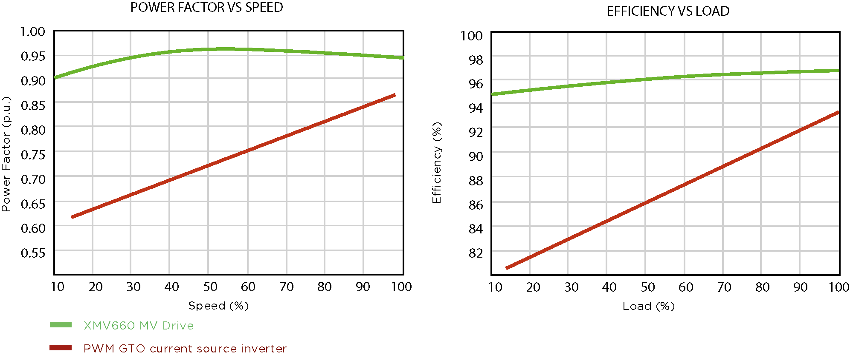
POWER QUALITY & EFFICIENCY
Outstanding Power Factor PF > 0.95 above 20% load, therefore no capacitor banks or active filters are needed.
High efficiency ƞ > 96 % above 40% load ( Including transformer)
Notes:
15

Slide 16
MAXIMUM RELIABILITY & AVAILABILITY
Proven Low Voltage Hardware:
IGBTs and DC bus capacitors
Power Board
Control Board
Delivered fully factory tested to ensure the best performance under any load condition.
Cooling redundancy and temperature monitoring (each cell and transformer) protects the drive against cooling fan clogging or failure, that can lead into drive’s overheating.
Standard Power Cells Sizes–100A, 200A, 300A, 400A, 600A, reduce worldwide spare part stocks
A fully controlled bypass in each cell and a centralized algorithm that permits the drive to keep running even when one or more cells fail, and at maximized output voltage.
Military and Aerospace conformal coating protects electronics boards
Notes:
16

Slide 17
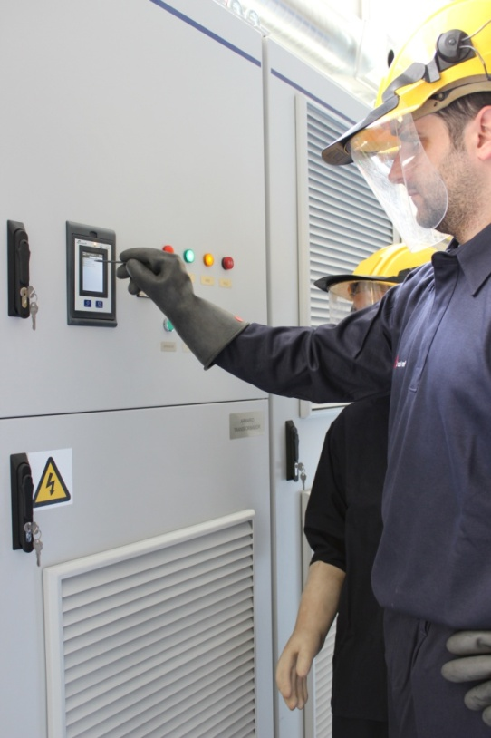
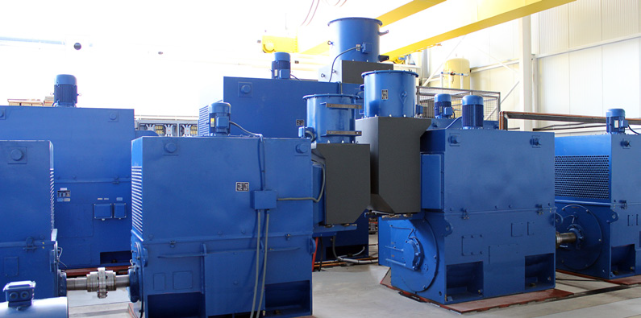
FACTORY TESTED & COMMISIONING
Low voltage test allow a safely fully functional performance test.
Factory tested at full current and optionally specific witness testing available.
Power Electronics personnel is present in every commissioning to get the most to your application.
Notes:
17

Slide 18
MAXIMUM RELIABILITY & AVAILABILITY
RATED CURRENT | RATED VOLTAGE | OVERLOAD (150%,1 min, cycle time 10 min)
100A | 700 Vdc | 150A
200A | 700 Vdc | 300A
300A | 700 Vdc | 450A
400A | 700 Vdc | 600A
600A | 700 Vdc | 900A
Under request | - | -
dV/dt < 1000V/ µs
Harmonic Voltage Factor < 0.019, No motor power derating needed according to MG1
All asynchronous and synchronous motor compatible
Forced air cooled
Operation temperature 0ºC ….50ºC. No power derating
Notes:
18

Slide 19
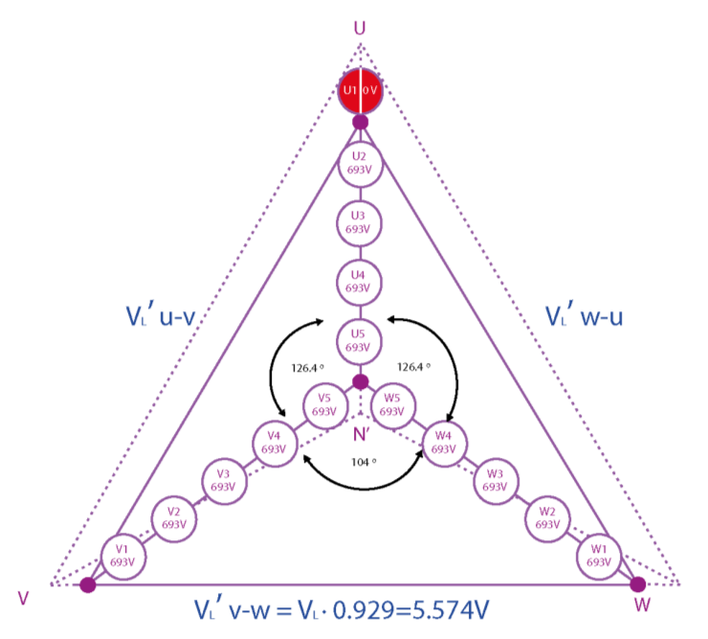
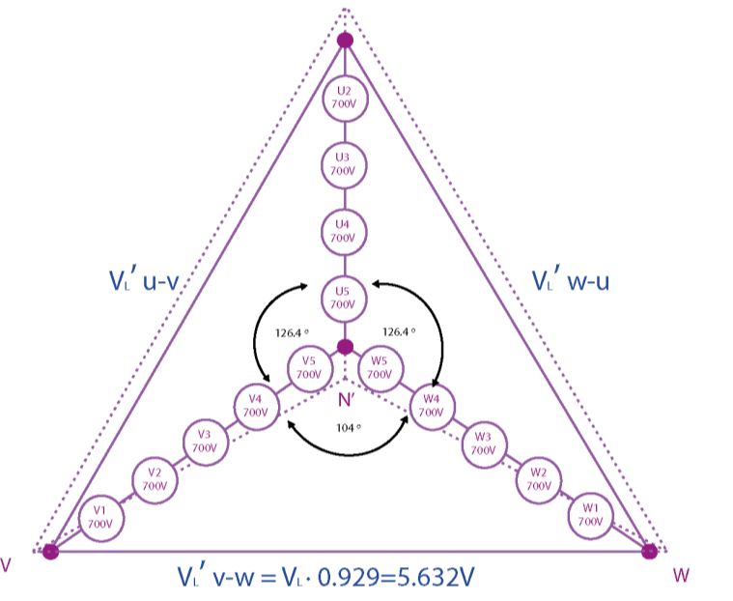
POWER CELL BYPASS
3465 V
x√3 = 6.000 Vac
693V
Cell Bypass
693V
6kV
693V
693V
3 ^{RD} Harmonic Injection
693V
30 pulses
Illustrative, measured values may vary depending on line-up and motor characteristics.
Notes:
19

Slide 20
POWER CELL BYPASS
Cell Bypass
3 ^{RD} Harmonic Injection
Illustrative, measured values may vary depending on line-up and motor characteristics.
Notes:
20

Slide 21
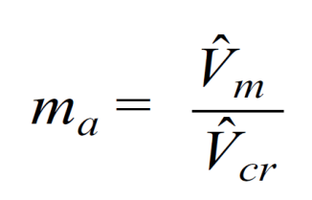
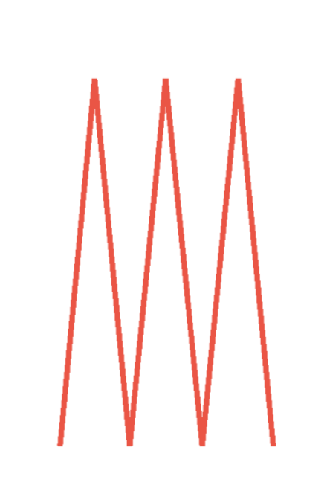
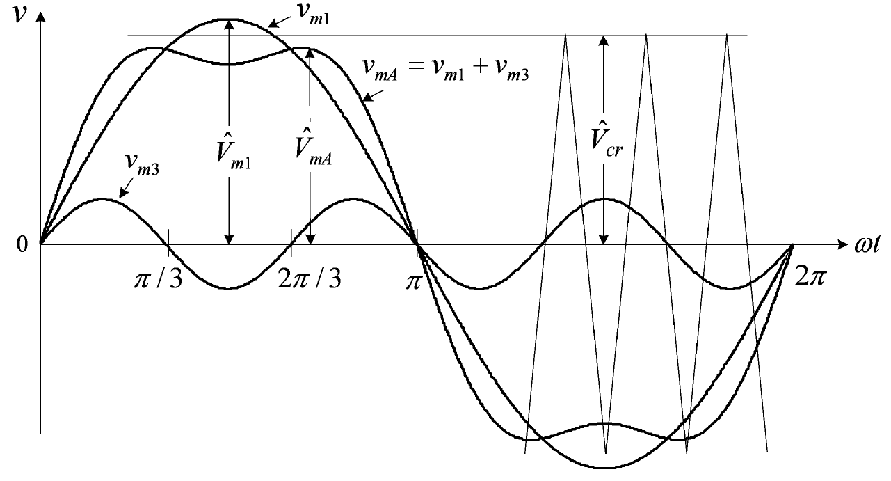
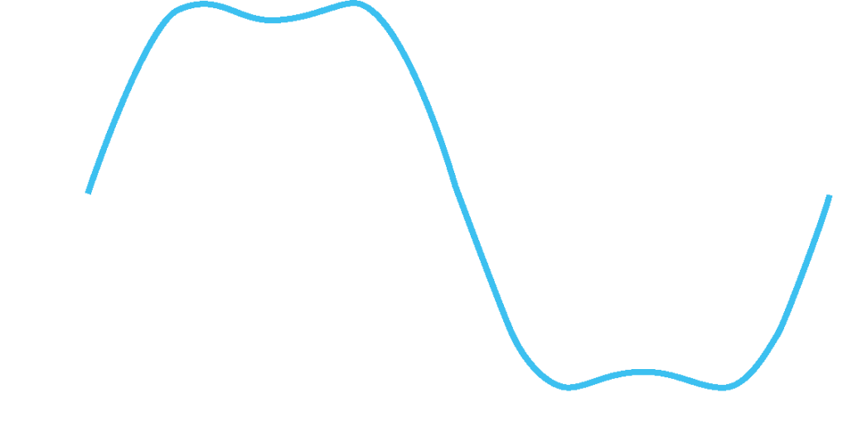
PULSE WIDTH MODULATION + 3RD HARMONIC INJECTION
Modulating waves
Carrier wave
>1 – Overmodulation
High THD
PWM wave
High Output Voltage
<= 1
Lower THD
Reduced Output Voltage
3 ^{RD} HARMONIC INJECTION
Lower THD
High Output Voltage
Modulating wave
Compensation of faulty cells voltage (15.5% boost)
Carrier wave
LCL Filter & SC
Notes:
21

Slide 22
POWER CELL BYPASS
6 Cells Configuration
AVAILABLE CELLS PER PHASE |  |  | XMV660 MAX. OUTPUT VOLTAGE | Voltage Reduction 6.6kV VSD (Standard Unit) | Voltage Reduction 5.5kV VSD (Cell Redundancy) | Redundancy
V_{U} | V_{V} | V_{W}
6 | 6 | 6 | 7.275 | OK | OK | N
6 | 6 | 5 | 6.849 | OK | OK | N+1
6 | 5 | 5 | 6.437 | - 2.47% | OK | N+2
6 | 6 | 4 | 6.385 | - 3.26% | OK | N+2
5 | 5 | 5 | 6.062 | -8.15% | OK | N+3
6 | 5 | 4 | 5.975 | -9.46% | OK | N+3
100 % Output current is always available
A motor operating at a lower voltage can still maintain torque and speed by increasing the VSD output current. This is done automatically by XMV660 control, under the protection’s supervision.
Illustrative, measured values may vary depending on line-up and motor characteristics.
Notes:
22

Slide 23
POWER CELL BYPASS
5 Cells Configuration
AVAILABLE CELLS PER PHASE |  |  | XMV660 MAX. OUTPUT VOLTAGE | Voltage Reduction 5.5kV VSD (Standard Unit) | Voltage Reduction 4.16kV VSD (Cell Redundancy) | Redundancy
V_{U} | V_{V} | V_{W}
5 | 5 | 5 | 6.062 | OK | OK | N
5 | 5 | 4 | 5.633 | OK | OK | N+1
5 | 4 | 4 | 5.217 | - -5.15% | OK | N+2
5 | 5 | 3 | 5.158 | - 6.23% | OK | N+2
4 | 4 | 4 | 4.850 | -11.82% | OK | N+3
4 | 4 | 3 | 4.414 | -19.74% | OK | N+4
4 Cells Configuration
AVAILABLE CELLS PER PHASE |  |  | XMV660 MAX. OUTPUT VOLTAGE | Voltage Reduction 4.16kV VSD (Standard Unit) | Voltage Reduction 3.3kV VSD (Cell Redundancy) | Redundancy
V_{U} | V_{V} | V_{W}
4 | 4 | 4 | 4.850 | OK | OK | N
4 | 4 | 3 | 4,414 | OK | OK | N+1
4 | 3 | 3 | 3990 | - 4.08% | OK | N+2
4 | 4 | 2 | 3.924 | - 5.68% | OK | N+2
4 | 3 | 2 | 3.470 | -16.59% | OK | N+3
3 | 3 | 2 | 3.192 | -23.26% | -3.26% | N+4
Illustrative, measured values may vary depending on line-up and motor characteristics.
Notes:
23

Slide 24
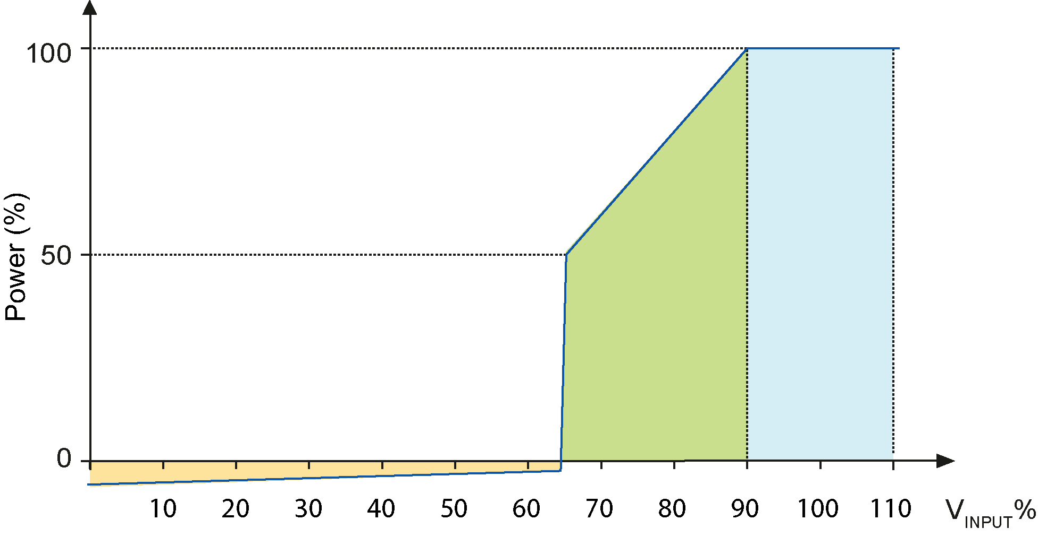
VOLTAGE RIDE THROUGH
Standard operation, maximum torque and overload available.
Power & Torque is reduced proportionally. The drive can work indefinitely in this mode because rated current is no overpassed.
XMV660 maintains synchronism with the motor and absorb power in order to maintain DC bus voltage. If DC voltage decrease below the limit, the VSD trips and stops the application. The number of cycles that XMV660 will remain connected depends on the load type.
Notes:
24

Slide 25
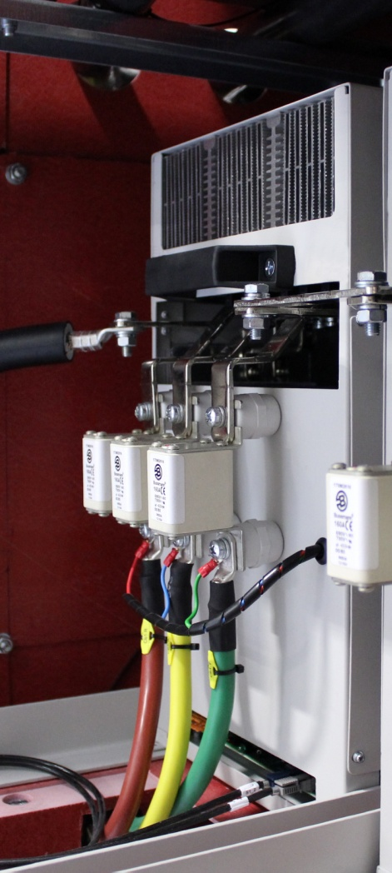
SAFETY AND PROTECTION
Built –in hardware and software protections reduce the associated risk of medium voltage facilities.
Input, output and each individual power cell monitoring protects your valuable rotating assets (pump, fan, conveyor, compressors…and drive) .
Each cell is protected by three fuses that provide overcurrent protection to the rectifier bridge.
Optionally it is available with a soft load system that magnetizes the transformer and charges each cell DC bus. This system limits the inrush current at the drive’s connection.
The optional input protection modules avoid the need for medium voltage protection switchgear.
Safety system, mechanical interlocks, restricted settings access with password and a warning buzzer will warn you of unexpected operation.
Notes:
25

Slide 26
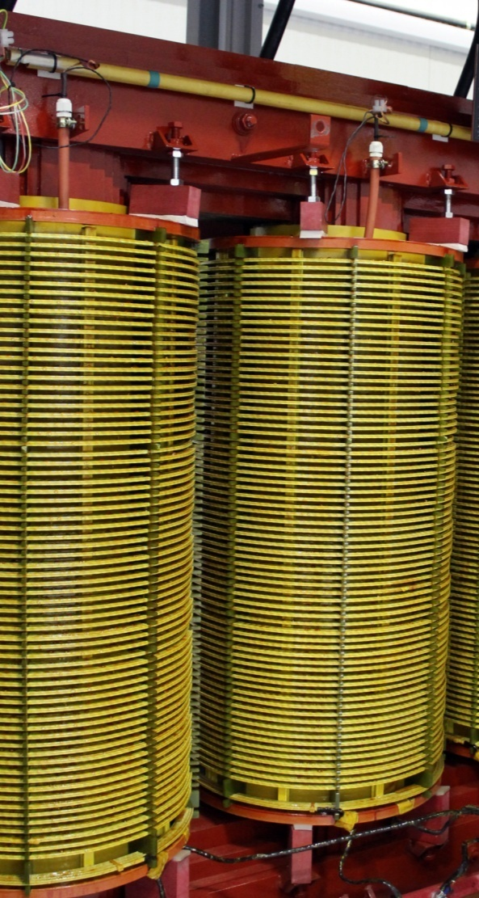
SAFETY AND PROTECTION | INPUT TRANSFORMER BENEFITS
An input phase-shift transformer offers a wide variety of benefits to your installation:
Protects power rectifier bridge semiconductors and withstands grid transitory anomalies.
Reduces the short circuit power and therefore the fault current in case of an unlikely internal isolation defect.
Compensates grid and drive voltage drops by using an on-site tap adjustment of the transformer. The motor will work under the rated voltage avoiding undesired motor oversizing and overheating.
A tailor made input transformer allows the user to order a different input and output voltage. Thus, there is no need to install further transformers or switchgear, and allows the user to work with different rated voltage equipment within the same facilities.
Notes:
26

Slide 27
SAFETY AND PROTECTION | PROTECTION LIST
MOTOR PROTECTIONS | DRIVE PROTECTIONS | POWER CELL PROTECTIONS
Rotor locked Torque limit Overload ( thermal model) Phase current unbalance Phase Voltage unbalance Overtemperature (PTC signals) Speed limit Stop time limit | Input phase loss High and Low input voltage Faulty cells limitation High and low input frequency Overcurrent limit High drive temperature Power supply fault Communication loss Analogue input signal loss (reference) Emergency stop | Overcurrent protection (fuses) High and low DC bus voltage DC bus voltage instability DC soft load time over passed Low input voltage Fiber optics communication failure Communication time out Power supply fault Gate drive fault High IGBt temperature High power cell temperature
Notes:
27

Slide 28
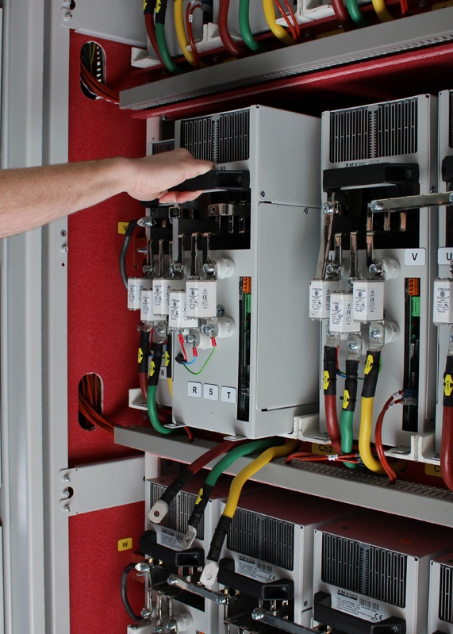
MAINTENANCE FRIENDLY
XMV660 is delivered with three adjoining or integrated cabinets: power transformer cabinet, power cells cabinet and control cabinet. All of them are designed to provide an easy front access that simplifies maintenance and supervision.
The transformer can be installed out of the plant room in order to reduce indoor heat loads.*
An accessible front connection together with built-in guide frame permits power cells to be manually changed by an operator with the aid of the delivered trolley.
* Consult availability
Notes:
28

Slide 29
ACCURATE AND POWERFUL CONTROL
PMC-OLTC is the unique master-slave motor control that allows the synchronization of multiple drives and motors without encoder. The result is a smooth, powerful and fast response with the least maintenance and supervision.
PMC factory settings and motor nameplate parameters ensure perfect performance without enabling the auto tuning function during commissioning. We have invested in new control methods to simplify settings. A fast and reliable commissioning saves time and money.
Start and Stop maximum control. Thanks to the MBC (Mechanical Brake Control), the Pre-Magnetization and Delay off IGBT, the loaded process will have a smooth start and stop.
Notes:
29

Slide 30
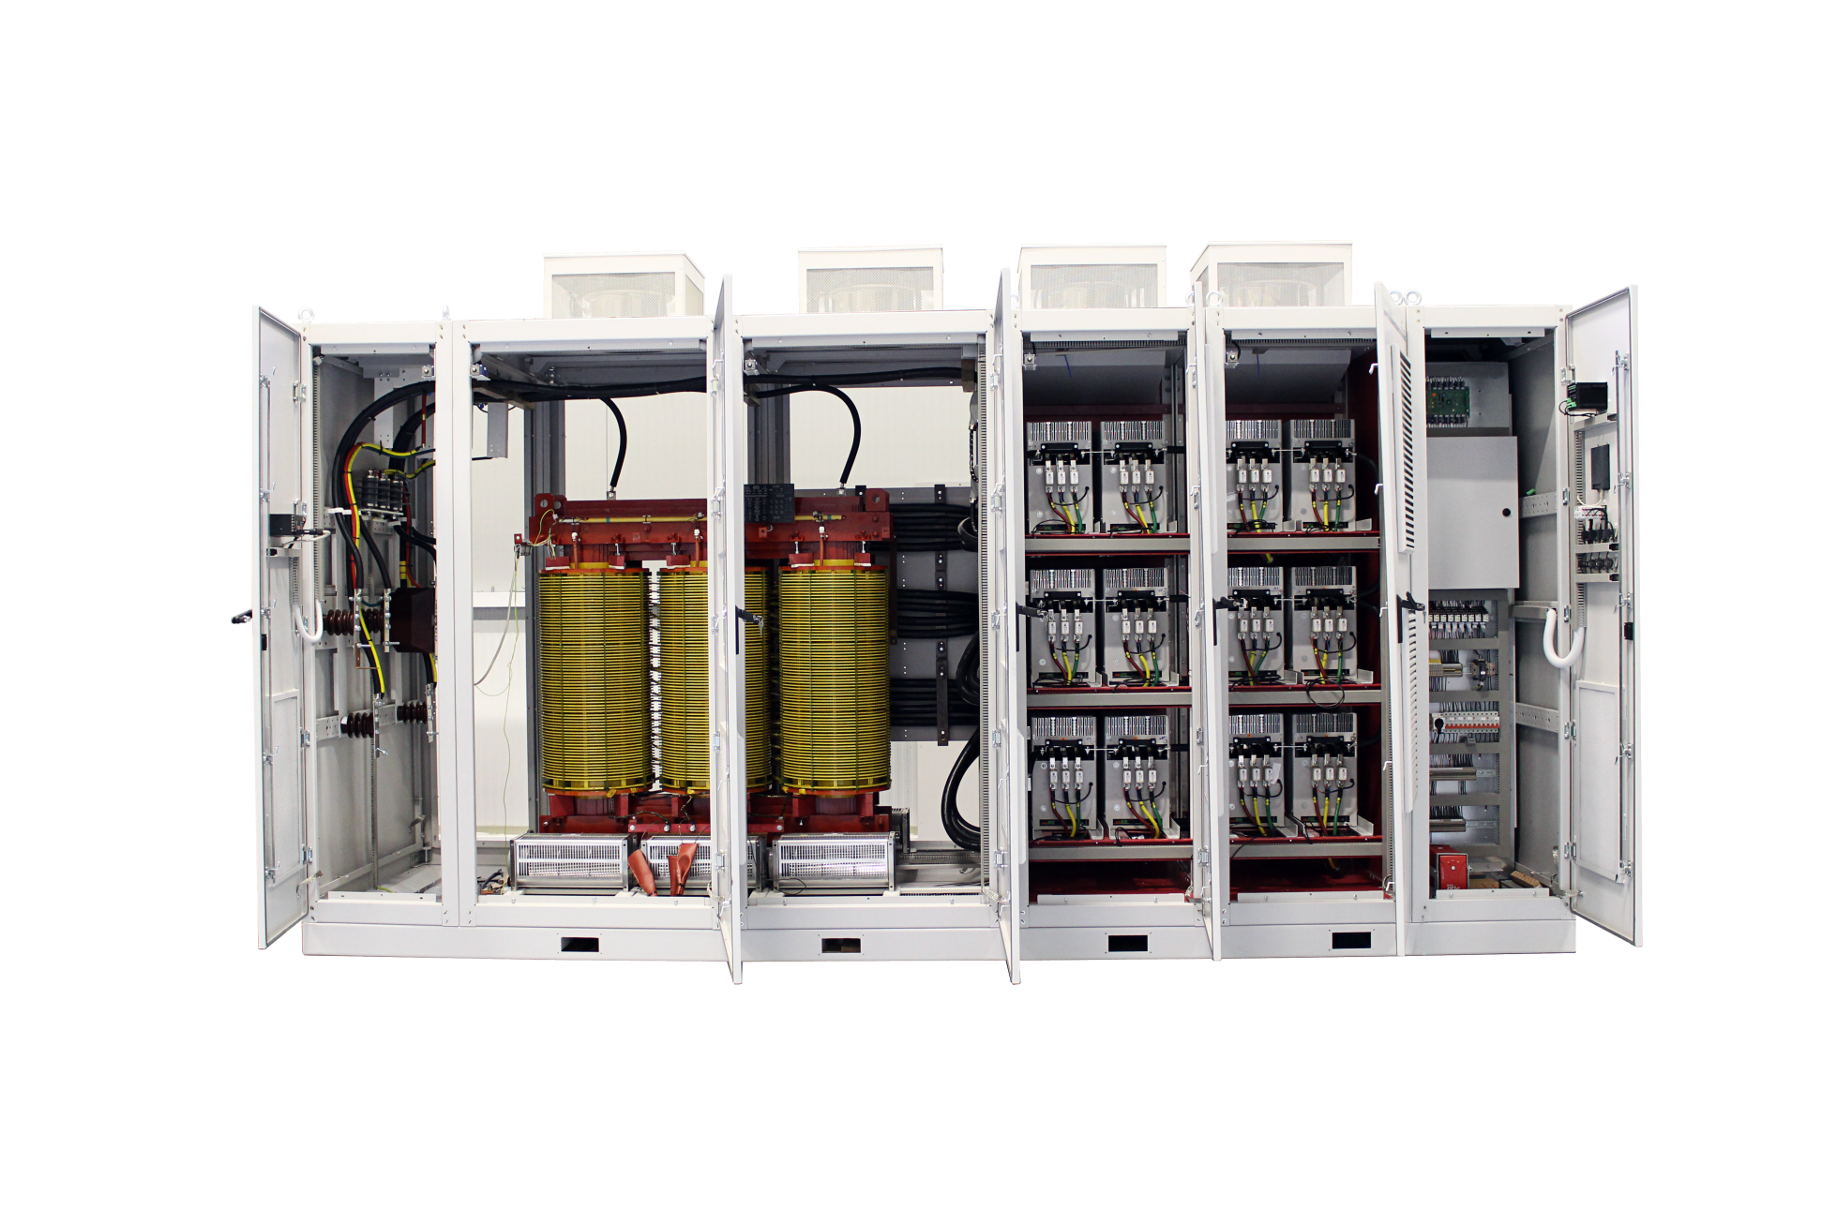
CUSTOMIZED SOLUTION
CABINET FEATURES
IP54 protection degree, stainless steel enclosure, specific RAL, tailor made labeling.
Incoming MV cable or busbar connection from top, right or backside.
Lined up VSDs with common main input bus bar and protection.
INPUT PROTECTION MODULE
VSD bypass with fully controlled line and bypass vacuum contactors
Automatic circuit breaker, fuses, withdrawable contactor, on-load disconnector with and without fuses.
Earthing switch
Motor protection relay
Commutation cells
CONTROL AND PUSHBUTTONS
Pushbottons, selectors and pilots.
Digital and analogue I/O preconfiguration
Customized user terminal strip
PTC and PT100 relays
Process and motor encoder boards.
Optional communication protocols (Profibus-DP, Dvicenet, Ethernet Modbus TCP, N2 Metasys, CAN Open…)
Power PLC dedicated applications
Notes:
30

Slide 31
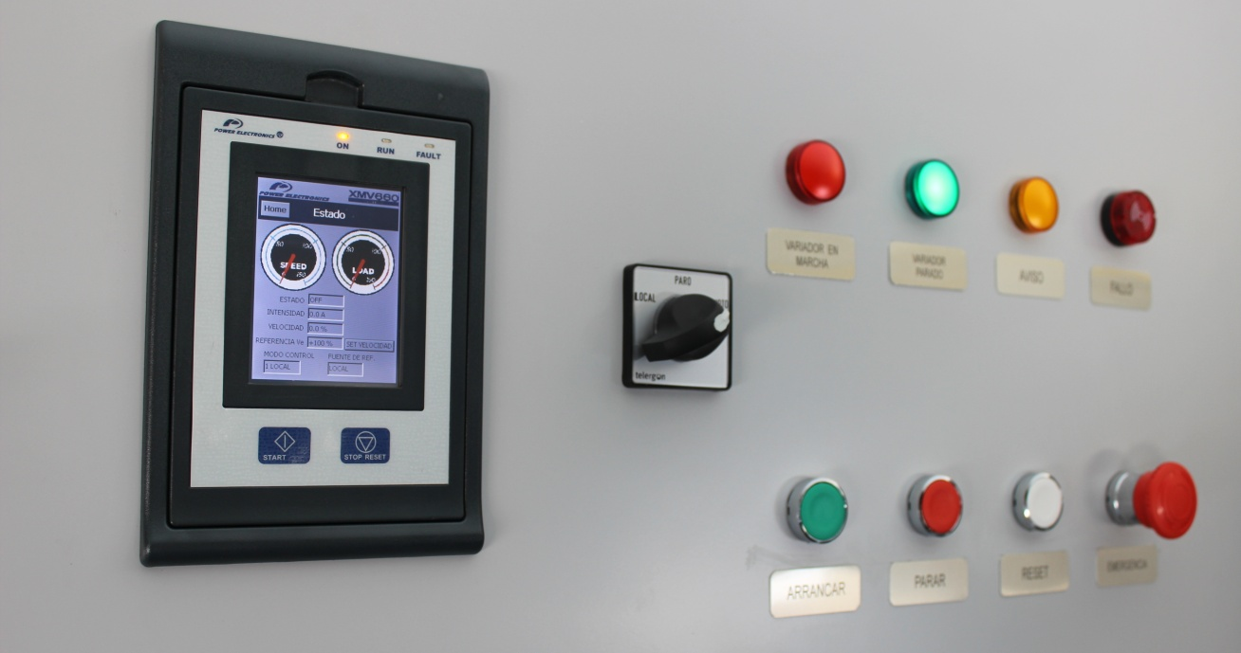
USER FRIENDLY INTERFACE
Red: Run
Green: Stop
Amber: Warning
Red (()): Fault
Emergency stop pushbutton
Green: Local start
Red: Local Stop
White: System reset
Colour touch-screen display 3.5” with integrated pen.
4Gbytes Micro SD for register and notification of faults, events and configurations.
Quad band GSM modem / Start, Stop, reset and remote consultations with SMS.
Ethernet RJ45 dual connection, micro-USB connection
Possibility of external or battery 5Vdc power supply
Control mode selector (local, remote, stop)
CUTOMIZED SOLUTONS AVAILABLE
Notes:
31

Slide 32
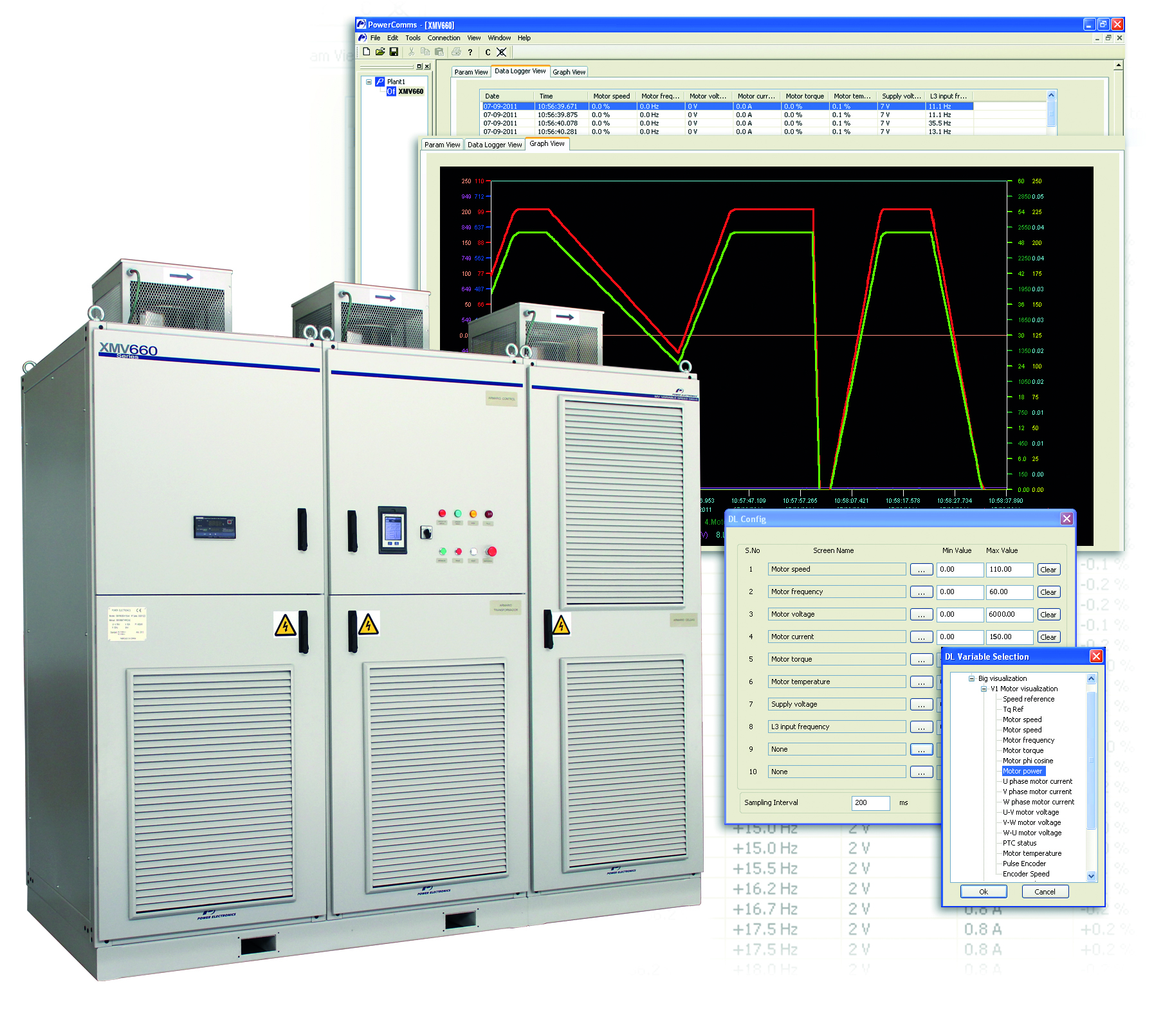
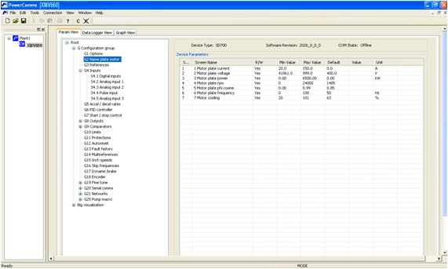
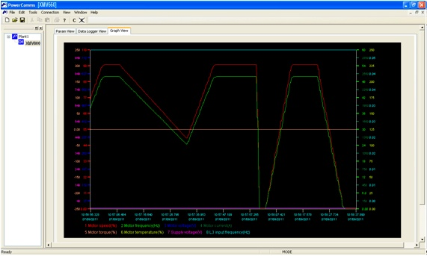
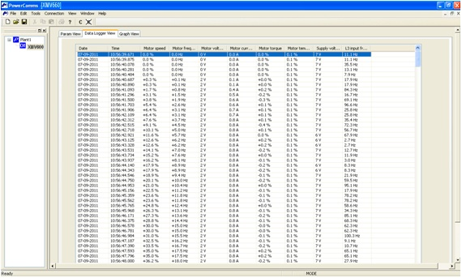
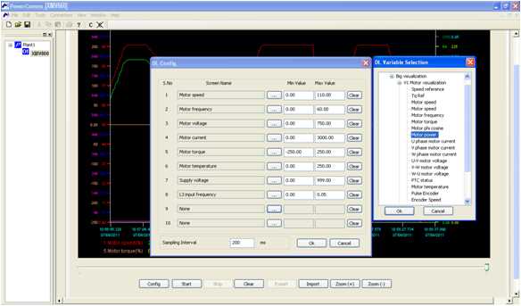
DEDICATED SOFTWARE TOOLS | POWERCOMS
Easy friendly remote configuration
Selectable Graphic representation
Electrical Values register - Datalogger
Analytical Process performance Studies & Data exportation
Notes:
32

Slide 33
ORDERING INFO
XMV66 | 100 |  | 030 |  | X |  | Y |  | Z |  | - |  | - |  | - |  | -
XMV66 SERIES | RATED OUTPUT CURRENT |  | RATED MOTOR VOLTAGE |  | OVERLOAD (%) |  | DEGREE OF PROTECTION |  | TOPOLOGY |  | WIRING ACCESS |  | SOFT LOAD |  | COOLING REDUNDANCY |  | RATED INPUT VOLTAGE^{[1]}
 | 100 | 100A | 023^{[1]} | 2.3kV (9 cells) | 1 | 110% Light duty | 4 | IP41 | A | Asynchronous Motor | - | Bottom input & output connection | - | Non included | - | Not included | - | Rated Motor Voltage
 | 200 | 200A | 030 | 3kV (9 cells) | 2 | 120% Normal Duty | 5 | IP54^{[1]} | S | Synchronous Motor | T | Top input and bottom output connection | C | Built-in low voltage soft-load system | V | Redundant cooling system | A | 2.3kV
 | 300 | 300A | 033 | 3.3kV (9 cells) | 5 | 150% Heavy Duty |  |  | R | 4Q Regenerative Asynchronous Motor, | U | Top input and output connection |  |  |  |  | B | 3kV
 | 400 | 400A | 416 | 4.16kV (12 cells) | - | Under request |  |  | W ^{[1]} | Synchronous Motor. 4Q |  |  |  |  |  |  | C | 3.3kV
 | 600 | 600A | 060 | 6kV (18 cells) |  |  |  |  | M | 4Q Regenerative Asynchronous Motor, monophase rectifier bridge |  |  |  |  |  |  | D | 4.16kV
 | ... | Under request | 066 | 6.6kV (18 cells) |  |  |  |  |  |  |  |  |  |  |  |  | E | 6kV
 |  |  | 100^{[1]} | 10kV (27 cells) |  |  |  |  |  |  |  |  |  |  |  |  | F | 6.6kV
 |  |  | 110^{[1]} | 11kV (27 cells) |  |  |  |  |  |  |  |  |  |  |  |  | G | 7.2kV
 |  |  |  |  |  |  |  |  |  |  |  |  |  |  |  |  | H | 10kV
 |  |  |  |  |  |  |  |  |  |  |  |  |  |  |  |  | I | 11kV
 |  |  |  |  |  |  |  |  |  |  |  |  |  |  |  |  | J | 12kV
 |  |  |  |  |  |  |  |  |  |  |  |  |  |  |  |  | … | Under request
[1] Consult availability with Power Electronics
Notes:
33

