Slide 1
CHAPTER 6
MV SOFT STARTER
VS65 SERIES
2013
Notes:
1

Slide 2
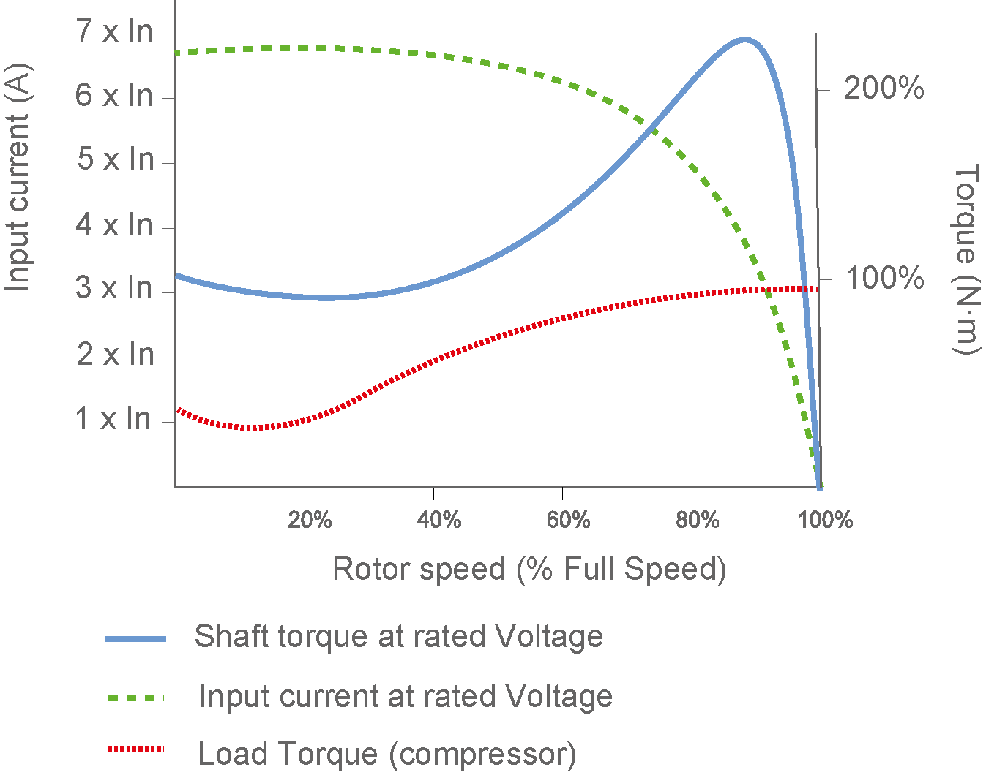
INDUCTION MOTORS
An induction motor performs two primary functions:
START - convert electrical energy into mechanical energy in order to overcome the inertia of the load and accelerate to full operating speed.
RUN - convert electrical energy into productive work output to a driven load.
Notes:
2

Slide 3
USEFUL FORMULAE
Motor synchronous speed
Efficiency
N_{s}: synchronous speed (rpm)
f. mains supply frequency (Hz)
P: number of stator pole pairs
Motor slip speed (%)
N_{slip}: percentage slip speed (%)
N_{s}: synchronous speed (rpm)
N_{r}: rotor speed (rpm)
Eff: motor efficiency (%)
Po: motor output power (kW)
Pi: motor input power (kW)
Motor shaft output power
P_{o}: output power (kW)
N_{r} : rotor shaft speed (rpm)
T_{r} : rotor torque (Nm)
Motor shaft output power
Pi: input power (kW)
V : motor line voltage (kV)
I: motor line current (A)
cosØ: motor power factor
Notes:
3

Slide 4
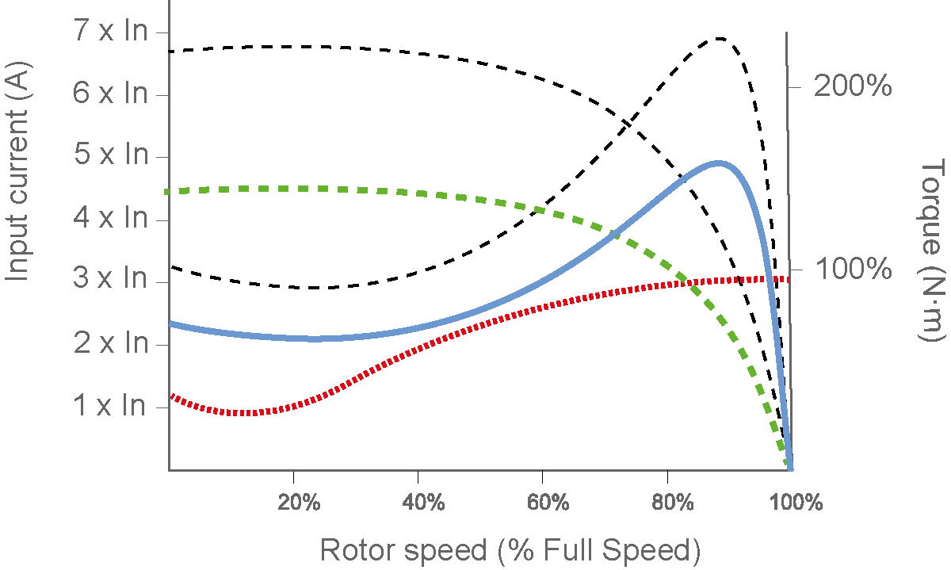
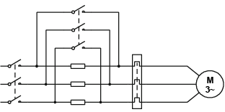
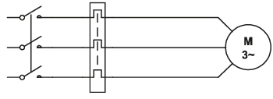
OUTDATED MOTOR STARTING METHODS
DIRECT ON LINE
PRIMARY RESISTANCE STARTING
Notes:
4

Slide 5
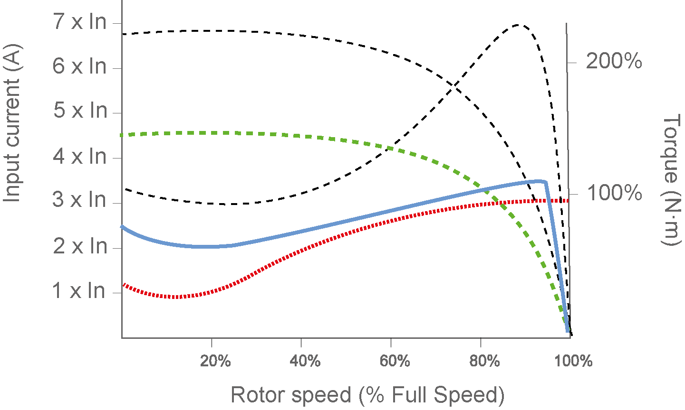
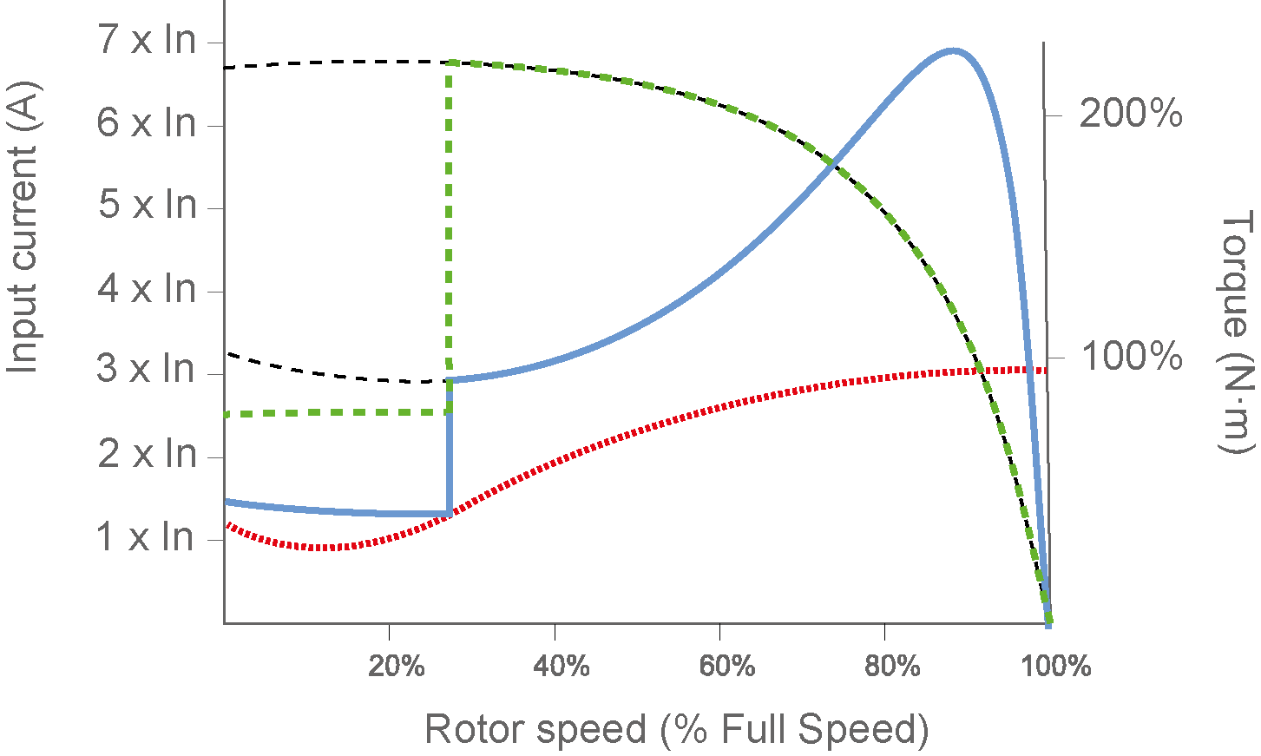
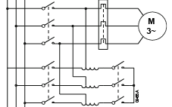
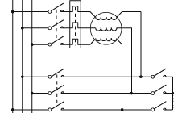
OUTDATED MOTOR STARTING METHODS
AUTO TRANSFORMER
START-DELTA STARTING
Notes:
5

Slide 6
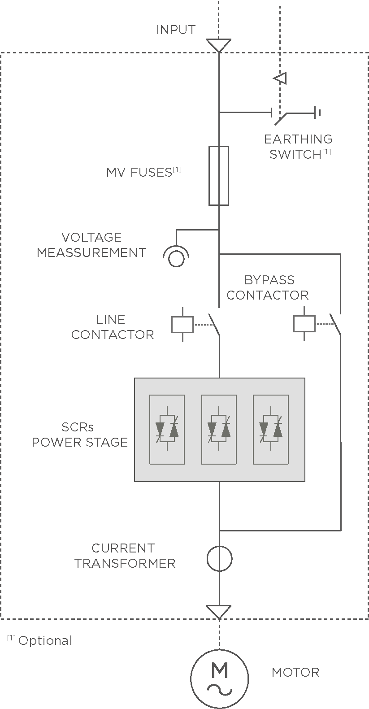
VS65 SOFT STARTER OPERATION PRINCIPLES
The soft starter controls the voltage or current supplied to the motor. Motor start and stop performance is optimised by reducing the total start current while optimising the torque produced by the motor.
Soft starters use SCRs (silicon controlled rectifiers, also called thyristors), arranged back-to-back for each controlled phase of the soft starter. This provides phase angle control of the voltage waveform in both directions.
Controlling the voltage controls the current supplied to the motor. The stepless control of motor terminal voltage eliminates the current and torque transients associated with electromechanical forms of reduced voltage starting, such as star-delta or autotransformer starters.

Slide 7
BENEFITS
ELECTRICAL BENEFITS | MECHANICAL BENEFITS | APPLICATION BENEFITS
Minimise start current to match the motor torque to the load torque. Eliminate inrush and transitory currents during motor starting and stopping. This avoids voltage dips that can affect the performance of other equipment. Reduce the size and cost of transformers, switchgear and cable. Lower current leads to lower voltage drops during start. Reduce maximum demanded peak power that increases the electricity bill. Full motor protection and safely disconnection. | Minimise break away torque to match application requirements, which reduces torque transients and mechanical stress. Smooth torque is applied to the load from the motor shaft. Reduce maintenance and production down-time. | PUMPING Reduce pipeline pressure surges (pipefilling) Eliminates water hammer damage. Full pump protection and failure detection Forward and reverse operation CONVEYORS Reduce belt slippage Reduce belt slap associated with long conveyor belts. Full motor protection (overload, temperature, ground fault,….)

Slide 8
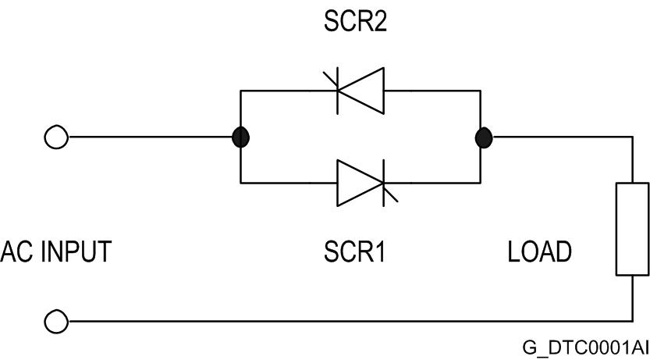
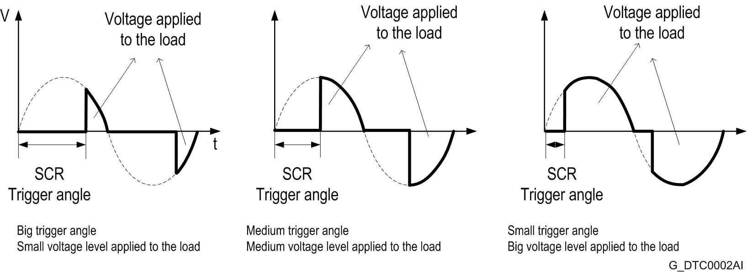
SOFT STARTER TOPOLOGY
Inverse parallel thyristor connection.
Effective voltage (rms) applied to the load.
8

Slide 9
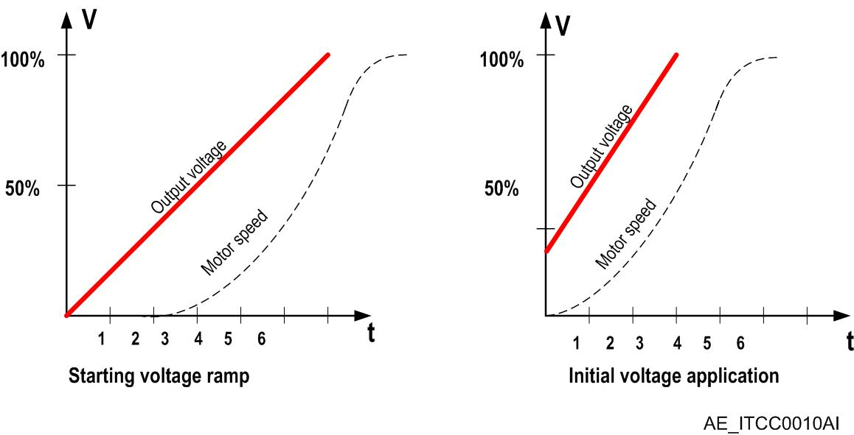
STARTING METHOD: VOLTAGE RAMP
The voltage ramp is a starting method in which the applied voltage to the motor is increased progressively:
  It does not exist power supply disconnection.
  The initial voltage level is adjustable.
  The time can be set.
  The motor stopping can be controlled too.

Slide 10
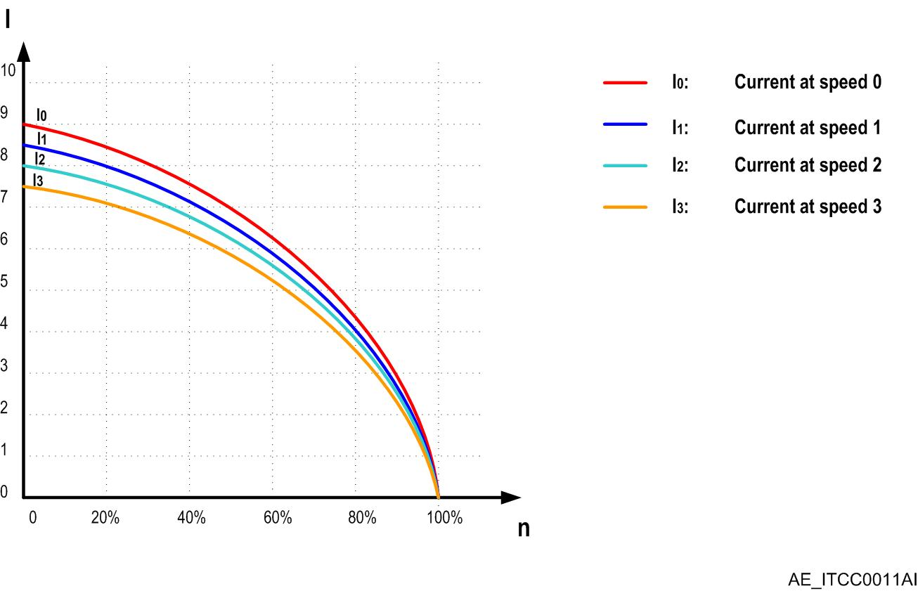
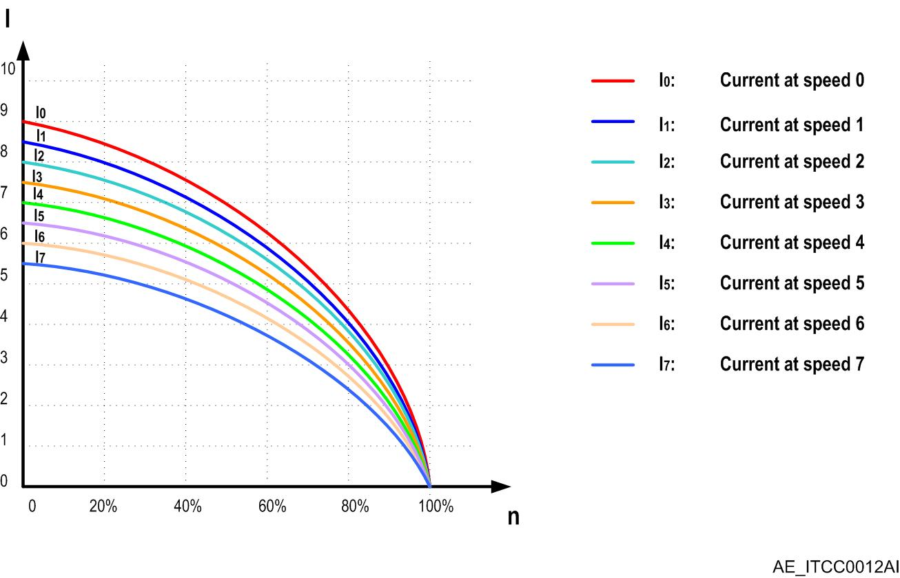
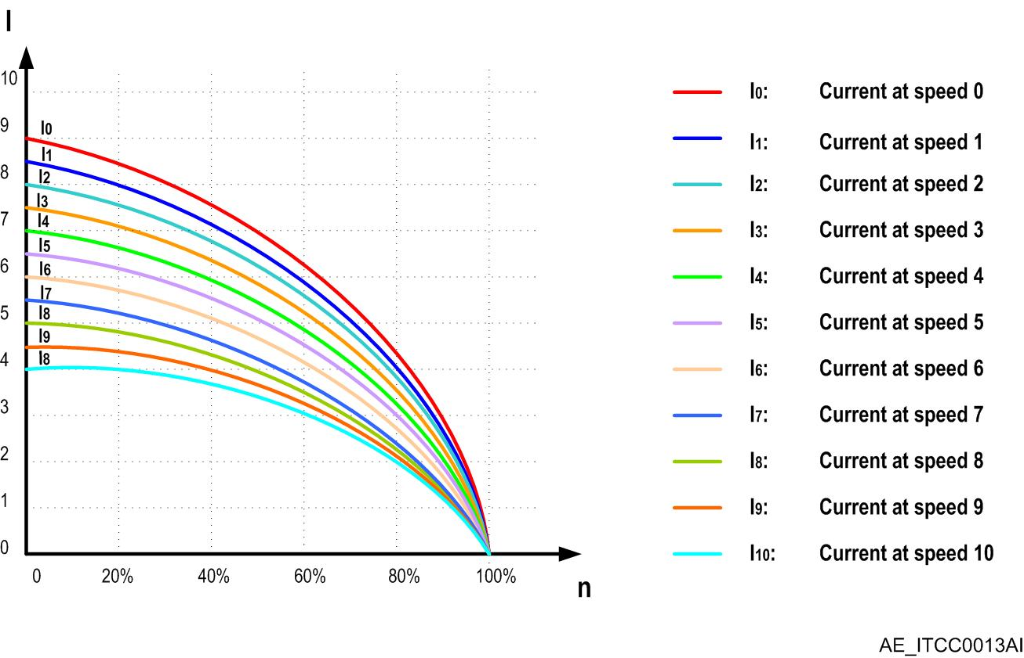
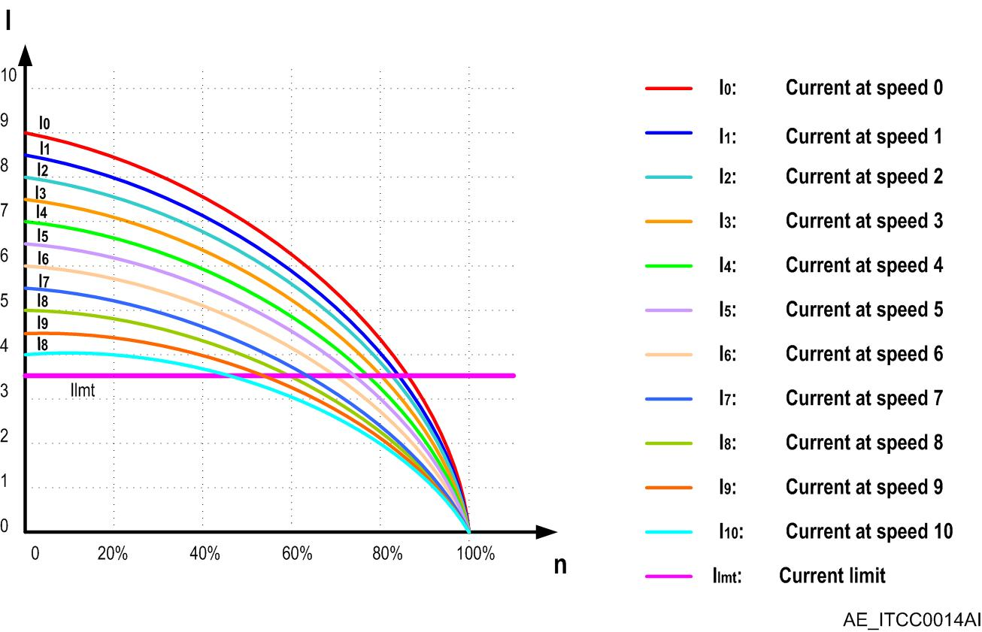
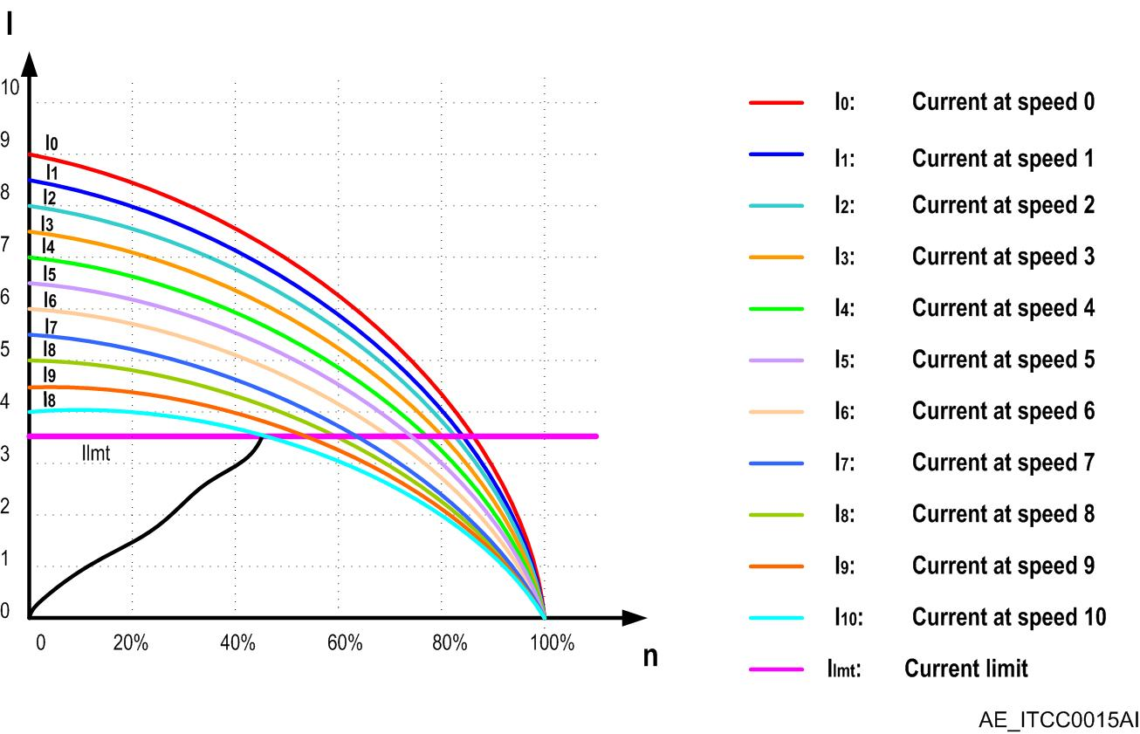

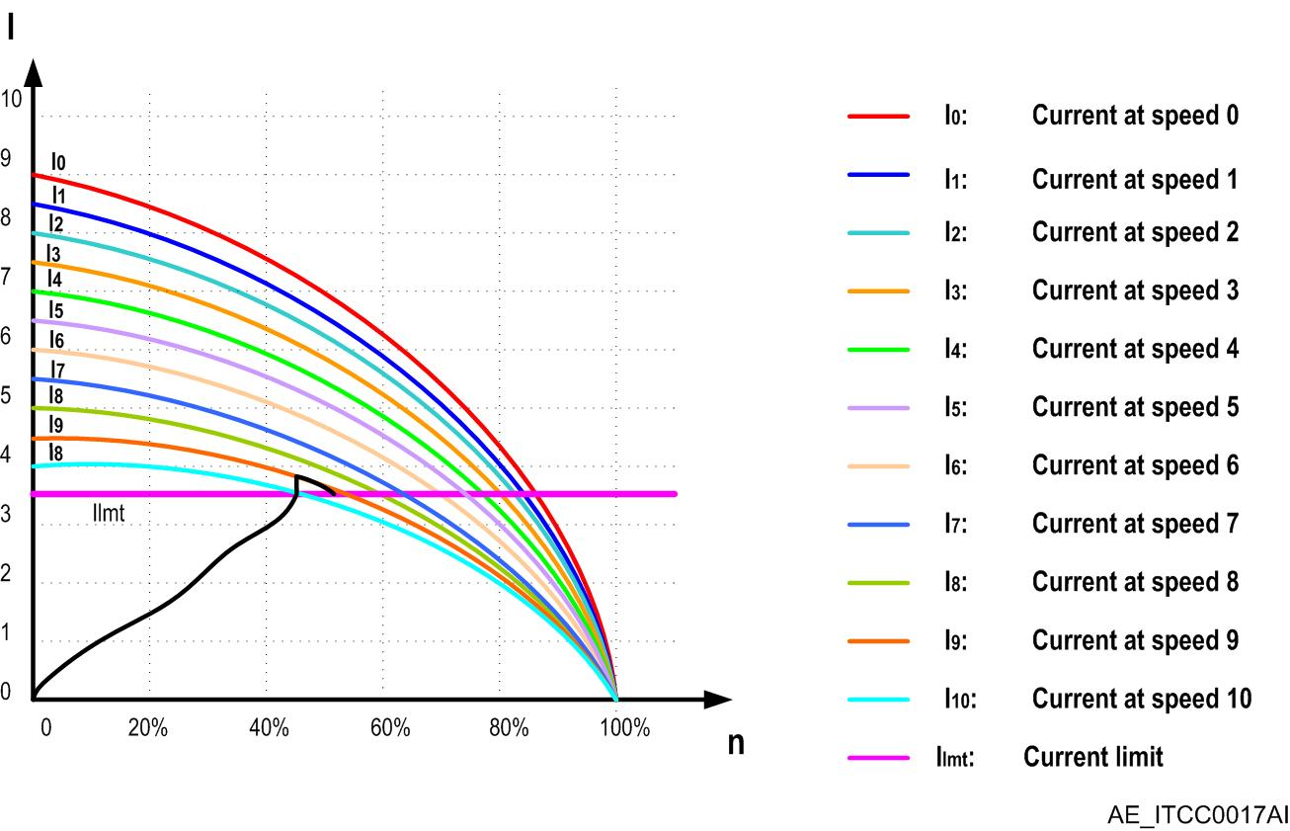





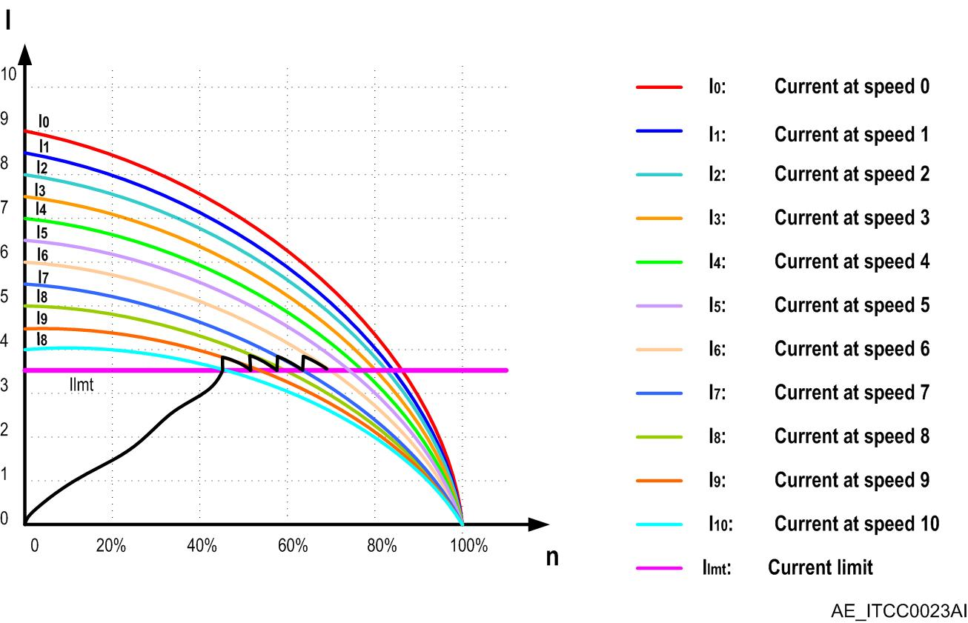

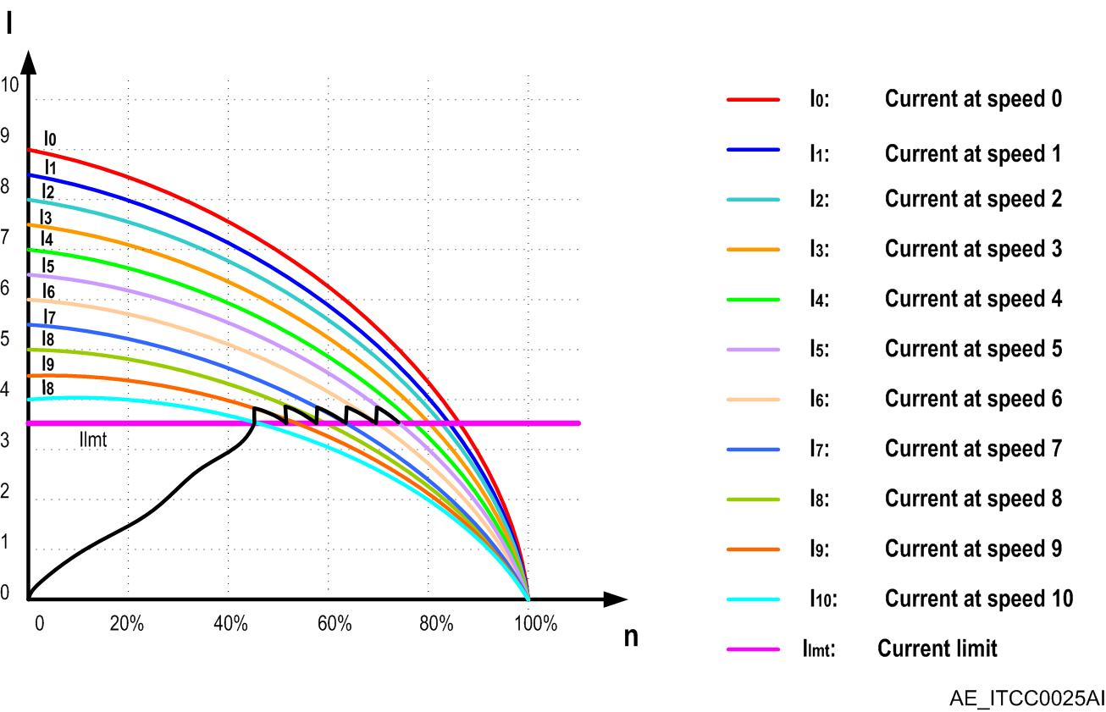

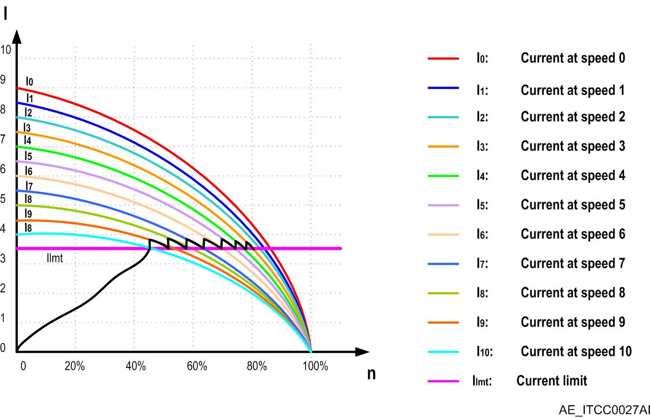



STARTING METHOD: CONSTANT CURRENT
Current is set to a fixed value depending on the specific application, for example (Is=3xIn).
  Upon start the current increases until reaching this value.
  At this point, control algorithm does not allow current to decrease.
  To achieve this the algorithm automatically increases the voltage, shifting from one curve to the next, maintaining current constant during start.

Slide 11
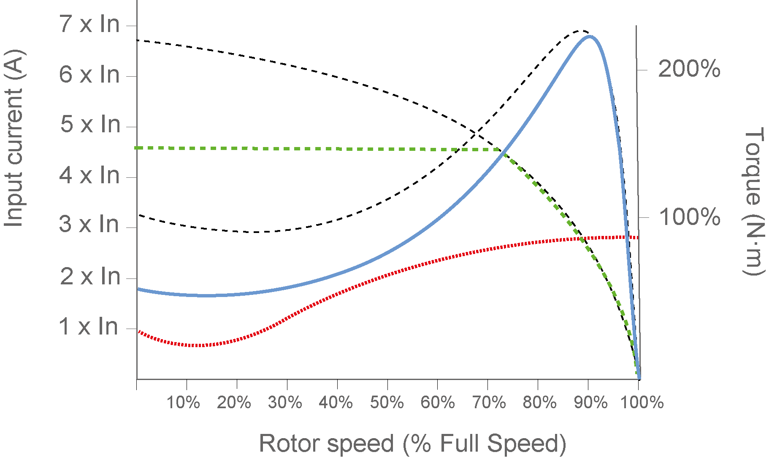

STARTING METHOD: CONSTANT CURRENT | ACCELERATION TORQUE
Input current at rated voltage
Torque at rated voltage
I _{MOTOR_LOCKED}
I_{MAX}
I _{START}
T _{MAX}
T _{MOTOR_LOCKED}
T _{START}
T _{LOAD}
Acceleration Torque
T _{LOAD_LOCKED}
T_{START}: Starting motor torque
T_{MAX} : Torque at rated voltage
I_{START}: Input start current limit
I_{MAX}: Input current at rated voltage
Notes:
11

Slide 12
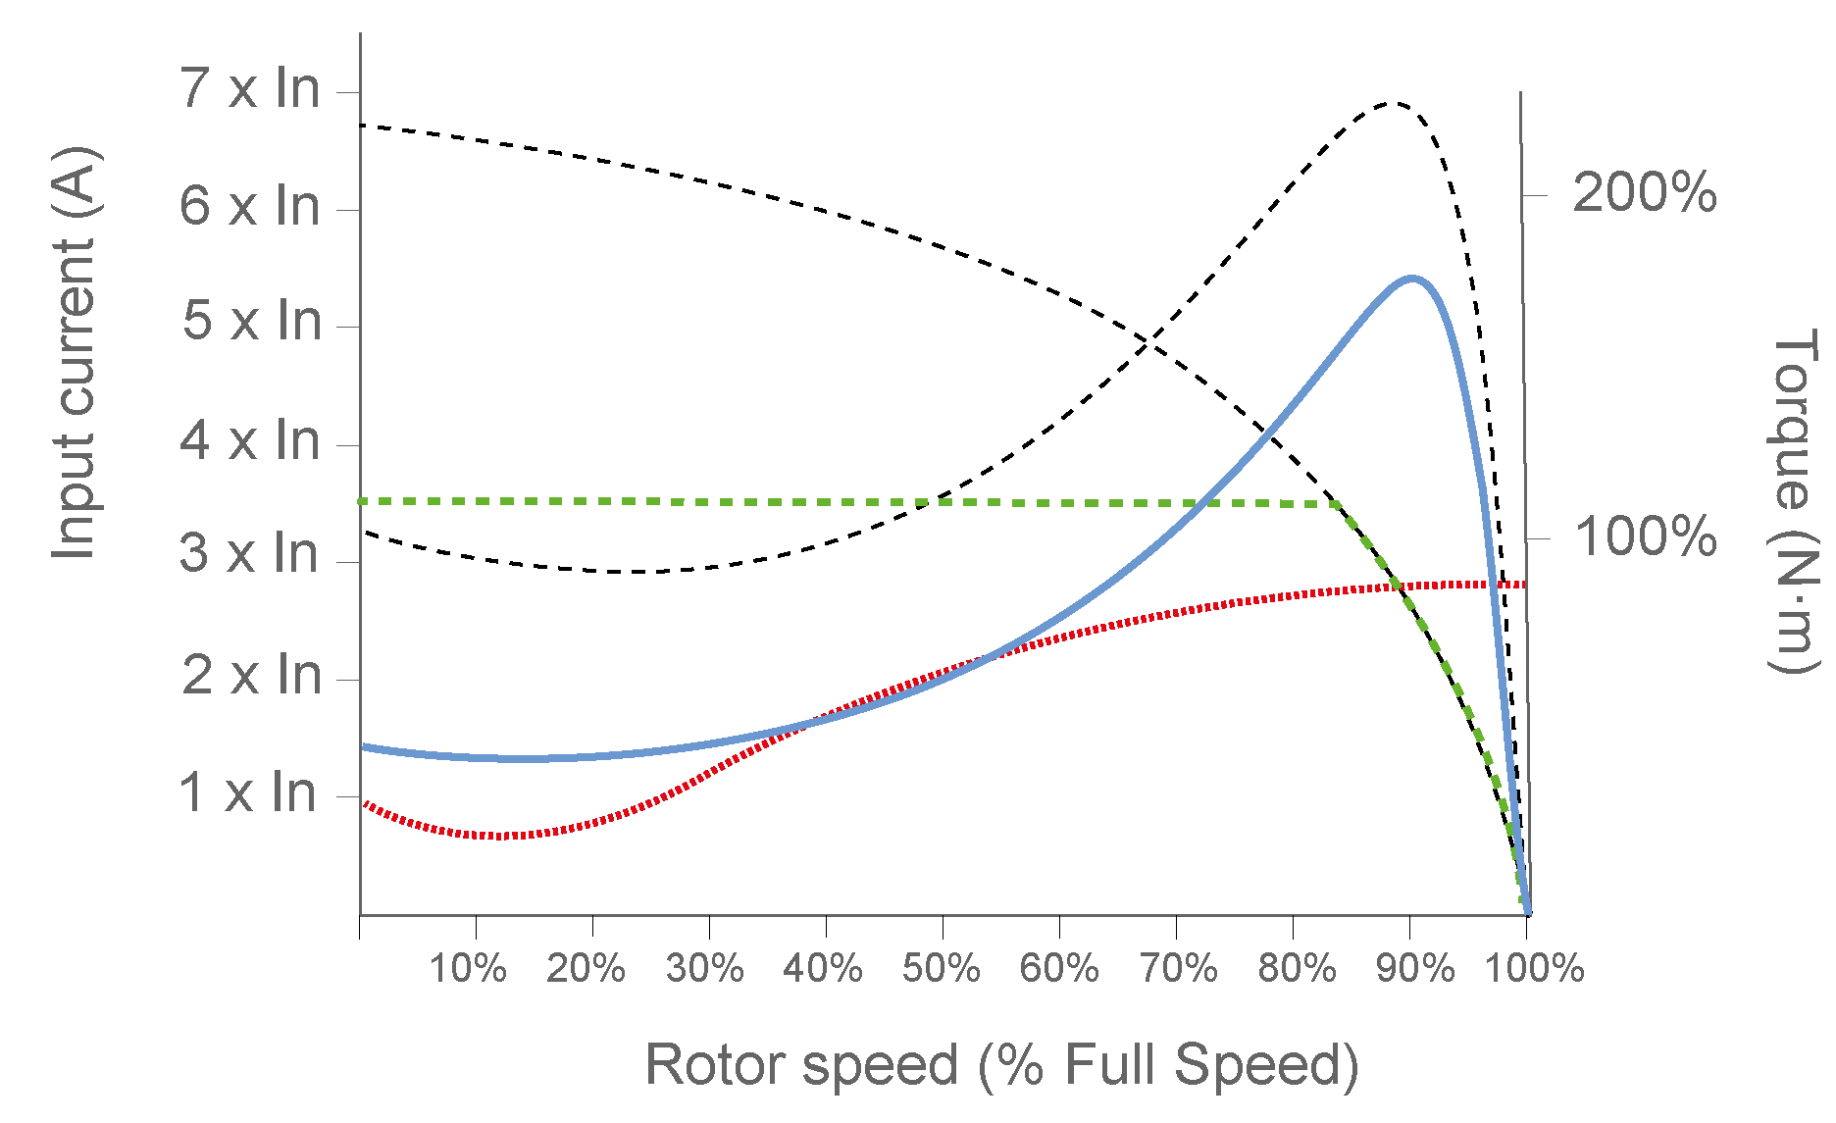


STARTING METHOD: CONSTANT CURRENT | MINIMUM START CURRENT
I _{MOTOR_LOCKED}
T_{MOTOR_LOCKED}
Stall
Acceleration Torque
T_{LOAD_LOCKED}
SUCCESFUL START
UNSUCCESFUL START
STARTING CURRENT ESTIMATION
I_{start:} Minimum required start current
I_{MOTOR_L:} Motor locked rotor current
T _{LOAD_L}: Minimum required start torque to accelerate machine from standstill
T _{MOTOR_L}: Motor locked rotor current
Notes:
12

Slide 13

STARTING METHOD: CONSTANT CURRENT | STARTING TIME
Input current at rated voltage
Torque at rated voltage
I_{MAX_1}
I_{MAX_2}
I _{START_1}
I _{START_2}
T _{MAX_1}
T _{MAX_2}
T _{START_2}
T _{START_1}
T _{LOAD_2}
T _{LOAD_1}
N₁
N₂
t_{acc}: Time to accelerate from one speed to another (seconds)
J_{T} : Total inertia of the motor rotor and load, coupled together (kg·m²).
Δn: Speed difference from N1 to N2 (rpm)
T_{ACC:} Acceleration torque is the difference between the developed motor torque and the required load torque as seen at the motor shaft.
Notes:
13

Slide 14
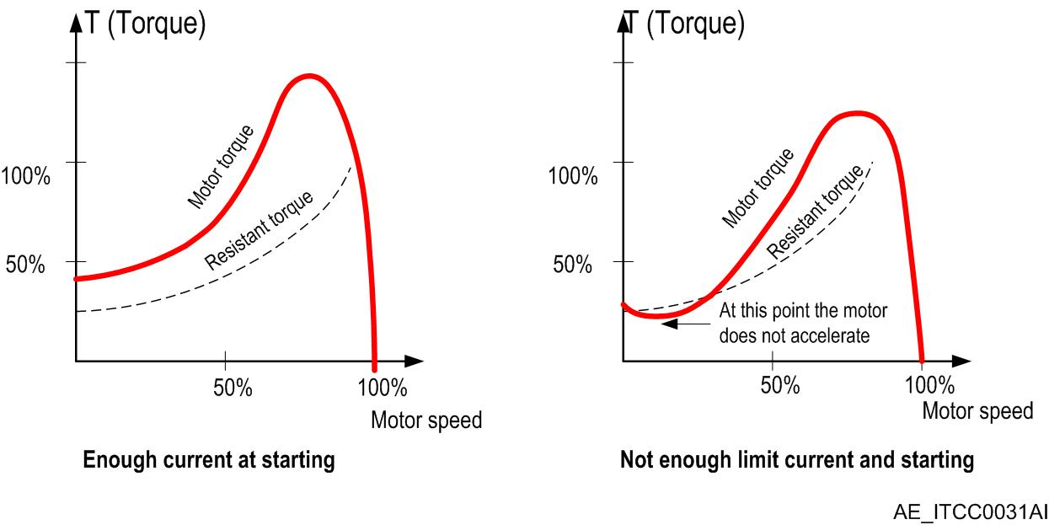
STARTING METHOD: CONSTANT CURRENT
Current is set to a fixed value depending on the specific application, for example (Is=3xIn).
  Upon start the current increases until reaching this value.
  At this point, control algorithm does not allow current to decrease.
  To achieve this the algorithm automatically increases the voltage, shifting from one curve to the next, maintaining current constant during start.

Slide 15
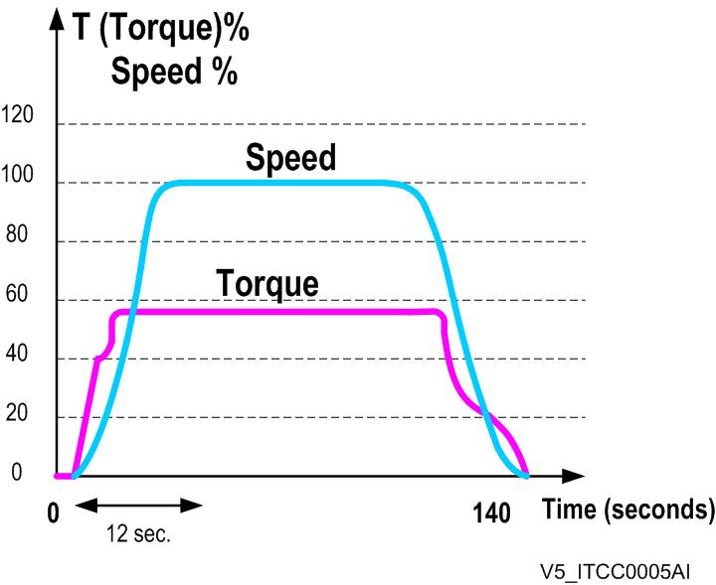
STARTING METHOD: DIRECT TORQUE CONTROL
DIRECT TORQUE CONTROL:
V5 series incorporates a “Dynamic Torque Control”, exclusive to Power Electronics. This ensures a soft and progressive start even in applications with a high moment of inertia. Using this control algorithm achieves linear acceleration and an optimization of peak currents during starting.

Slide 16
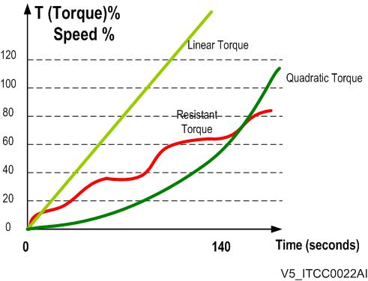
STARTING METHOD: DIRECT TORQUE CONTROL
DIRECT TORQUE CONTROL:
Torque automatically adjusts to suit any load type, not necessarily linear or quadratic, other types are suitable.
Torque automatically increases as the soft starter can detect when the motor is not accelerating.
If acceleration continues the soft starter will automatically maintain torque levels.
The soft starter can self-adjust ramp times to suit any torque/load profile.
In no situation will the soft starter provide more torque than is needed. This minimizes any energy loss during start.

Slide 17
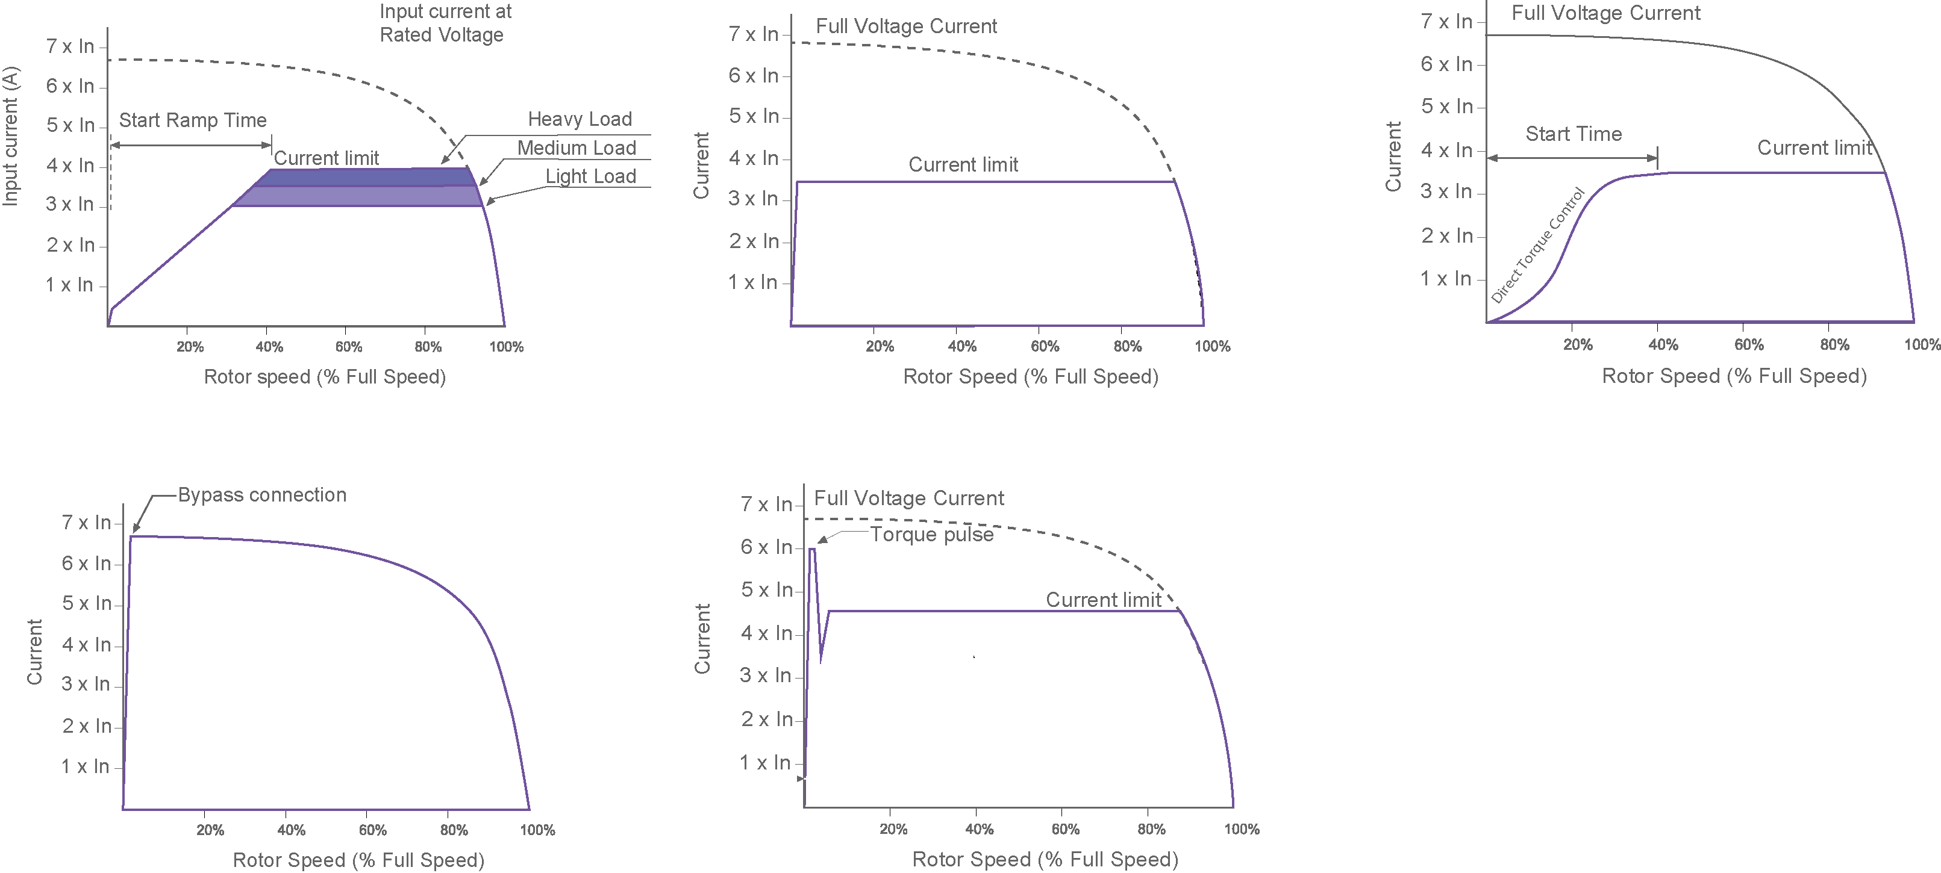
AVAILABLE STARTING SETTINGS
Voltage Ramp + Current limit
Current limit
Direct Torque Control
Direct on line
Rotor locked
GET THE MOST OF YOUR APPLICATION WITH THE DUAL SETTING FUNCTION
Notes:
17

Slide 18
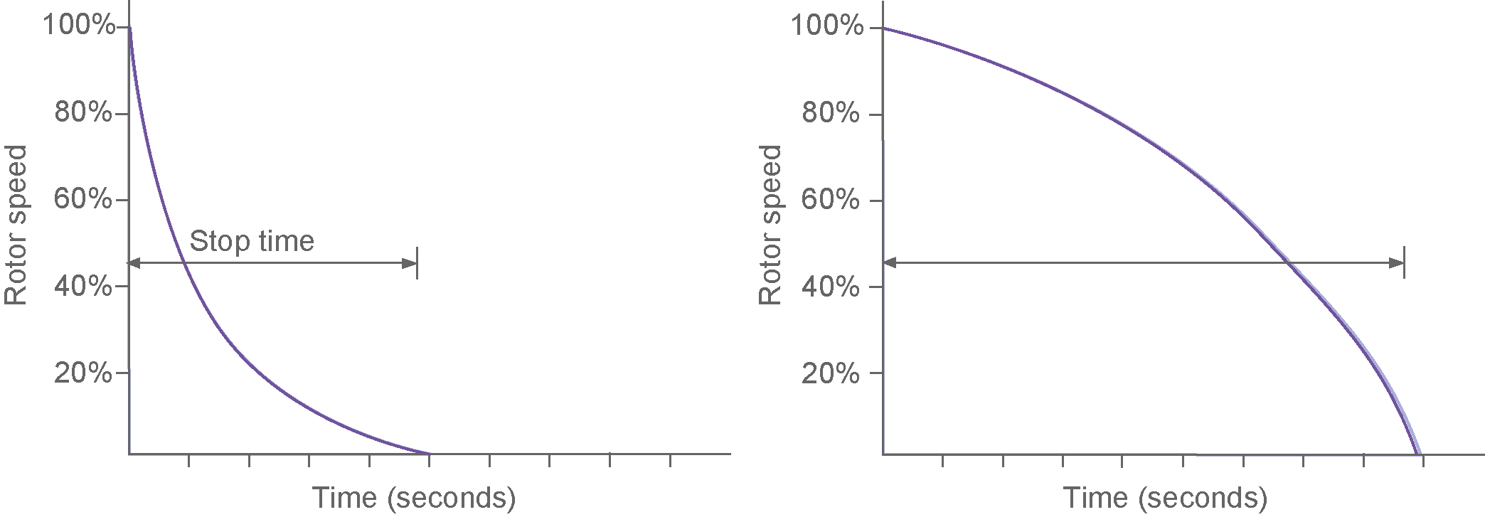
AVAILABLE STOPPING SETTINGS
Spin stop
(Freewheel stop)
Voltage ramp stop
( Water Hammer Control)
Notes:
18

Slide 19
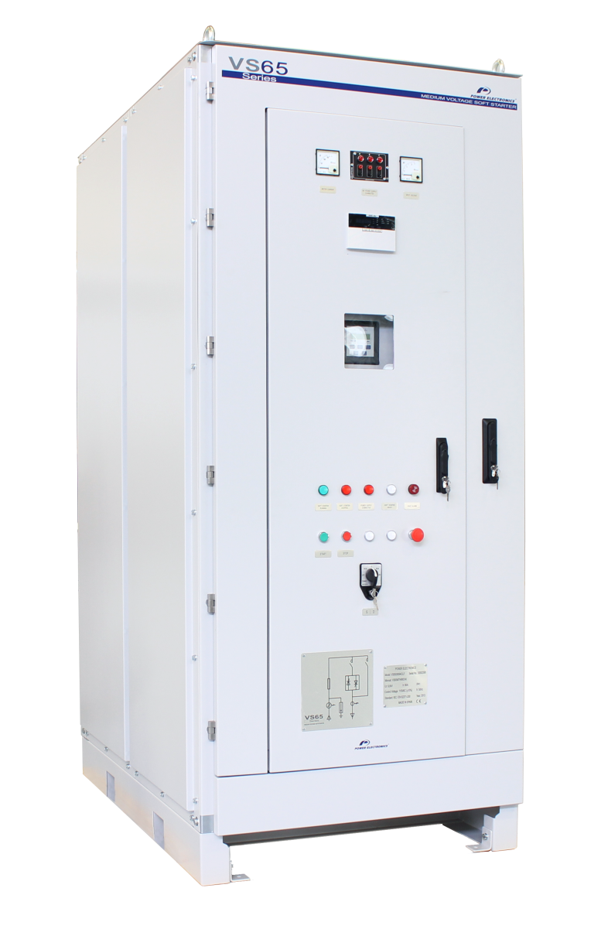








MEDIUM VOLTAGE VS65 SOFT STARTER
Power range from 150kW to 6.300kW
Voltage ratings 2,3kVac – 11,0kVac
Highest operator Safety
Built-in motor protection functionalities
Outstanding rugged and reliable design
Highest break away torque
Easy operation and intuitive control
Fully customizable to your stringent requirements
Notes:
19

Slide 20
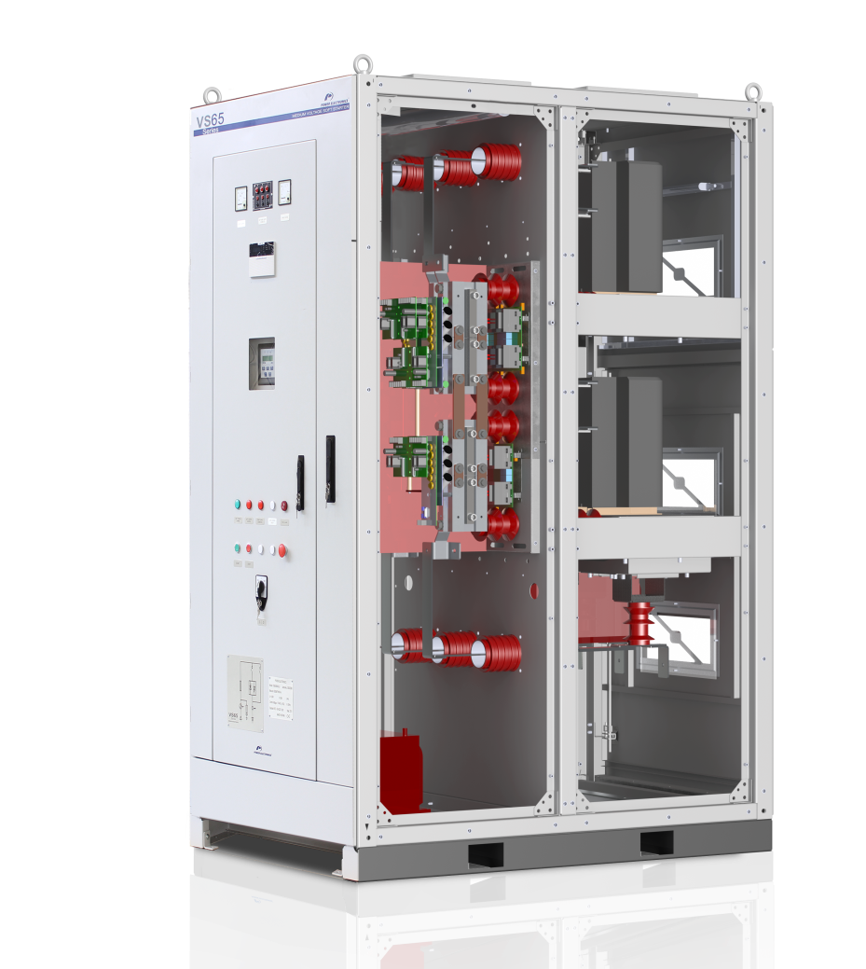
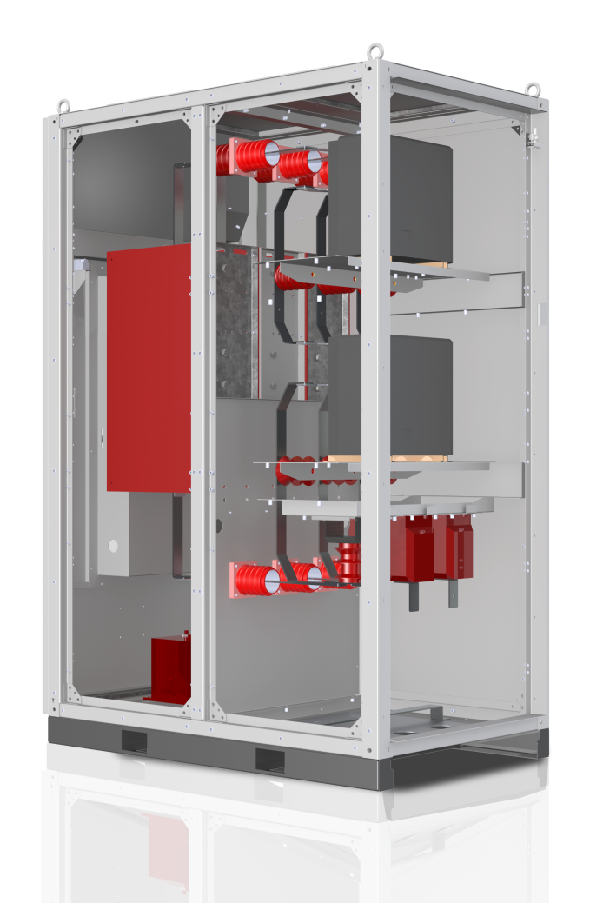
VS65 TOPOLOGY
SCR SECTION
CONTACTOR SECTION
EXPLOSION RELEASE DUCTS
LINE VACUUM CONTACTOR
TRIGGERING CIRCUIT
INPUT
BUSBARS
USER INTERCONNECTION AND INTERFACE
BYPASS VACUUM CONTACTOR
SCR STACKS
MV TRANSFORMER FOR AUX. POWER SUPPLY
OUTPUT BUSBARS
Notes:
20

Slide 21
MAXIMUM OPERATOR SAFETY
Independent sections isolate terminal strip and interface, from medium voltage equipment.
Mechanical or electrical interlock that avoid unexpected door opening or reconnections.
Optional input earthing switch that connects to ground each phase avoiding unexpected reconnections during maintenance task.
Explosion proof cabinet resistant to internal shortcircuit. The energy generated is released through a dedicated duct on the top, therefore avoiding any personal injury.
High BIL rating for safety and reliability in applications at high altitude. Clearance and creapage distances oversizing offers maximum safety against corona discharge effect on isolated conductors and dust build-up.

Slide 22
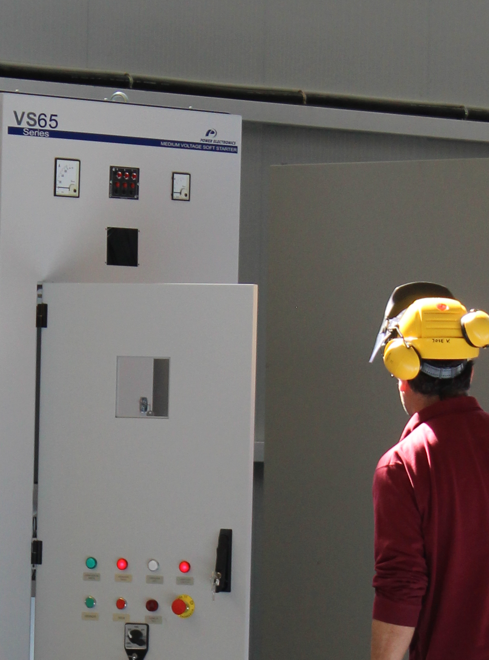
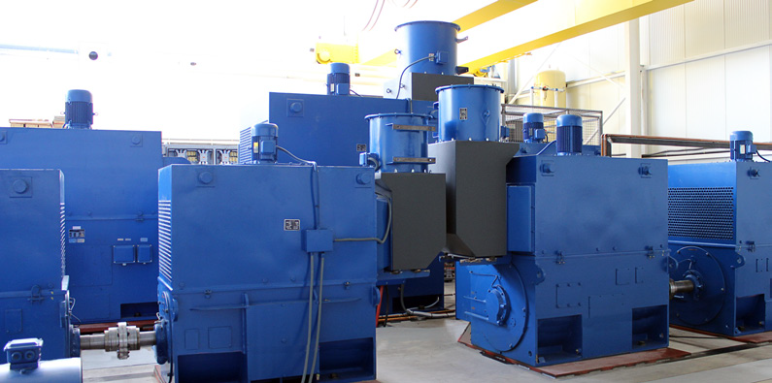
FACTORY TESTED & COMMISIONING
Low voltage test allow a safely fully functional performance test including: plant control integration, enabling bypass and line contactors, I/O settings and thyristor firing
Factory tested at full current and MV test and optionally specific witness testing available.
Power Electronics personnel is present in every commissioning to get the most to your application.
Notes:
22

Slide 23
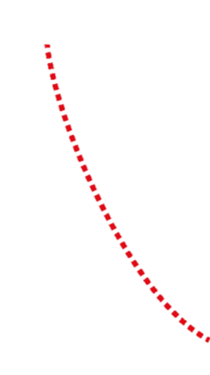

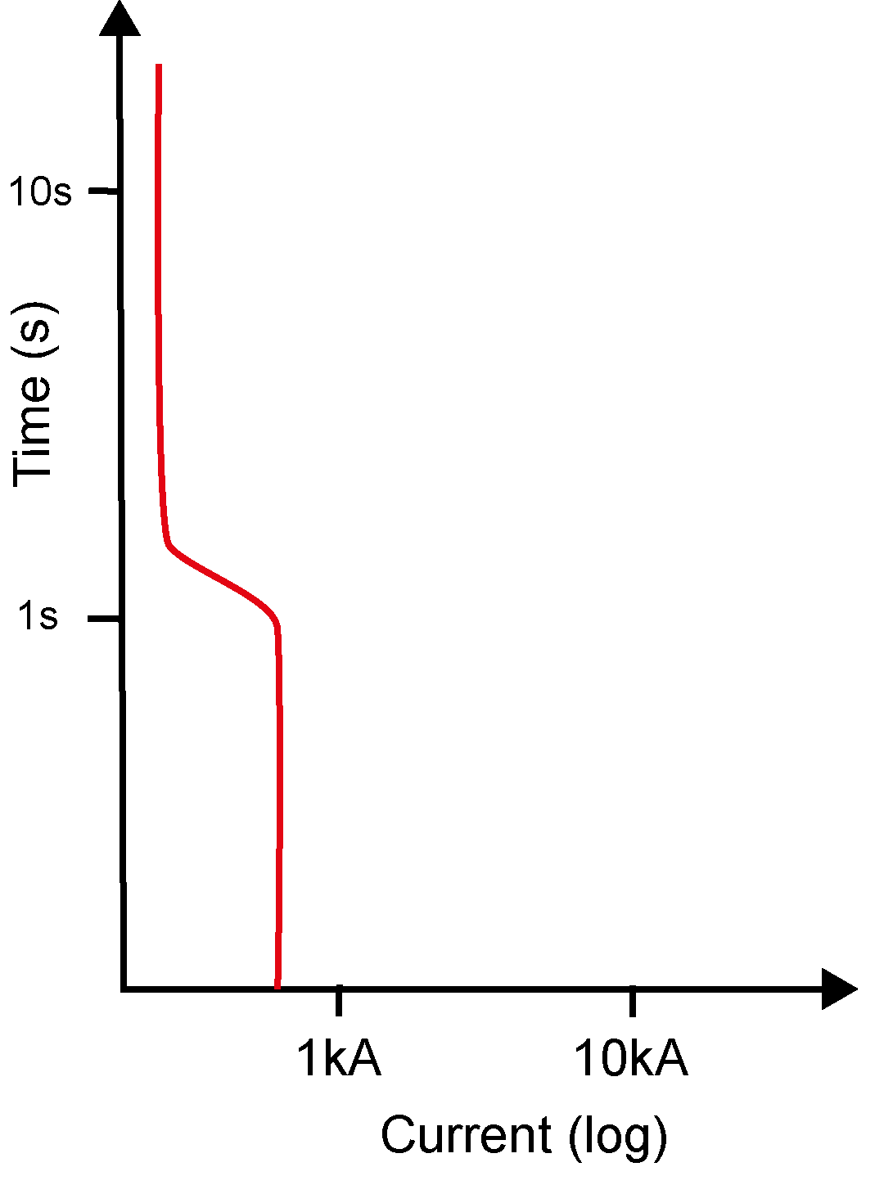



DISCONNECTION AND PROTECTIONS
Motor current direct on line start ~ 0.2kA - 0.6kA
Contactor breaking capacity ~ 2kA
Thermal relay protection ~ 0.2kA – 1.5kA
Fuse/Circuit breaker trip curve ~ 10kA – 40kA
Contactor withstand ~ 10kA - 40kA
Transformer/ Cable withstand ~ 0.2kA - 0.6kA
MV Switchgears shall be able to provide:
Switching of load current
Short circuit protection
Means of isolation
Means of earthing

Slide 24
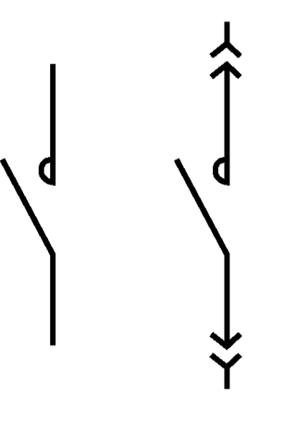
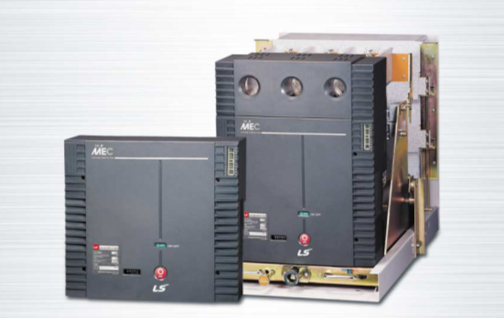
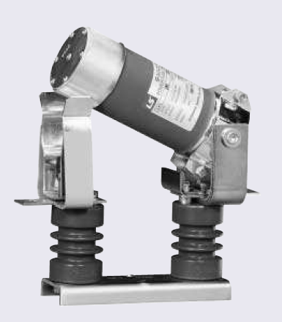
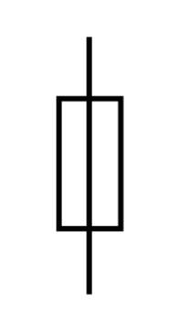
DISCONNECTION AND PROTECTIONS
Vacuum Contactors
Load breaker suitable for high frequency switching (>10,000 operations), with continuous AC3 currents (motor).
Fuse protection and earthing switch (interlocked) shall be used.
Fixed and withdrawable options are available.
Rated current: up to 400A *
Rated voltage: up to 7,2kV*
Rated breaking current : 4kA*
Rated short-time peak current : 60kAp
VS65 ordering info:
    CL: Fixed line contactor/ Fixed bypass contactor
    CX: Withdrawable line contactor/ Fixed bypass contactor
    XX: Withdrawable line contactor/ Withdrawable bypass contactor
Fuses
Motor short circuit protection.
Rated current: 20A to 400A
Rated voltage: up to 7,2kV
Rated interrupted current : 40kA
*: Other characteristics under request

Slide 25
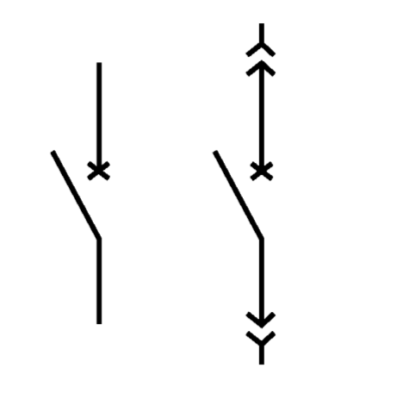
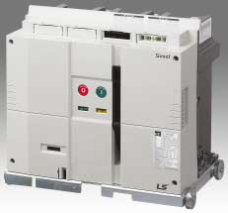
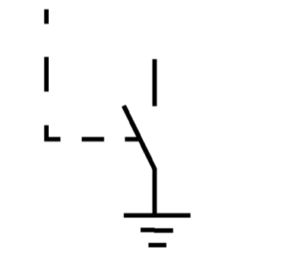

DISCONNECTION AND PROTECTIONS
Vacuum Circuit Breaker
Fast acting load breaker device capable of switching high fault current levels.
Earthing switch with electrical or mechanical interlock shall be used
Rated current: up to 3150A *
Rated voltage: up to 11kV*
Rated breaking current : 40kA
Rated short-time peak current :104kAp
Earthing Switch
Manual switch that short circuits the 3 poles to earth prior to disconnection. Mandatory to carry out internal maintenance or supervision task.
Rated for withstand short-time fault current
No load switching capability
Requires mechanical or electrical interlock with contactors, circuit breakers or switches.
*: Other characteristics under request

Slide 26
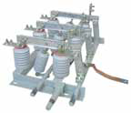
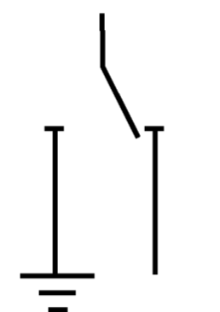
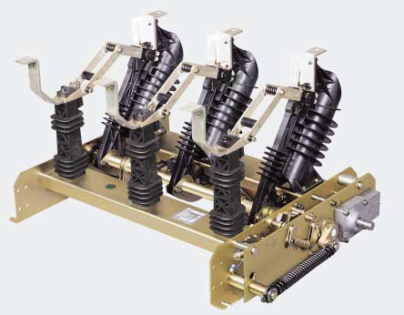
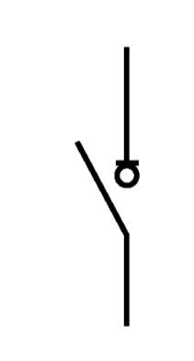
DISCONNECTION AND PROTECTIONS
Switching, isolation and earthing
Manual switching, isolation and earthing after disconnection.
No load switching capability
Rated for withstand short-time fault current
Do NOT requires mechanical or electrical interlock with contactors or circuit breakers, it isolates the circuit from the mains. Nevertheless access to live parts must be forbidden by a mechanical interlock with an upstream disconnector.
On-load disconnector
Manual or motorized load breaker that switches and isolates from the mains.
Rated for withstand short-time fault current
Fuse protection and earthing switch (interlocked) shall be used.

Slide 27
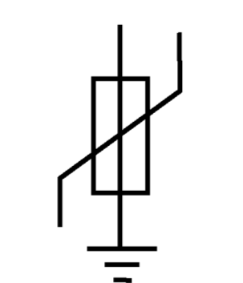
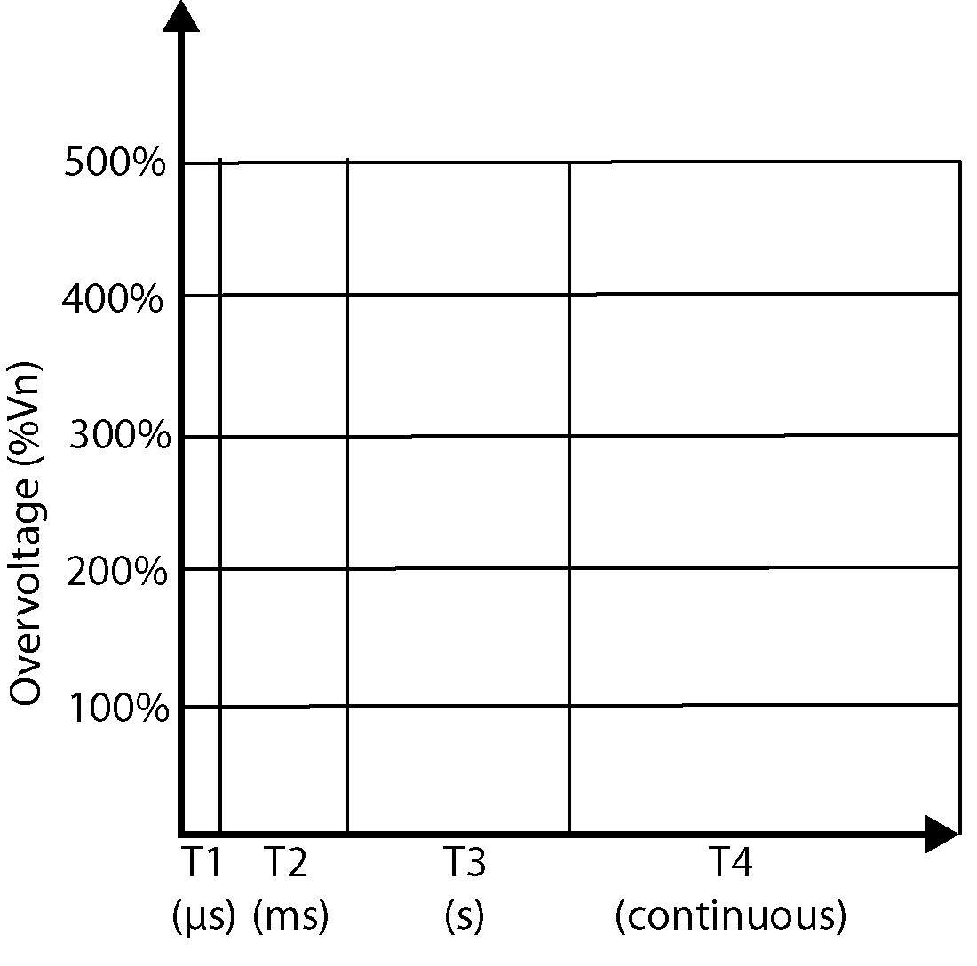
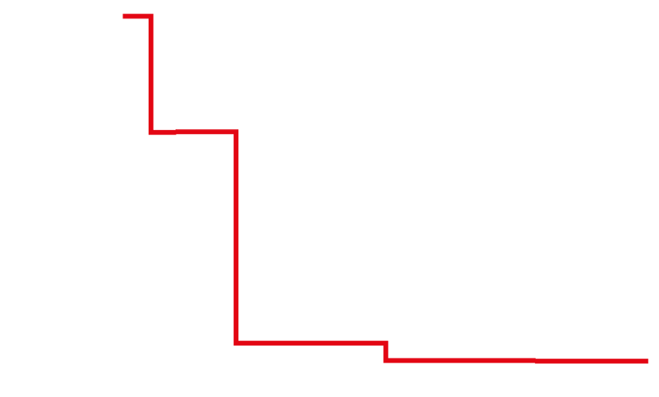



DISCONNECTION AND PROTECTIONS
Surge Arresters
Overvoltage protection devices are used to protect electrical machinery, cables, lines, motors, etc. against damage from overvoltage transients.
Overvoltage transients are caused by two main issues:
A lightning strike causes a high energy voltage transient. This can produce a 8/20 μs current transient in the order of 1.5 to 20 kA, depending on the installation.
Load breakers causes a medium level voltage transient. This can produce a 30/60 μs current transient in the order of 125 to 1000 A, depending on the installation.
Withstand voltage of equipment
Possible voltage without protection
Voltage limited by the arrestors
Voltage limited by the voltage protections

Slide 28
DISCONNECTION AND PROTECTIONS
Continuous Operating Voltage
This is based on the maximum-peak operating voltage likely to occur in the system when a single phase-to-earth fault occurs.
MCOV_{TT,TN}: Maximum continuous operating voltage in TT and TN distribution systems
MCOV_{TT,TN}: Maximum continuous operating voltage in IT distribution systems
U_{L}: system phase-to-phase line voltage (kV)
U_{R}: Rated voltage of the MO arrester
Residual Protection Voltage
This is the voltage which appears across the MO arrester when it is shunting the maximum nominal discharge current to ground.
U_{res}: Residual protection voltage
BIL: Basic Impulse Level that electrical equipment withstands

Slide 29
DISCONNECTION AND PROTECTIONS | ANSI PROTECTIONS
ANSI | RELAY’S FUNCTION | DESCRIPTION
14 | Tochometer relay | Activates if the speed falls or exceeds the presets values.
19 | Apparatus Device | Enables to set a reduced voltage soft start
27 | Undervoltage relay | Activates if the voltage falls below a preset level.
37 | Undercurrent/ power relay | Activates if the current or power falls below a preset level.
38 | Bearing protective Device | Activates when the upper temperature limit of a machine bearing is exceeded or abnormal bearing wear is detected.
46 | Phase reversal or current imbalance relay | Monitors line currents and activates when phase reversal is detected or when line current imbalance of negative phase sequence currents fall outside a preset range.
47 | Phase sequence voltage relay | Monitors line voltages and activates when phase reversal is detected.
48 | Rotor Locked/Incomplete sequence relay | Trips or turns off a device if a particular sequence has not been completed within a preset time period. It appears when the motor’s shaft is locked due to mechanical issues.
49 (P,R) | Machine or transformer thermal relay i²t | Activates if the monitored machine or transformer part exceeds a preset temperature. (P = PTC, R = RTD)
50(N,G) | AC instantaneous or di/dt relay | Activates if the current or di/dt values exceed a preset level. Normally indicates a medium to high level fault condition. (N = neutral, G = ground)
51 (N,G) | AC time-overcurrent relay | Activates when the current exceeds a preset level based on a thermal overload trip curve. (N = neutral, G = ground)
55 | Power factor relay | Activates if the power factor falls below a preset value
59 | Overvoltage relay | Activates if the voltage exceeds a preset level.
64 | Ground (earth) detector relay | Activates when earth current flow is detected from the frame, chassis, case or structure of a device, indicating a breakdown of insulation in an electrical machine or transformer.
81 | Frequency relay | Activates if the frequency falls outside a preset range.
86 | Locking-out relay | Shuts down or holds equipment out of service under abnormal conditions. May be manually or electrically operated.

Slide 30
DISCONNECTION AND PROTECTIONS | VS65 PROTECTIONS
Motor start delay
Door open sensor
Accelerating and decelerating control
Starting to running transition
SCRs over temperature
Low input voltage
Under-load protection
Local and remote control selector
Current imbalance
Phase rotation
Locked rotor / incomplete sequence
i²t Electronic motor over load
Instantaneous electronic over current trip/ Shearpin current
Motor overcurrent
Over voltage protection
Input phase loss
Controlled stopping ramp
Starts per hour -Notching and jogging
Communication loss
Local Emergency Stop
Line contactor
Remote Emergency Stop
Excessive start time (max. 120s)
Optional
Automatic circuit breaker /fuses.
On-load disconnector or contactor
Grounding switch
Instantaneous ground fault detection
Stator and bearing RTD protection
Power factor protection
Automatic circuit breaker, fuses and contactor status indicator
Over and under frequency protection

Slide 31

RELIABILITY
Electronics conformally coated with military and aerospace technology (IEC61086-1:2004, -3-1) and totally sealed, allow to be installed in harsh environments.
IP42 and optional IP54 degree of protection. No dust filters that is suitable for humid and polluted environments.
EMC cabinet design to offer maximum immunity and minimum emissions.
Line and bypass vacuum contactors isolate the power stage in running mode against electric anomalies.
Copper or Aluminum busbars that can withstand from 40kA to 80kA short circuit current.

Slide 32
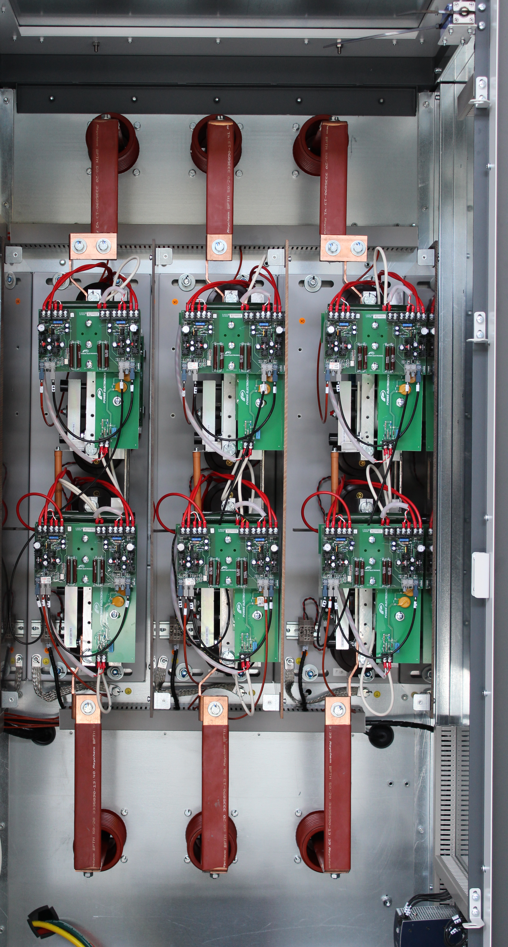
RELIABILITY | SCRs
Heavy duty SCR design:
  Continuous overload 125% (60s) every 10min @ 50ºC
  Instantaneous overload 500% (5s) every 10 min @ 50ºC
  High inverse peak voltage without reactors (chokes).
  Snubber circuits provide SCR control stability and a level of overvoltage protection.
Rated voltage SCRs | SCR pairs in series | SCRs Inverse Peak Voltage (V)
2.3kV | 1 | 6.500V
3kV/3.3kV/4.16kV | 2 | 13.000V
5kV/5.5kV/6kV/6.6kV | 3 | 18.000V
10kV | 4 | 26.000V
11kV | 5 | 32.500V

Slide 33

USER FRIENDLY INTERFACE
Backlit alphanumeric Display 2x16 with membrane keypad
Indicators LEDS: ON, RUN, FAULT
Intuitive Key PAD
CUSTOMIZED SOLUTIONS AVAILABLE
Run
Stop
Warning
System reset
Emergency stop pushbutton
Local start
Local Stop
Fault
Control mode selector (local, remote, stop)
Notes:
33

Slide 34


CUSTOMIZED SOLUTION
INPUT PROTECTION MODULE
Automatic Circuit Breaker
Medium voltage fuses
Withdrawable vacuum contactors
Earthing switch
Input and Output MV cabin with commutation vacuum contactors and fuses
Input MV cabin to connect different fixed power factor correction solutions.
Surge arresters
CABINET FEATURES
Degree of protection IP54, stainless steel enclosure, special RAL, special labeling and warning.
Incoming MV cable or busbar connection from top, right or backside.
Lined up soft starters with common main input busbar and protection “Run busbar”.
CONTROL AND PUSHBUTTONS
Selectors and Pushbuttons
Digital and analogue I/O preconfiguration
Customized user terminal strip
PTC and PT100 relays
Instantaneous ground fault protection relay
Specific external power suppy
Optional protocols (Profibus-DP, DeviceNet, …)
Soft starter’s and motors’s heating resistor control
Notes:
34

Slide 35

RECOMMENDED CONFIGURATIONS
Notes:
35

Slide 36
RECOMMENDED CONFIGURATIONS
Notes:
36

