Slide 1
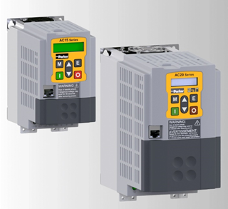
AC15 AC20 Hardware Tutorial

Slide 2
Content
Product Overview
Product Codes
Technical Specifications
Wiring and Terminal Identification
User Display Keypads
SD Card
Option Modules (AC20 only)
Communication Interface Option Cards
(AC20 only)

Slide 3
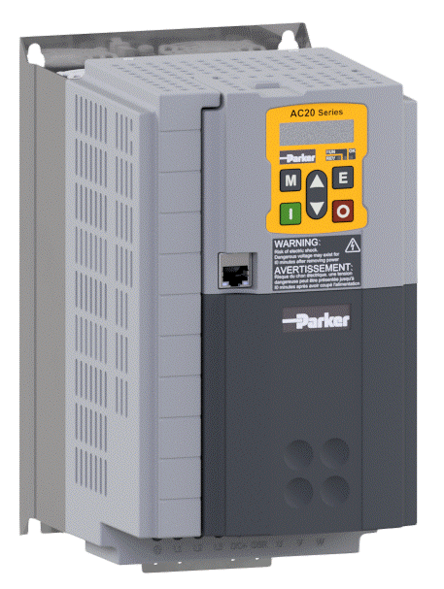
Product Overview
AC15
  Lower cost
  0.37 to 30kW in 5 Frames
  Open loop Induction & PMAC
  Ethernet TCP/IP & STO
AC20
  Open and Closed loop
  1.5 to 180kW in 9 Frames
  Expandable IO, STO, Ethernet IP and ProfiNet
  ‘Anybus’ fieldbus expansion modules

Slide 4
Product Overview
AC15
General Overview:
Power Range: | 0.37 – 30kW
Frame Sizes: | 5 (Sizes 1 – 5)
Power Supply: | 1ø 220 – 240Vac ±10%, (Frames 1 – 2: 0.37 – 2.2kW) 3ø 220 – 240Vac ±10%, (Frames 1 – 5: 0.37 – 11kW) 3ø 380 – 480Vac ±10%, (Frames 1 – 5: 0.37 – 30kW)
Input Frequency: | 50/60Hz ±5%
Output Frequency: | 0.5 – 590Hz (Output frequency is limited to a maximum frequency of 590Hz due to export rules)
Safe Torque Off (STO): | SIL2, PLd
Environment: | Temperature: 0 - 45°C (derate possible up to 50°C) Altitude: 0 – 1000m (derate possible up to 2000m)

Slide 5
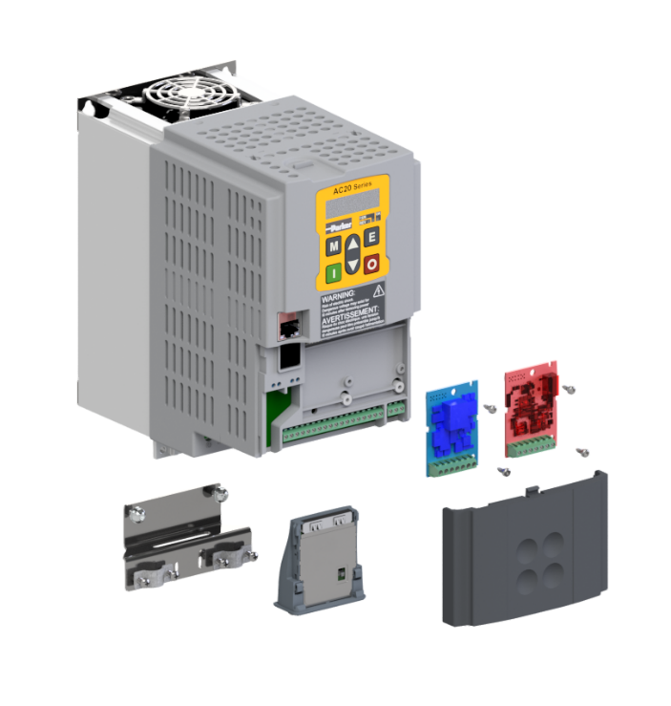
Product Overview
AC20
EMC bracket is supplied with the drive
General Overview:
Power Range: | 1.5 – 180kW
Frame Sizes: | 9 (Sizes 2 – 10)
Power Supply: | 1ø 220 – 240Vac ±10%, (Frame 2: 1.5 – 2.2kW) 3ø 220 – 240Vac ±10%, (Frames 2 – 5: 1.5 – 11kW) 3ø 380 – 480Vac ±10%, (Frames 2 – 10: 1.5 – 180kW)
Input Frequency: | 50/60Hz ±5%
Output Frequency: | 0.5 – 590Hz (Output frequency is limited to a maximum frequency of 590Hz due to export rules)
Safe Torque Off (STO): | SIL2, PLd
Environment: | Temperature: 0 - 45°C (derate possible up to 50°C) Altitude: 0 – 1000m (derate possible up to 2000m)

Slide 6
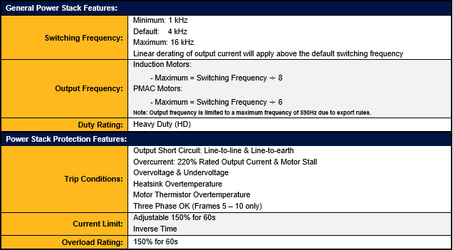
Product Overview
AC15 AC20 Power Stack Features

Slide 7
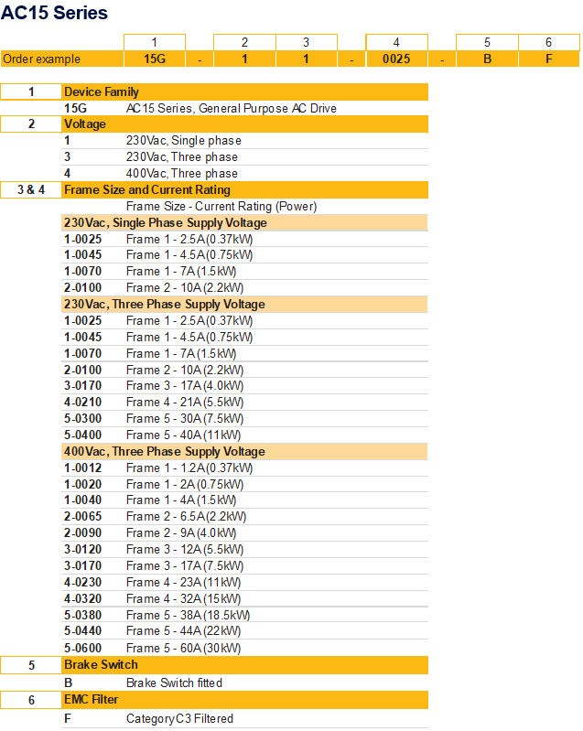
Product Codes
AC15

Slide 8
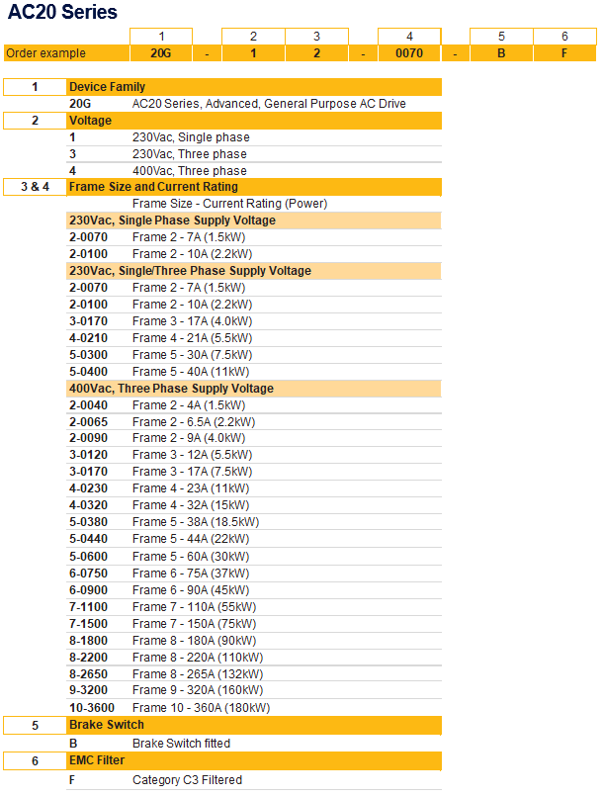
Product Codes
AC20

Slide 9
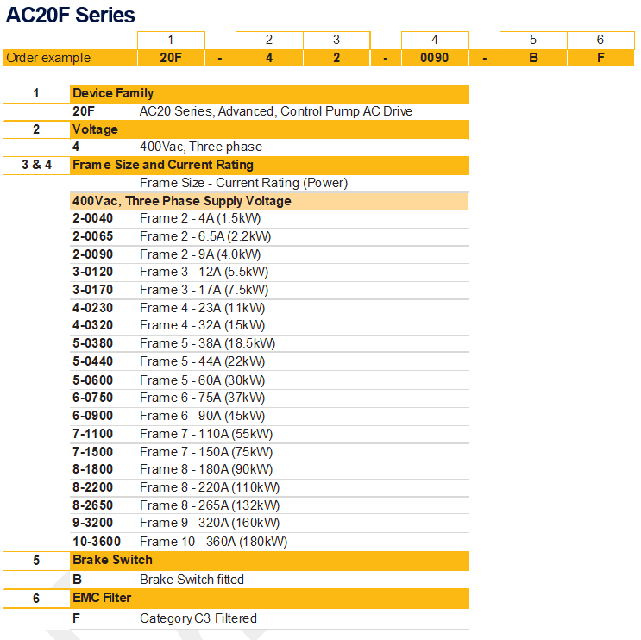
Product Codes
AC20F

Slide 10
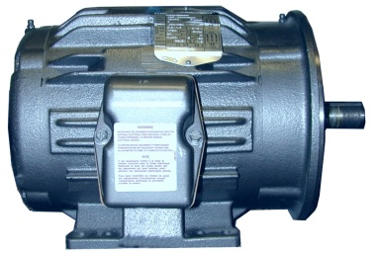
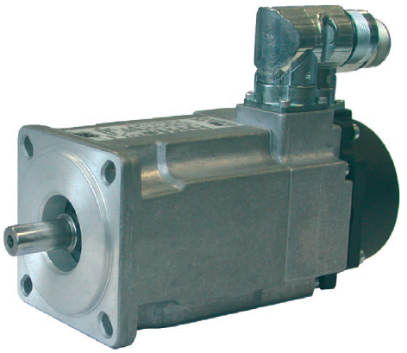
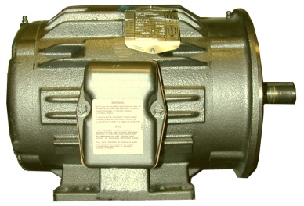
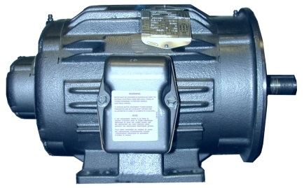
Control for all AC Motor Types
Induction motors
Servo motors
Velocity and Torque Control
Basic Motion Control
Brushless AC
V/Hz
Open Loop
Induction motor
PM synchronous
Open Loop
Closed Loop
Sensorless
Vector
Open Loop
Induction motor
Flux Vector
Closed Loop
Induction motor
CONSTANT TORQUE RATED
150% OL 60 sec.

Slide 11
4 Types of Regulation Mode
V/hz Mode
Low Dynamic Performance
Accuracy of speed 1%
Low Torque below 10Hz
Sensorless Vector
Need a Autotune
Accuracy of speed 0.1%
Torque from 1Hz
Open Loop Servo Mode
Database Motor in the DSE Lite
Accuracy of speed 0.1%
Torque at Stop
Closed Loop Vector
High Dynamic performance
Accuracy of speed 0.01%
Torque at stop
V/Hz
Sensorless Vector
Open
Loop
Servo
Closed
Loop
Vector

Slide 12
Technical Specifications
Supply voltage
  1ø 220 – 240Vac ±10%,
  (Frame 2: 1.5 – 2.2kW)
  3ø 220 – 240Vac ±10%,
  (Frames 2 – 5: 1.5 – 11kW)
  3ø 380 – 480Vac ±10%,
  (Frames 2 – 10: 1.5 – 180kW
  Supply frequency : 50 to 60Hz +/-5%
Output frequency
  0,5 - to 590Hz
Switching frequency
  4 to 16kHz
Control module I/O
  2 Analogue Inputs
  3 Analogue Outputs
  2 Relay Outputs
  8 Digital Inputs (10 frame 6-10)
  3 Digital Outputs
Base communication
  RJ45 Port Ethernet
    Web HTTP Server
    Modbus TCP
    Ethernet/IP
    Profinet/IO
  RJ11 RS232 (6901 Remote MMI)
I/O Options (2 slots)
  Encoder Input
  General purpose I/O GPIO
Ambient temperature (operation)
  0...+50°C, no frost allowed
    45...50°C derating for constant torque
Mounting
  IP20 & Through Panel Mount
Contamination levels (Operation)
  3C3 as standard
  Enhanced coating as option
Safety
  EN13849 PLe STO as standard
SD Card
  Easy cloning
  Program upload/download
  Upgrade Firmware
Integrated Ethernet
  Drive Programming
  Web Server
Communication options (AC20 only)
  CANopen
  EtherCAT
  Ethernet IP
  Profibus DP-V1
  Profinet IO
  RS485 Modbus RTU
12 Bit Resolution
12 Bit Resolution

Slide 13
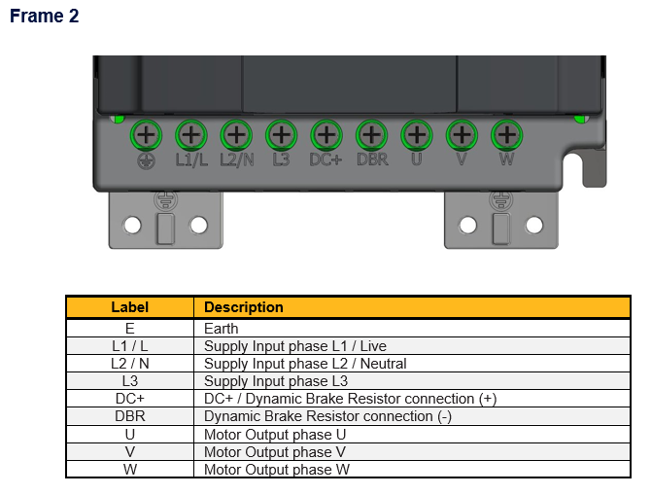
Wiring and Terminal Identification
Potential Earth Connections
AC Line Input Connections
DC Dynamic Brake Connections
AC Motor Ouput Connections

Slide 14
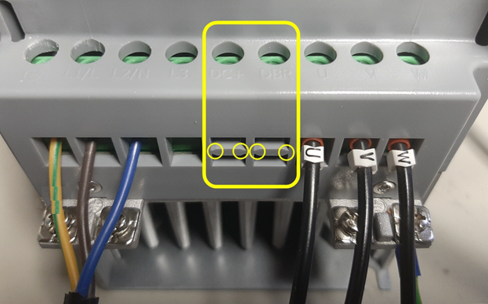
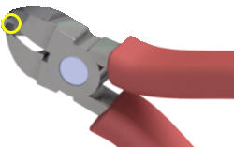
Wiring and Terminal Identification
DC Dynamic Brake Connections
Remove and discard the DBR break-out feature in the housing by cutting the 4x bridges using suitable small side cutters.

Slide 15
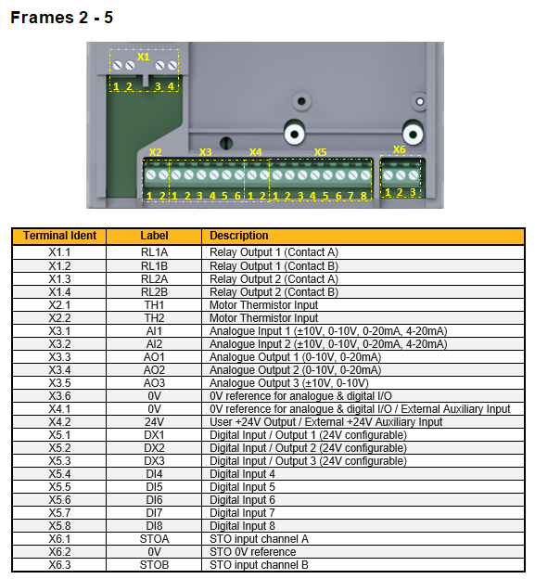
Wiring and Terminal Identification
Control Board
Terminal Connections
X1 – X6
X1 Relais Outputs
X2 Motor Thermistor
X3 Analogue Inputs/Outputs
X4 0V Reference, 24 V Supply
X5 Digital Inputs
X6 STO

Slide 16
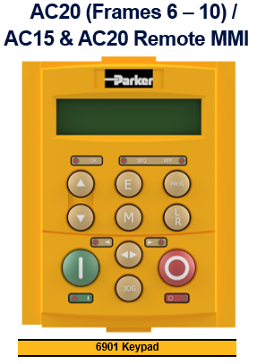
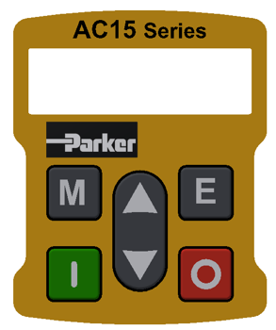
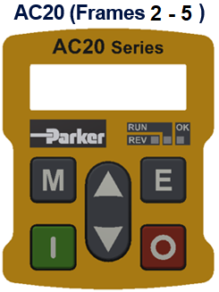
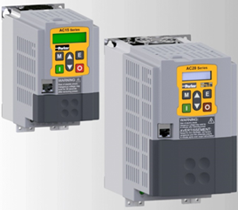
User Display Keypads
Embedded
in the drive
Common Operator Station
with 590, 690 & 890 drives
Connection Cable for Remote mounted Op Station
Part Number: CM057375U300

Slide 17
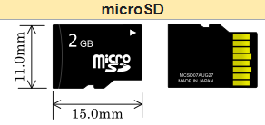
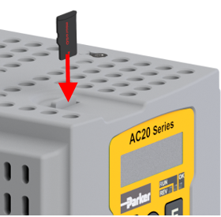
SD Card
µSD Card
  Simple Firmware upgrade
  Cloning application to other drives
  Carte µSD card
  Saving project
NOTE:
  The µSD card must be FAT32 formatted.
  This implies a 32GB limitation of MS Windows OS
  (if a different type of µSD card is used,
  then a partition tool might be required)
  The µSD Memory Card (not supplied)
  is intended to be customer installed!

Slide 18
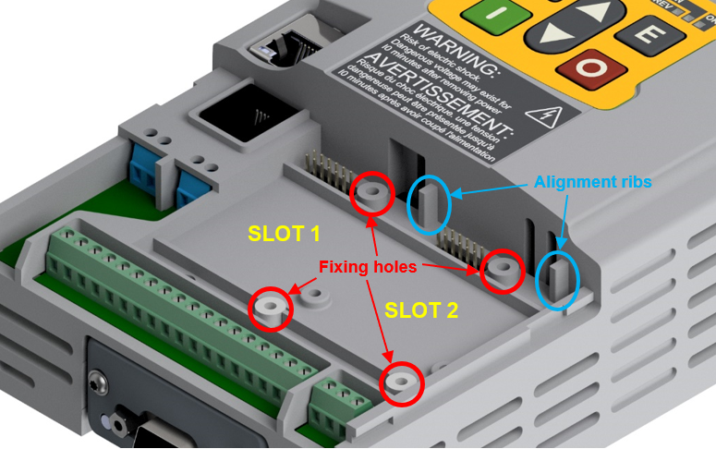
Option Modules (AC20 only)
Encoder Feedback option card
General Purpose Input/Output (GPIO) option card

Slide 19
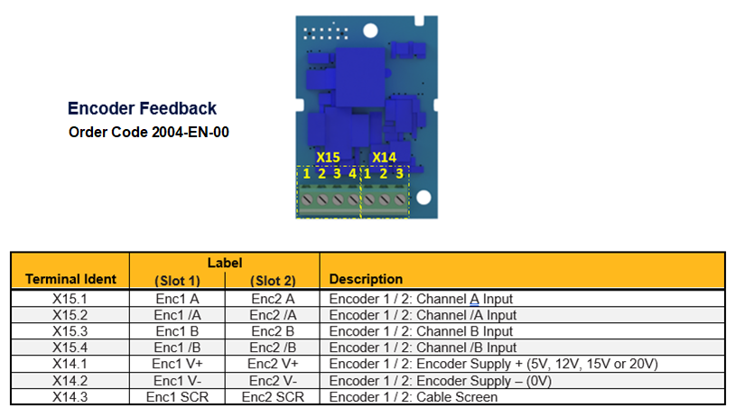
Option Modules (AC20 only)
Encoder Feedback option card

Slide 20
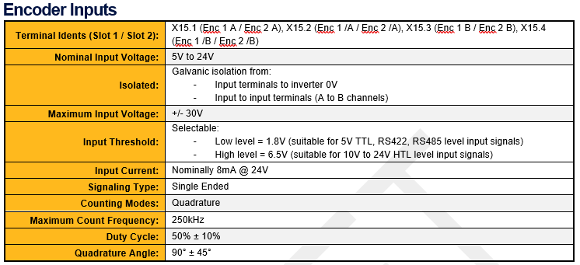
Option Modules (AC20 only)
Encoder Feedback option card ratings

Slide 21
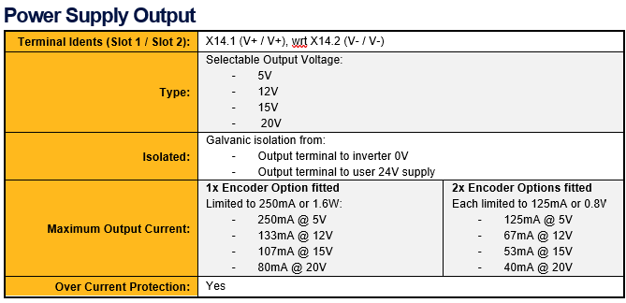
Option Modules (AC20 only)
Encoder Feedback option card ratings

Slide 22
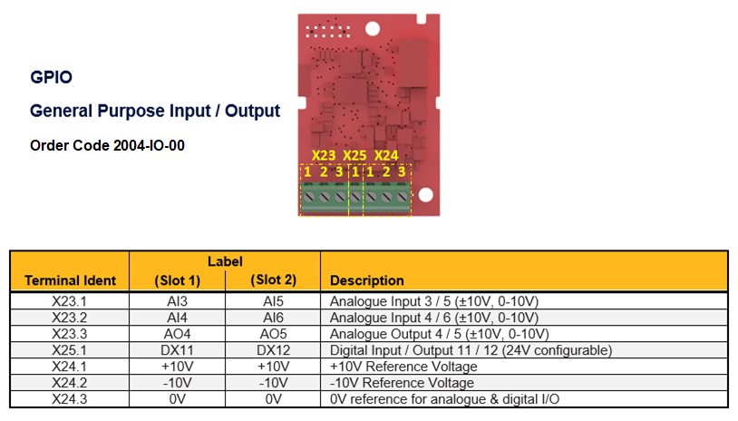
Option Modules (AC20 only)
General Purpose Input/Output (GPIO) option card

Slide 23
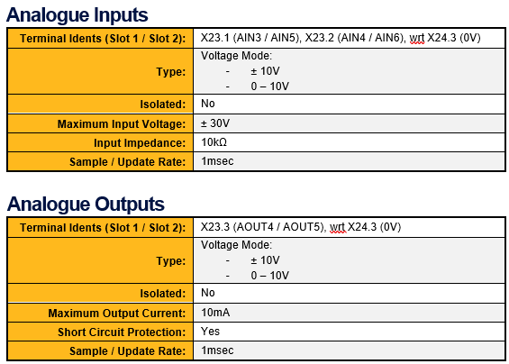
Option Modules (AC20 only)
General Purpose Input/Output (GPIO) option card ratings
12 Bit Resolution
12 Bit Resolution

Slide 24
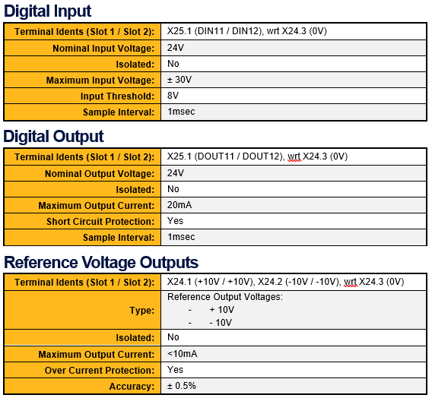
Option Modules (AC20 only)
General Purpose Input/Output (GPIO) option card ratings

Slide 25
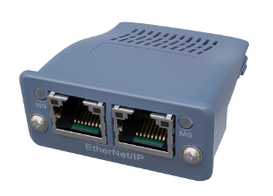
Communication Interface Option Cards
(AC20 only)
Easy setup
Field mountable
Configured by the MMI or Softwares
Easy integration into any AC20 system
Fieldbus options easily expanded
EtherNet/IP
PROFINET IO
PROFIBUS DP-V1
CanOpen
EtherCat
Modbus RTU

Slide 26
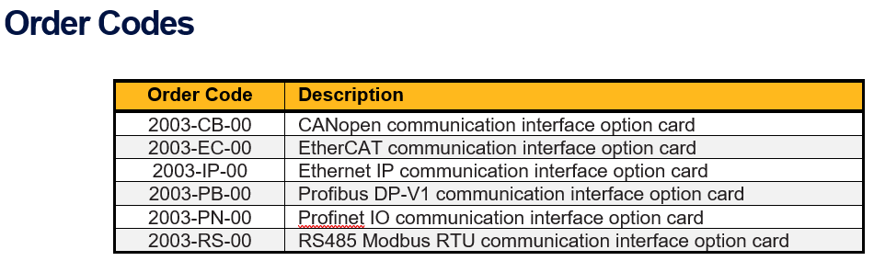
Communication Interface Option Cards
(AC20 only)
Altough EtherNet and PROFINET are available as standard, the Communication Interface Option Cards allows to use the onboard connector for the Web Server or the DSELite configuration tool!

Slide 27
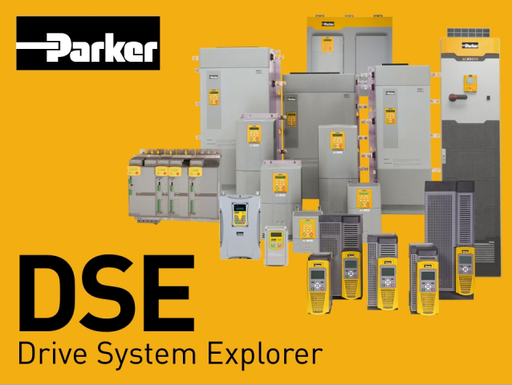
Parker DSElite
Ethernet Connection with the drive
Automatic drive detection
Application Macro (PID, Raise/lower, Preset..)

Slide 28
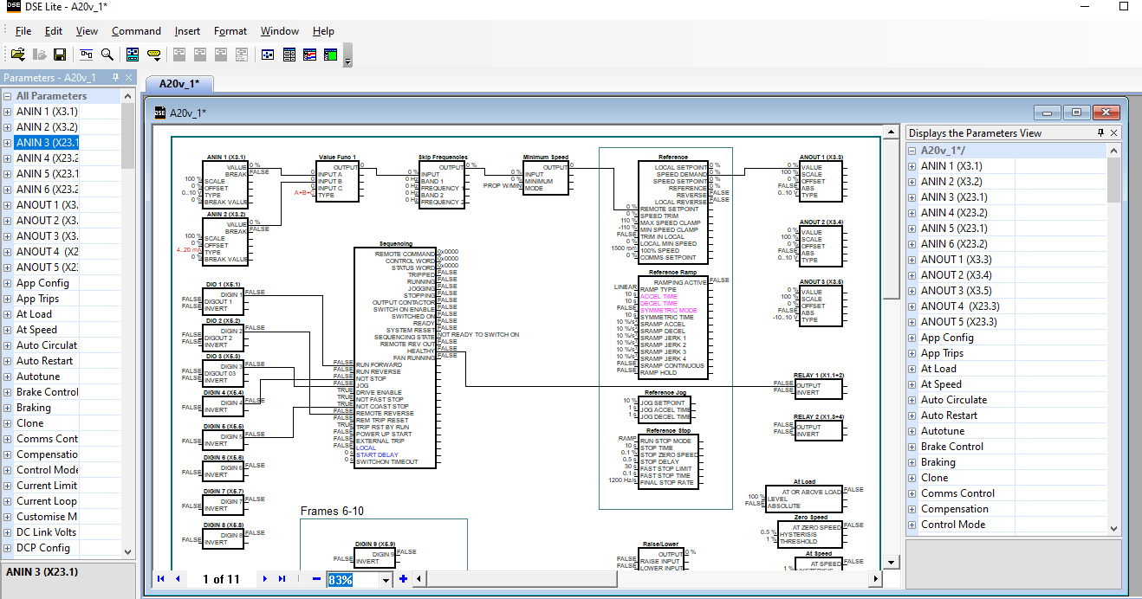
Parker DSElite
Free download
Intuitive
Graphical
Drag & Drop
Self Documenting
Back-up & Restore
Monitoring and diagnostics
Set-Up
Same tool supports all Parker industrial drives
External AC15-AC20 Scope Tool

Slide 29
Questions ?
Thank you

